Slide 1
Financial Affairs
Departmental Climate Action Plan (CAP)
April 2022
Notes:
Good Morning, as most of you know, my name is Rachelle and today we’re going to talk about Sustainability in Financial Affairs. I will be sharing with you a little about what we have done so far, and what we are looking forward to in the coming months and years. I hope that you will join me in driving staff engagement and elevating our Green Department Certification.
Financial Affairs has made many successful strides with our efforts in sustainability over the past 5 years. What started as a departmental holiday gift in 2015, a coffee mug for our staff; resulted in an ambitious plan highlighting numerous initiatives which were aimed at earning a Green Department Certification. Today, those initiatives have evolved into a Departmental Climate Action Plan that changes behavior and moves the needle toward becoming a truly sustainable department.

Slide 2
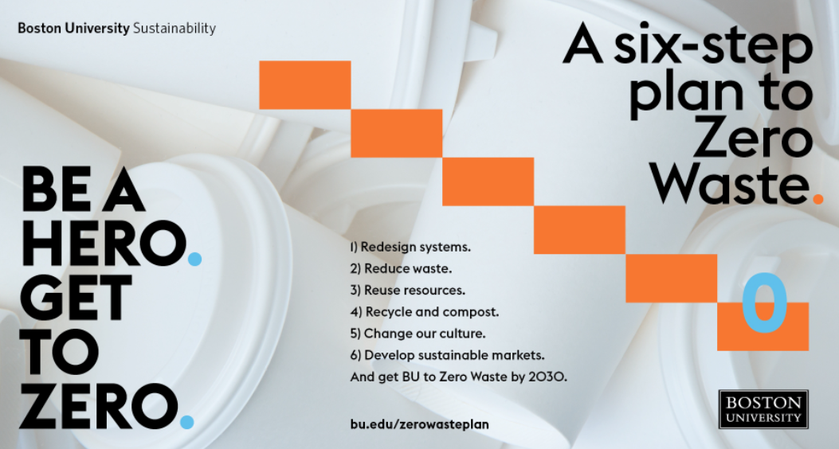
Sustainability in Financial Affairs
Develop a culture of Sustainability
Green Office Certifications
Staff Engagement
Support BU Sustainability’s Zero Waste Campaign
Notes:
The Financial Affairs CAP focuses on developing a culture of Sustainability within the department. We will continue our efforts to certify and bi-annually re-certify every office according to BU’s Sustainability standards.
Engagement across FA is crucial to our success. To facilitate ownership across the department, our plan includes the creation of a Green Team. I’ll go over this more in a future slide, but its purpose is to elevate our current efforts, while creating new initiatives to advance our department’s response to the climate change crisis.
We have been working with Denis Carlberg’s team at the Office of Sustainability, and are aligned in supporting their Zero Waste Plan which involves a significant reduction in our environmental footprint.

Slide 3
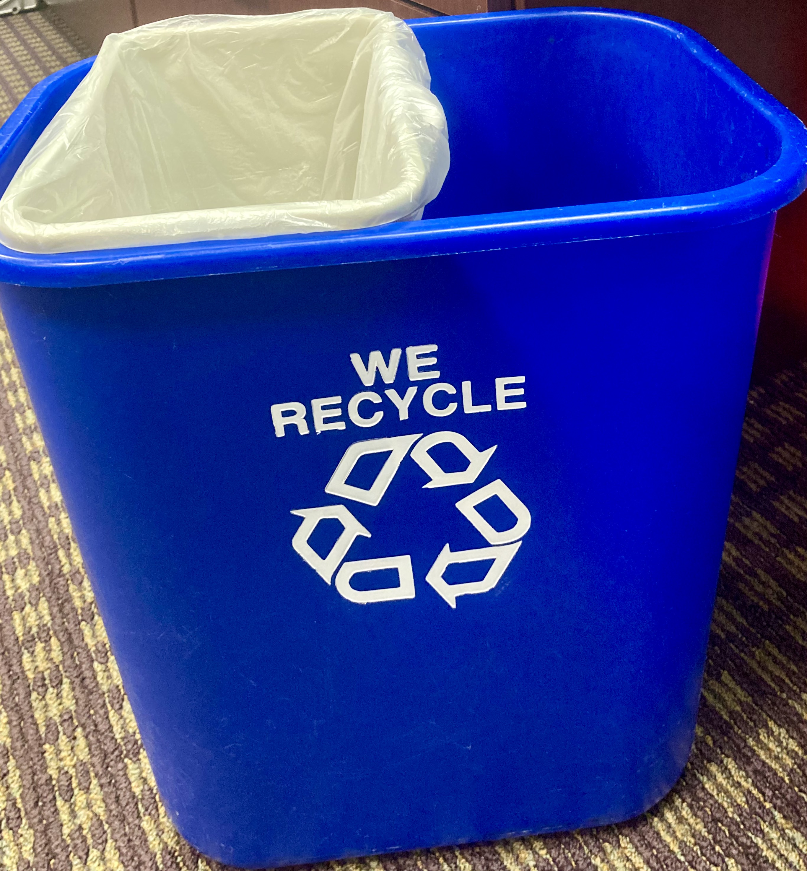
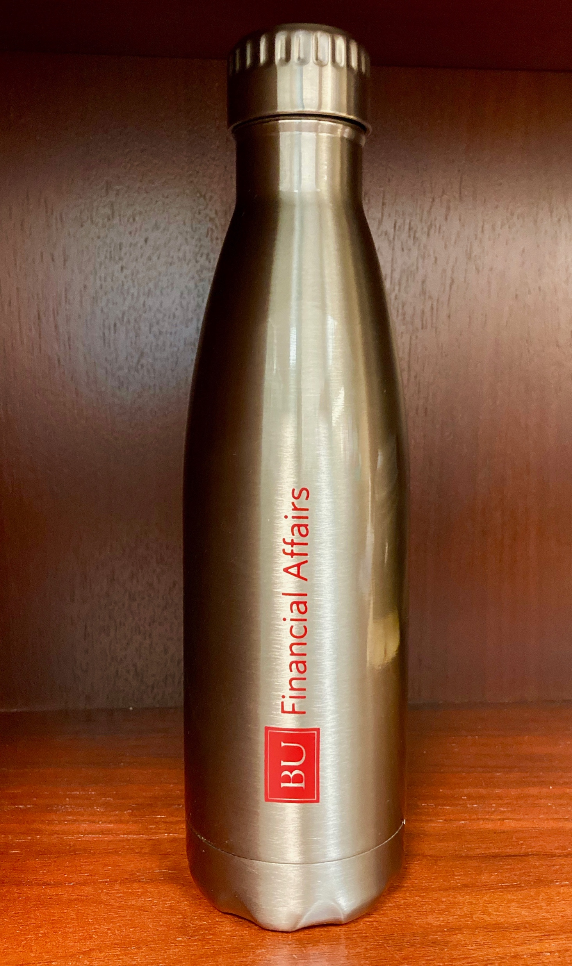
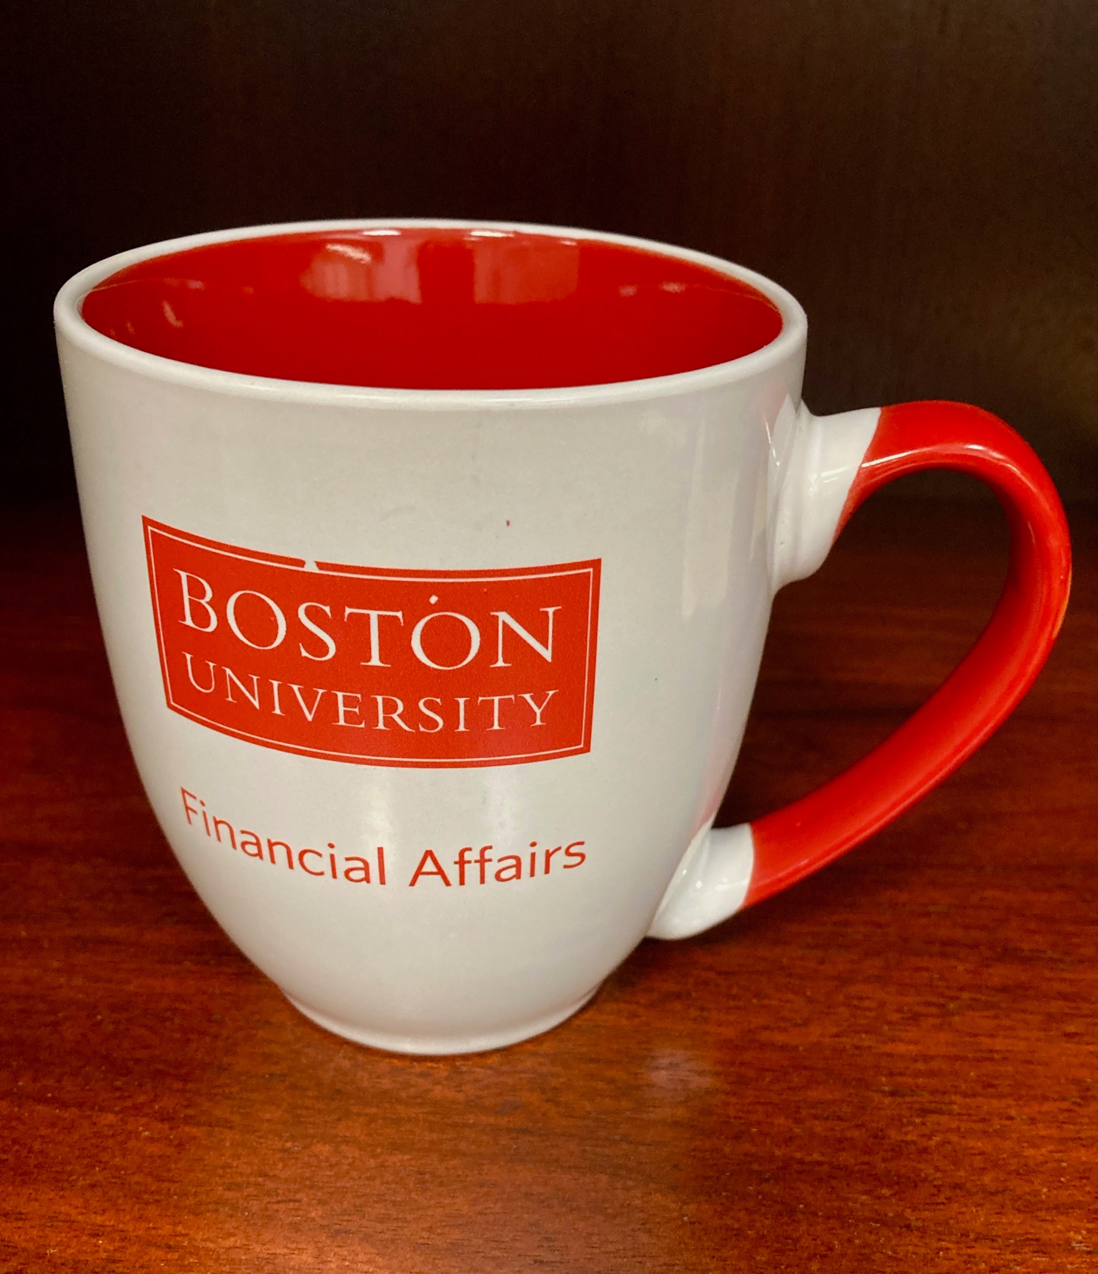
Sustainability in Financial Affairs
Zero Waste - Conserve, Reuse, Recycle
Consumables
Reduction in Single Use Plastics
Recycling Used Toner and K-Cups
Energy
Upgrade Lighting to Motion Sensing
Smart Power Strips
Purchasing
Electronic signature initiative
Purchase 100% Recycled Paper
A culture of Sustainability begins with each of us...
Notes:
Our plan targets measurable actions that conserve, reuse, and recycle in the areas of Consumables, Energy, and Purchasing.
True sustainability however, centers on Zero Waste. Over the past few years, we have partnered with The Office of Sustainability as a leader in pilot programs through W.B. Mason, which include a Reusable Tote Program for deliveries, and Recycling used Toner and K-Cups. In addition, we have reduced the volume of single use cups and utensils in our kitchens by providing coffee mugs, reusable water bottles, and bamboo flatware to our staff.

Slide 4
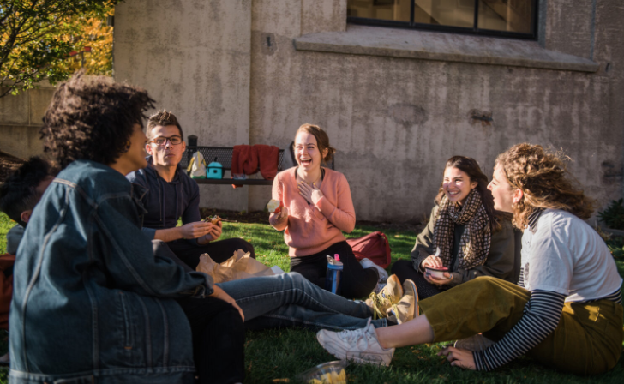
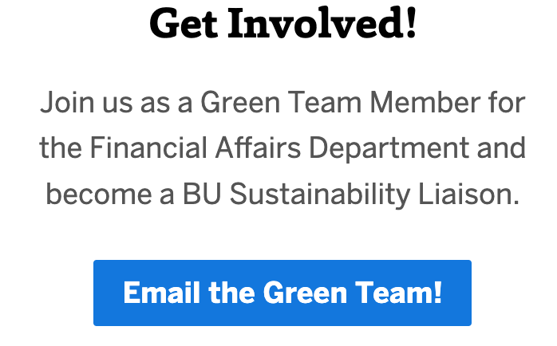
Sustainability in Financial Affairs
Join the Financial Affairs Green Team
Primary Goals
Complete Green Office Certifications
Initiate Sustainability App Challenges
Plan Lunch and Learn Eco-Events
Notes:
As I mentioned earlier, in order to accomplish our ambitious goals, we would like to establish a Green Team. The Green Team will initially be responsible for completing the Green Office Certification and Re-Certification process by the fall 2022, with a long-term goal of identifying and implementing new initiatives to push us toward a Platinum Level Green Department Certification.
The team will be led by the Sustainability Liaison, and we are currently looking for five volunteers who share our passion, to join us. We will hold regular bi-monthly meetings with goals aimed at reducing the department’s environmental footprint. The team will focus on developing a culture of Sustainability, providing a central resource to communicate our initiatives and accomplishments; and to bolster positive, environmentally friendly change through networking, education and training.

Slide 5
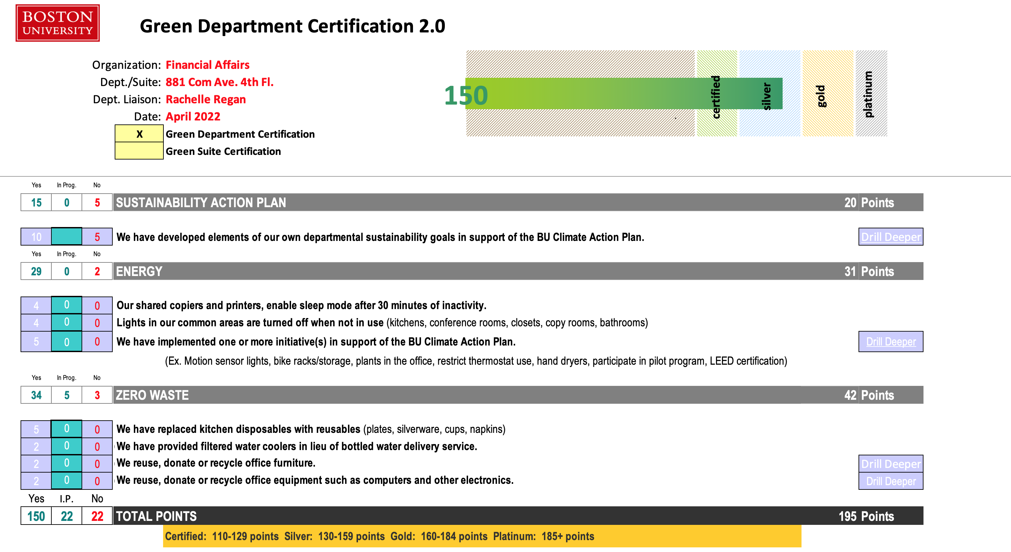
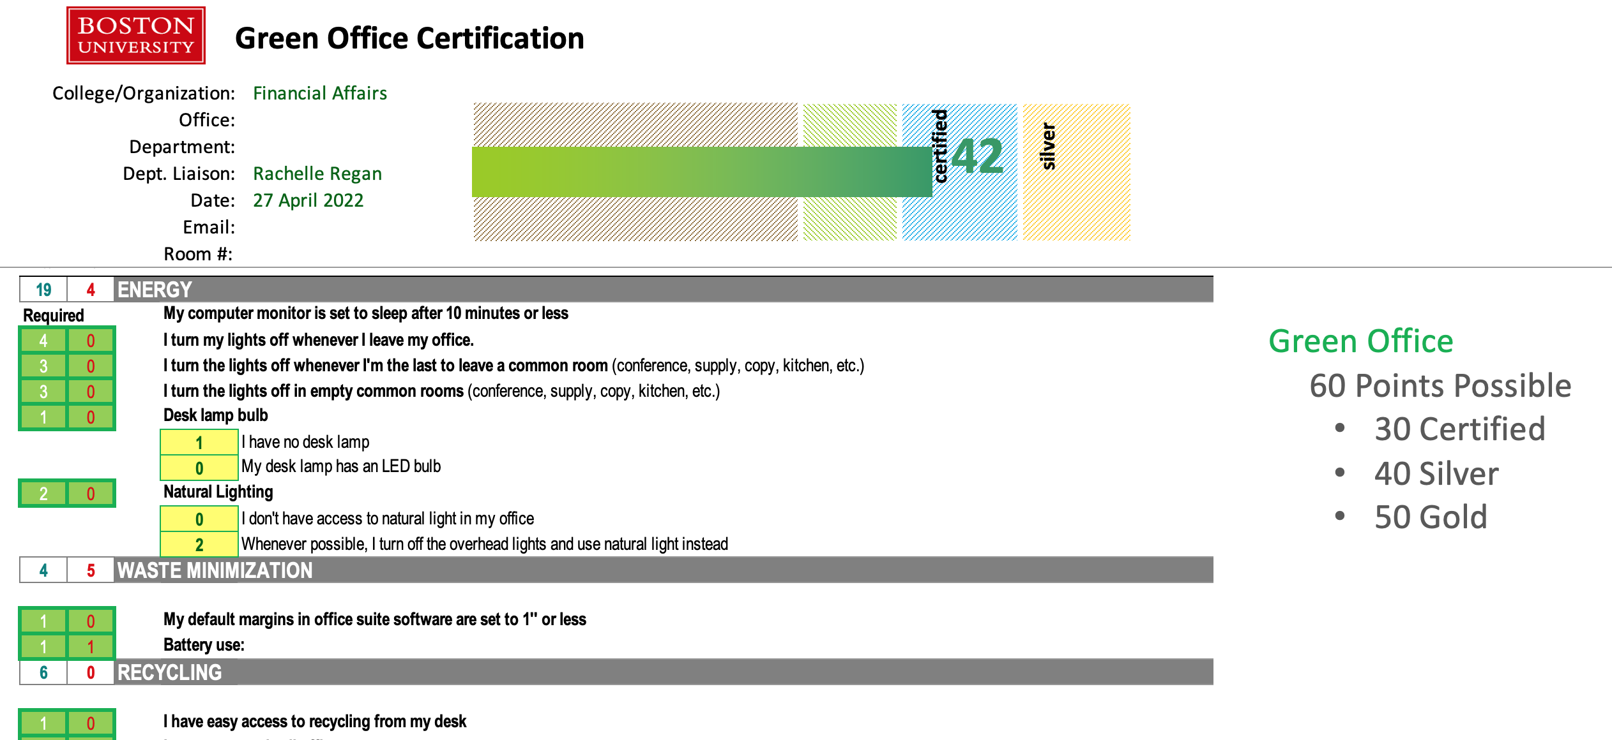
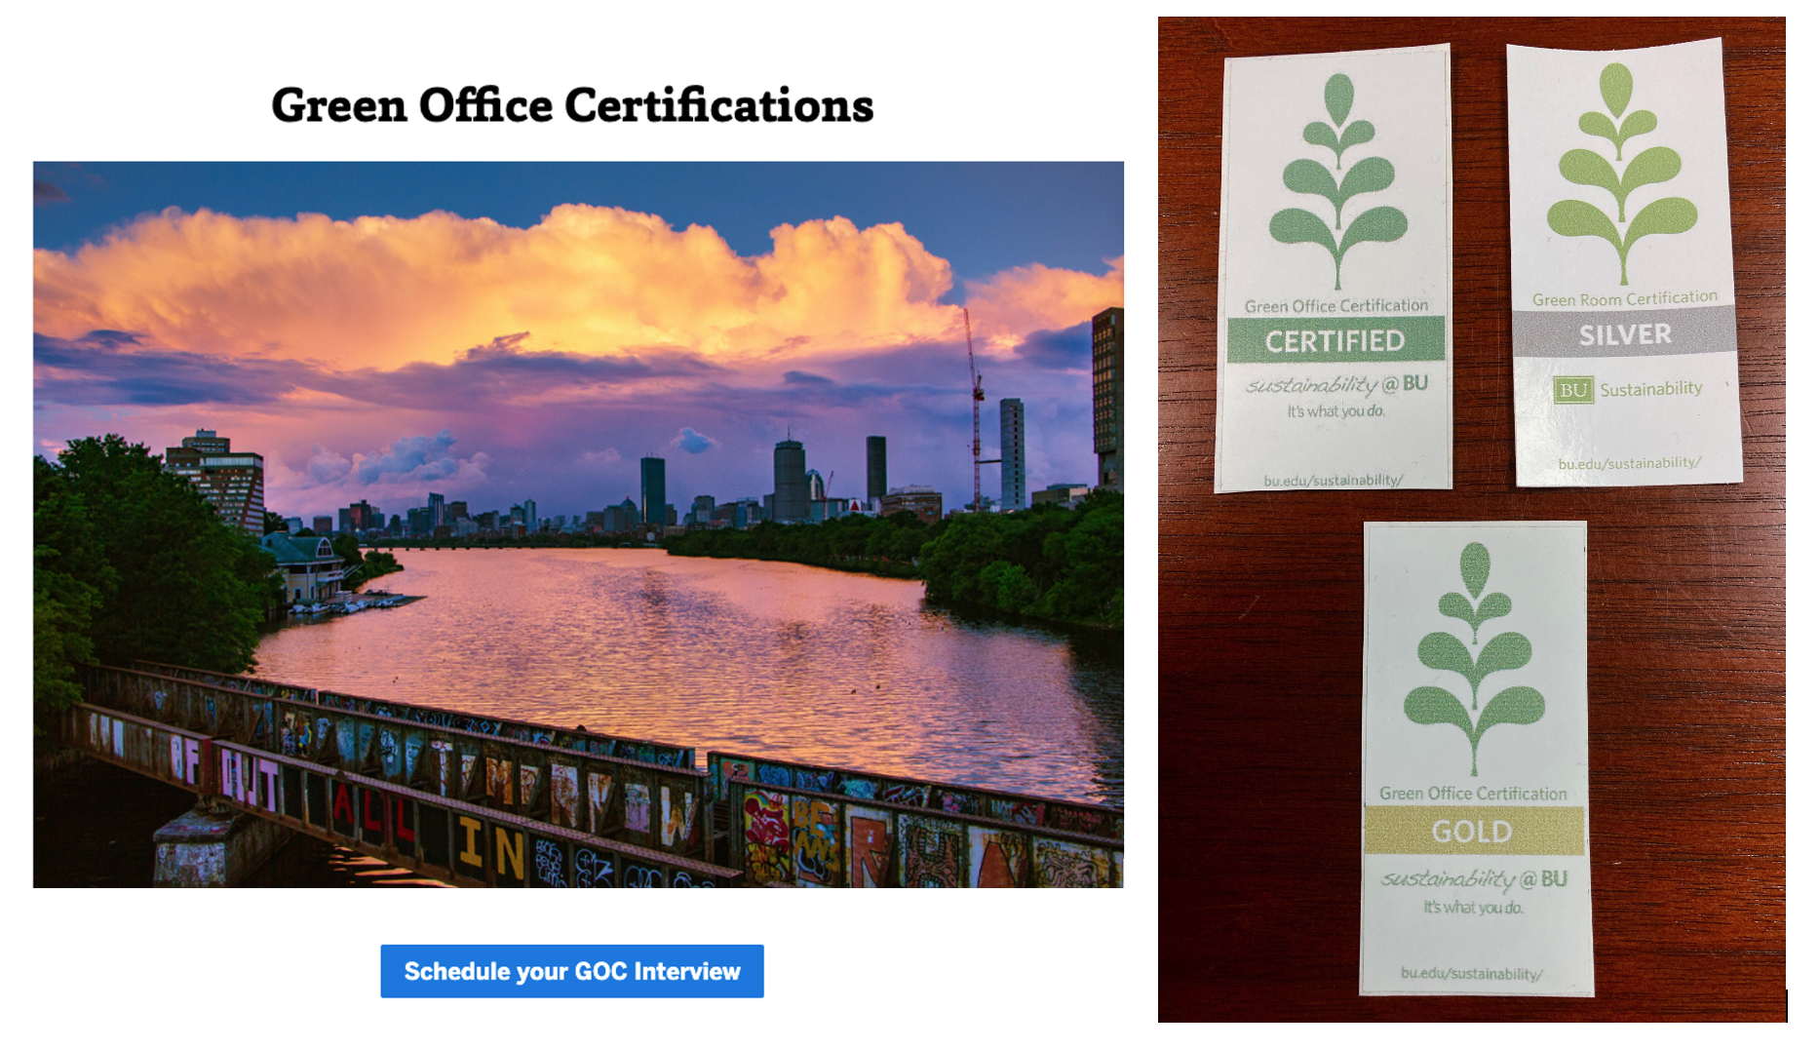
Sustainability in Financial Affairs
Schedule Your Green Office Certification Interview Today
Notes:
Developing a culture of Sustainability starts with the individual. The Office of Sustainability recognizes this, and has created a set of certifications based on LEED standards that educate and re-enforce the importance of the individual’s sustainable actions.
There are two types of certifications awarded by the Office of Sustainability. The first, titled Green Office, are individual certifications for each staff member to display their commitment to sustainability. This certification consists of a 15-minute interview in which points are accumulated for sustainable actions taken.
The second is called Green Department. By working together as a department, we can accomplish larger scope goals, such as reducing our energy use by installing motion sensing overhead lights. As of this month, Financial Affairs has achieved a Silver Certification as a Green Department. Over the next couple slides, we’re going to talk about how you and your team can get involved so that we can reach for a Platinum Level certification.

Slide 6
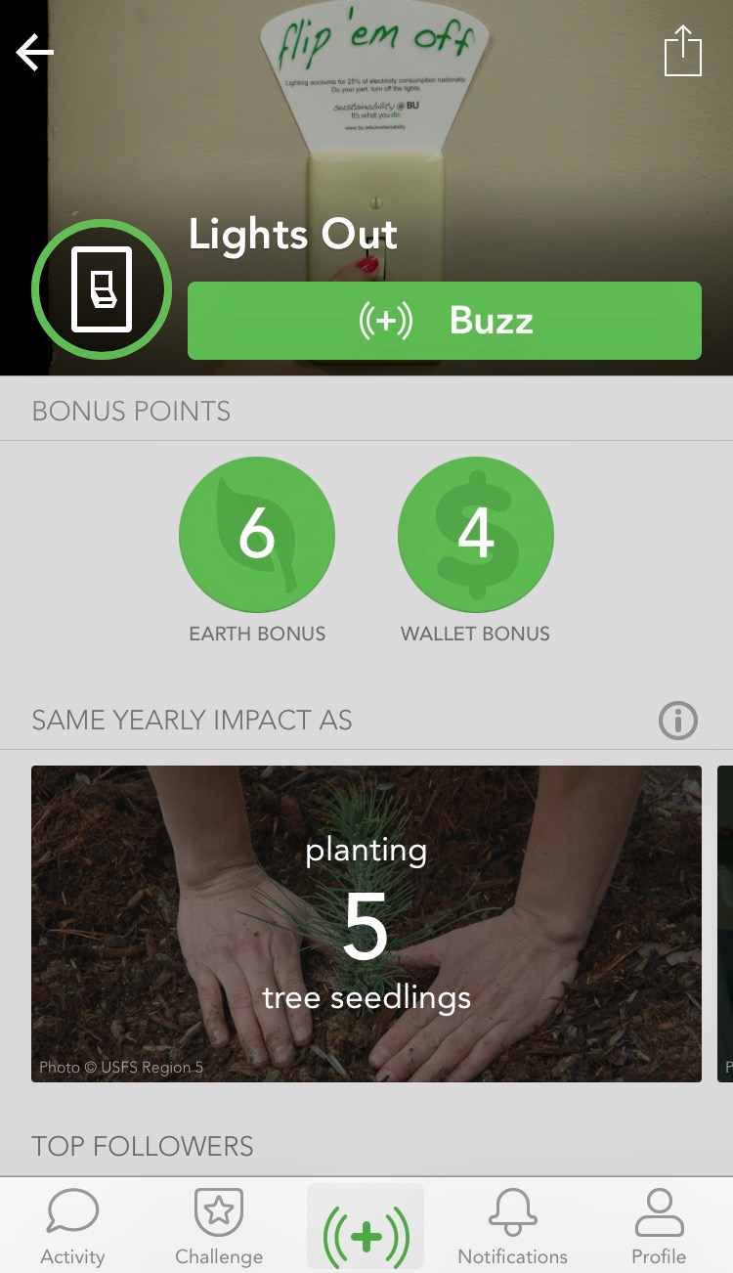
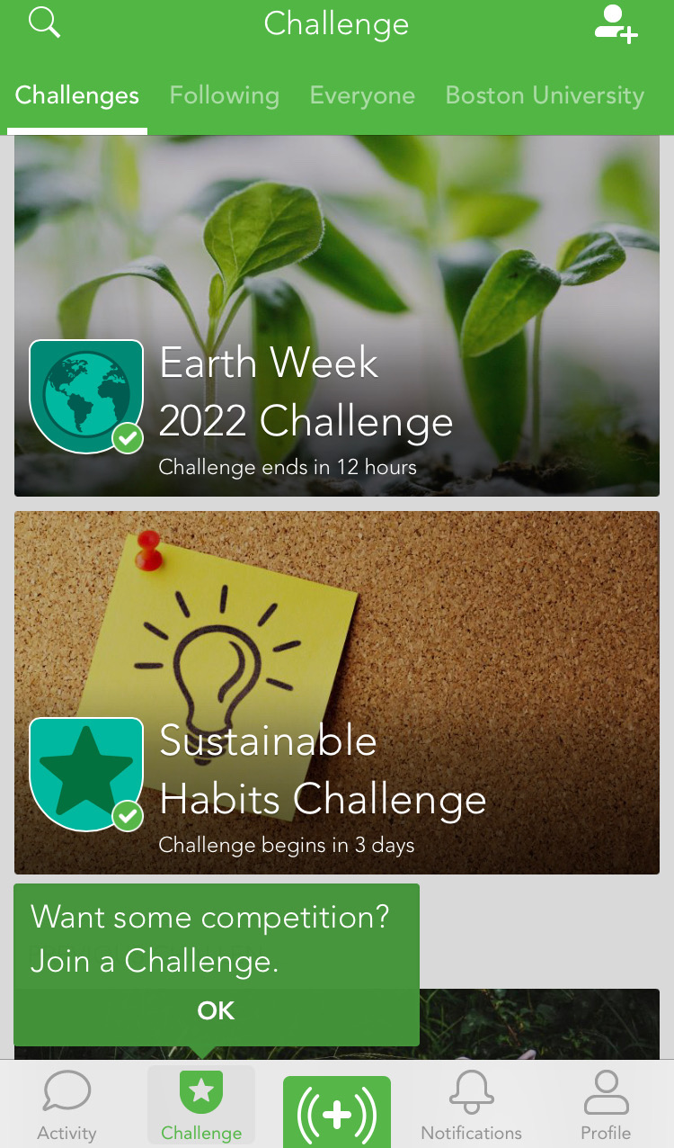
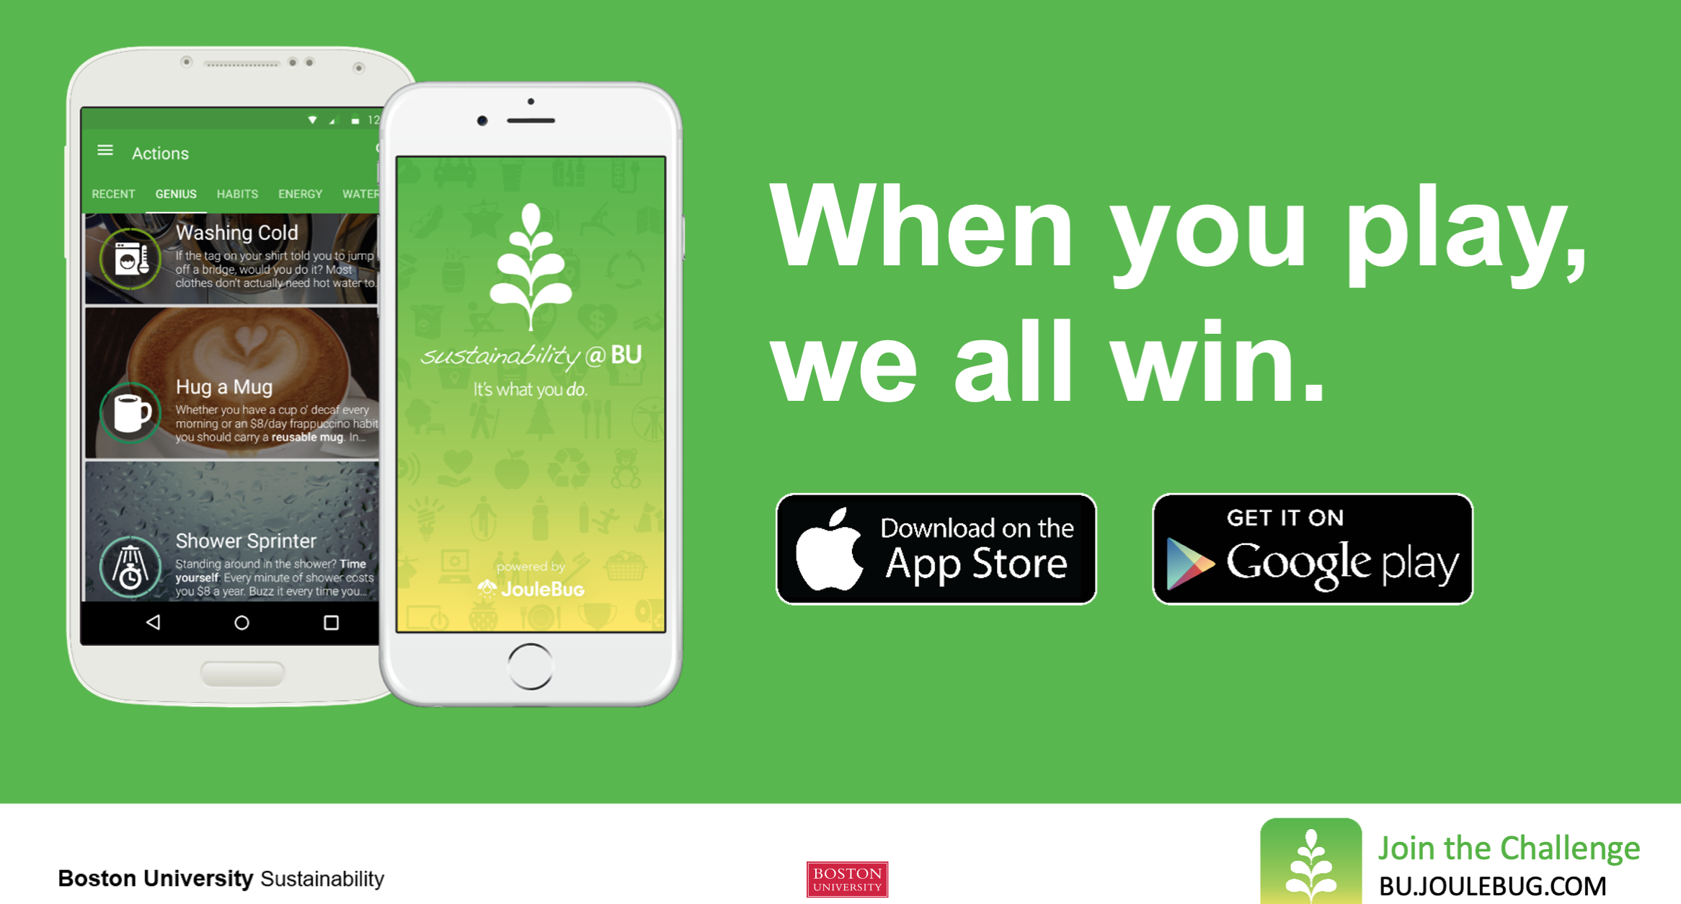
Sustainability in Financial Affairs
Sustainability @BU App will host personalized challenges for FA Staff.
New Employee Onboarding and Orientation
Eco-events (guest speakers, lunch/learn)
Notes:
As you may have noticed with the Fitbit challenge, we are an incredibly competitive department. To lean into that spirit, we will be partnering with the Office of Sustainability to create eco-friendly app challenges that will drive staff engagement, and provide metrics on how our everyday actions are contributing to our efforts.
Participating is easy, just download the BU JouleBug App, create an account with your BU email, - Find a Challenge, - and then buzz, whenever you choose to do something sustainable. And remember, a sustainable action can be as simple as turning out the lights when you leave the room. -
Staff will be split into 5 teams, allowing everyone to compete with each other by “Buzzing” their sustainable actions. Follow your teammates and other Staff for inspiration, and of course, to keep tabs on who’s winning.
In addition, - our work will focus on new employee onboarding and orientations, - as well as hosting lunch and learn events, to raise awareness.

Slide 7
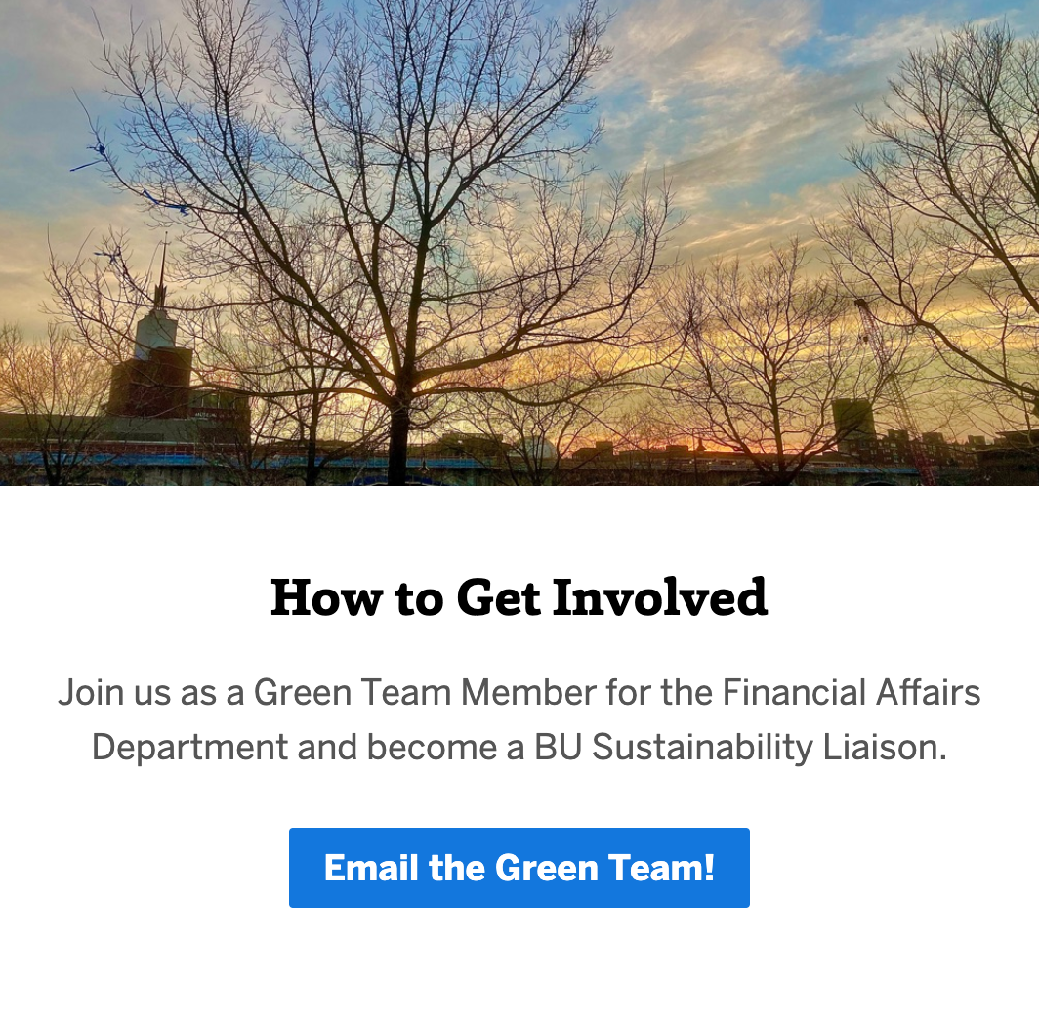
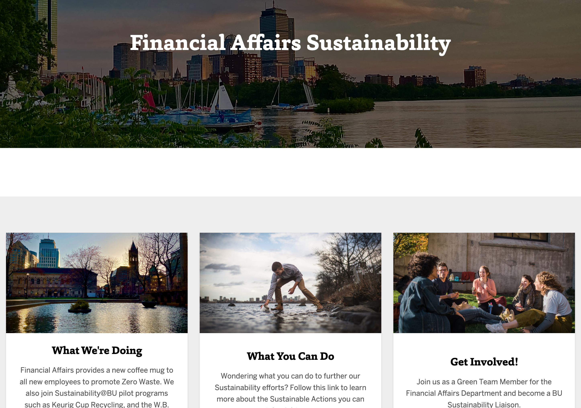
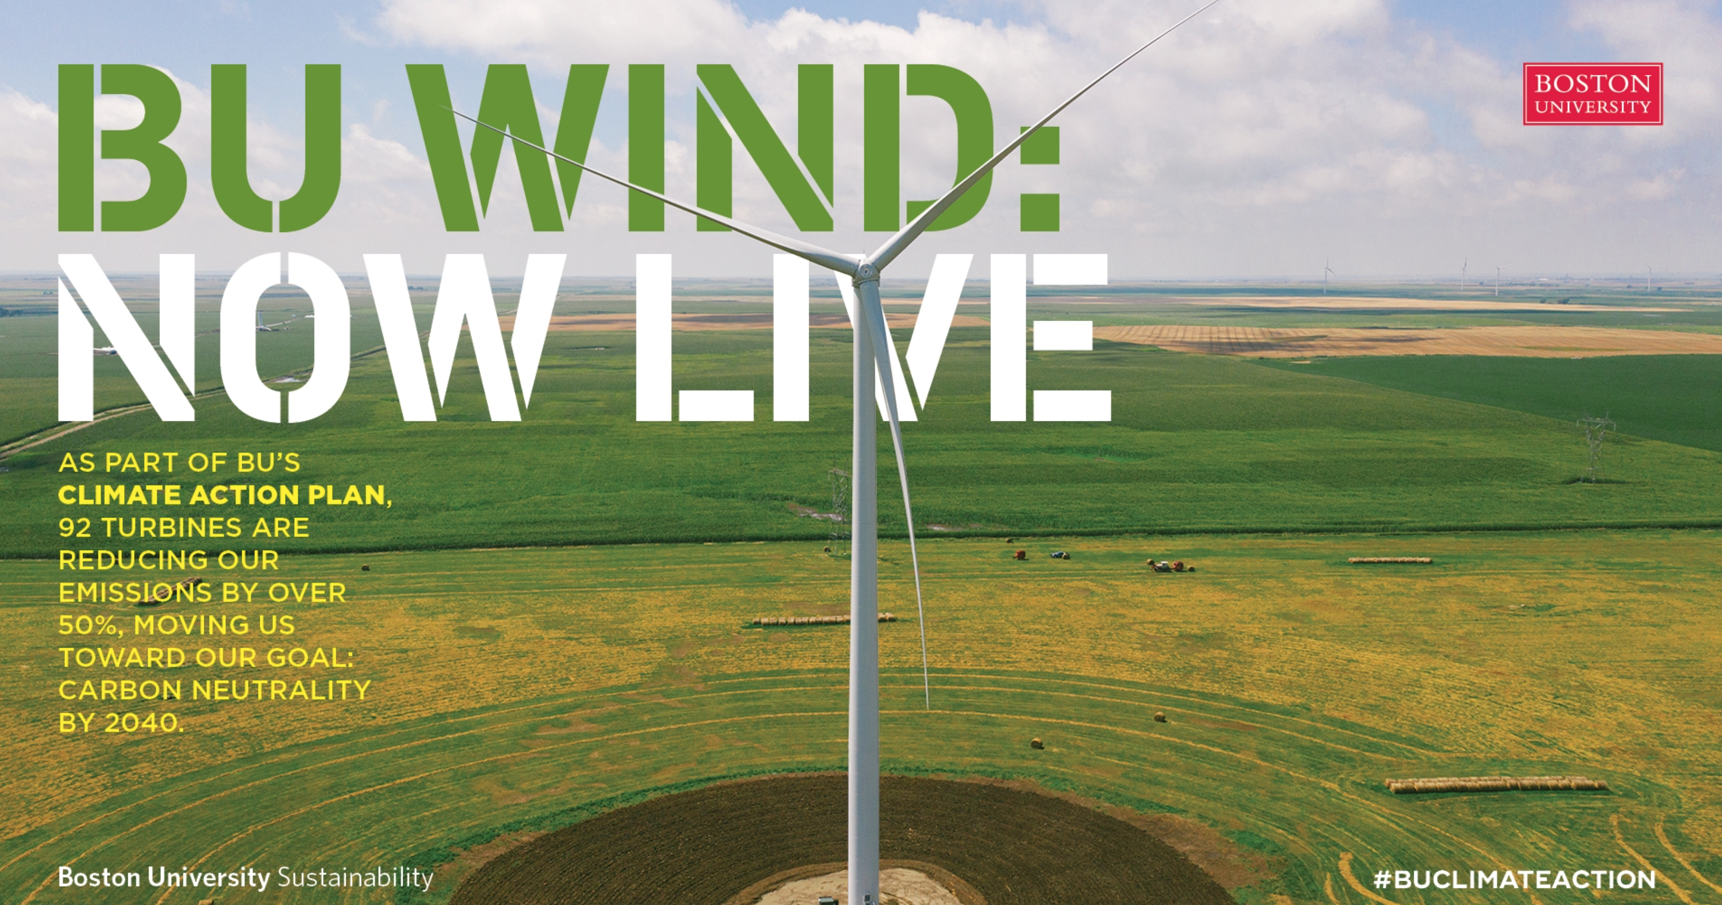
Sustainability in Financial Affairs
FA Sustainability webpage
Digital Signage
CFOGreen@BU.edu
Notes:
To foster unit engagement, we created a Financial Affairs Sustainability website This site will exhibit our initiatives, metrics dashboards, news from the Office of Sustainability, and provide a central resource to all current and onboarding staff.
Additionally, we plan to use the digital signage screen, right here in the hallway of 881, to track progress in challenges and to drive healthy competition among units in the completion of their Green Office Certifications.
Lastly, we have established a shared, Green Team email address to encourage participation and to field inquiries or suggestions.

Slide 8
Questions?
CFOGreen ~ Sustainability in Financial Affairs
Notes:
That concludes my presentation; what we’re really hoping for is support in building our green team so that we can keep pushing the needle with new initiatives and challenges. We'll be sending an email out soon to the department that will invite staff to join the team, and announce upcoming initiatives.
And with that, I will open the floor for your feedback. Does anyone have questions or recommendations?
And now I’d like to introduce Lisa Tornatore, Director of the Office of Sustainability to talk a bit about our recent Green Department Certification.

Slide 9
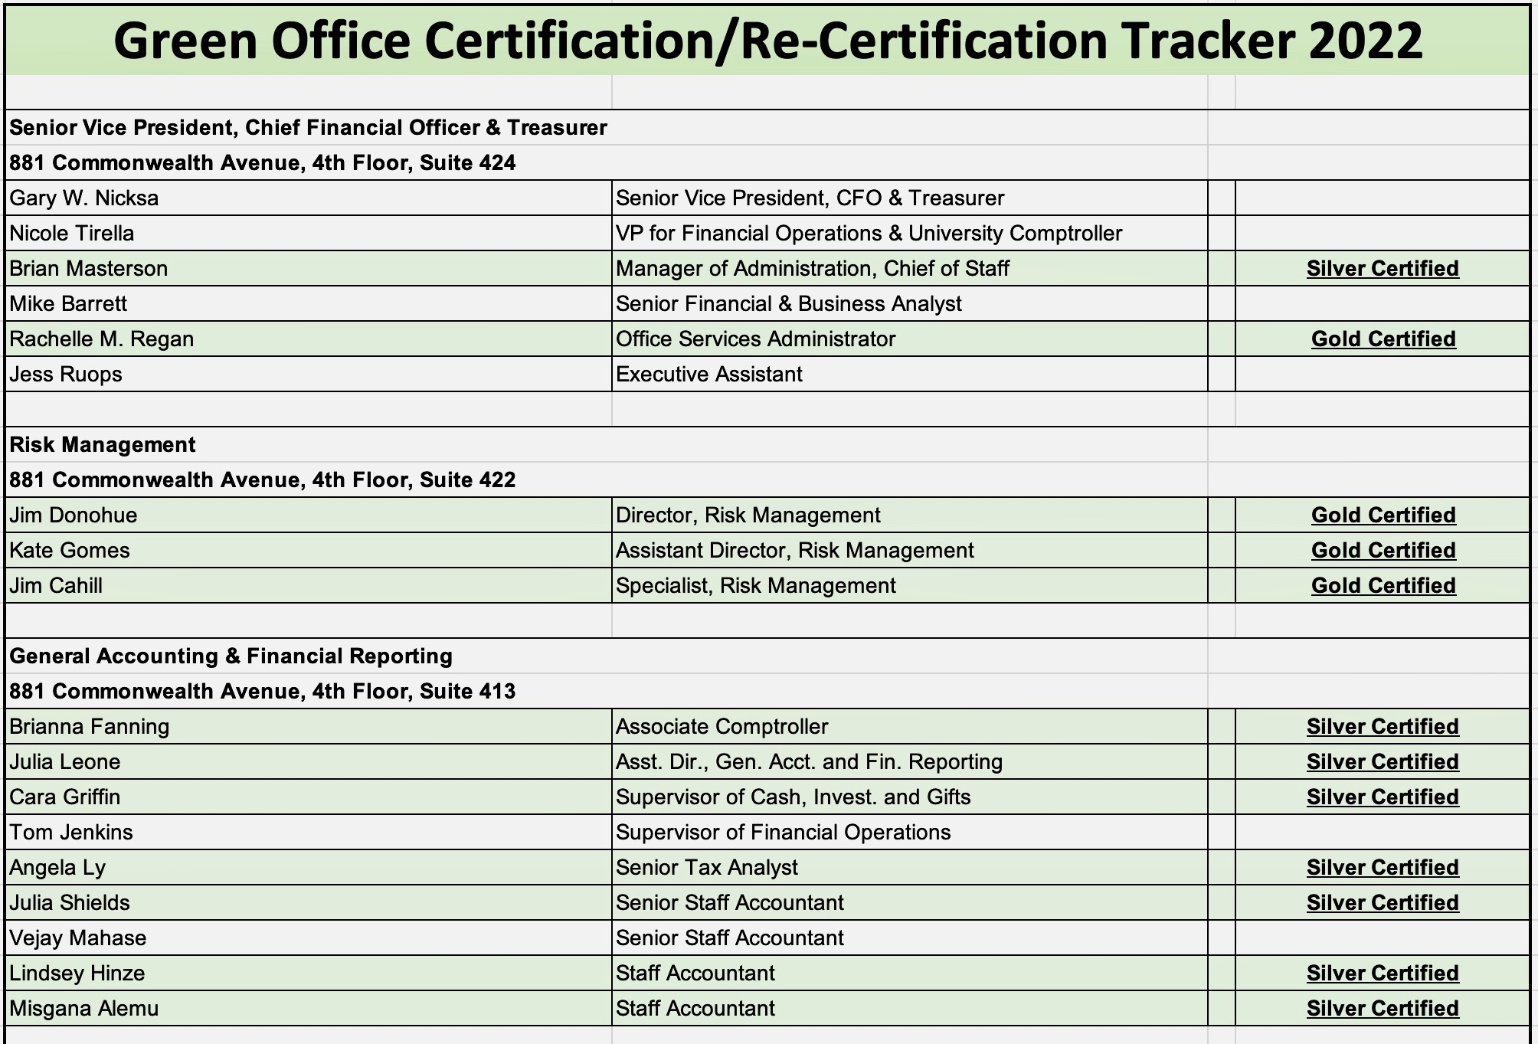
Green Office certification tracker

