Slide 1
Talk About: Academic Success
Fall 2021

Slide 2
Overview
ERC Services
Time Management and Community Engagement
Establishing Relationships with Professors
Academic Peer Support
Breakout rooms
Q&A

Slide 3
ERC Services
Academic Skills Advising
Language Link
Peer Tutoring
Workshops
Writing Assistance
Graduate Writing Support

Slide 4
Where to Find Us
Visit Us!
100 Bay State Road, 6th Floor
Website: bu.edu/erc
Contact Us! Follow Us!
(617) 353-7077 BU_ERC
erc@bu.edu BUERC
BUERC

Slide 5
Time Management and Community Involvement
24 Hour Time Grid
Semester at a Glance Calendar
Community involvement

Slide 6
24 Hour Time Grid

Slide 7
How to Create Your Grid
Classes
Sleep
Meals and exercise
Study time
Free time

Slide 8
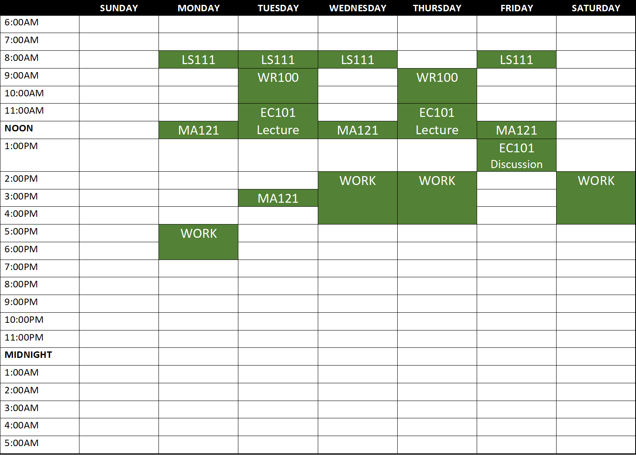

Slide 9
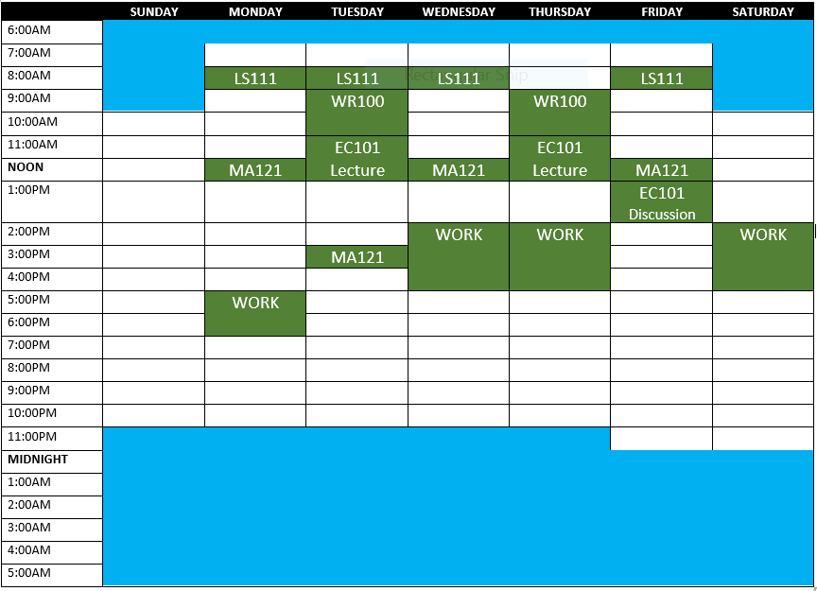
SLEEP

Slide 10
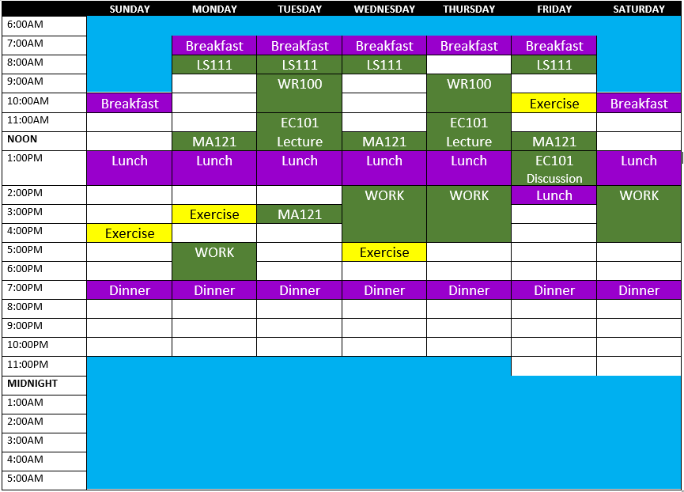
SLEEP

Slide 11
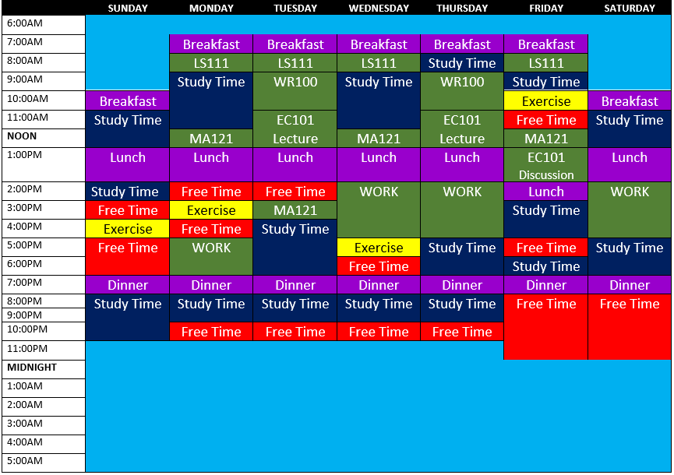
SLEEP

Slide 12
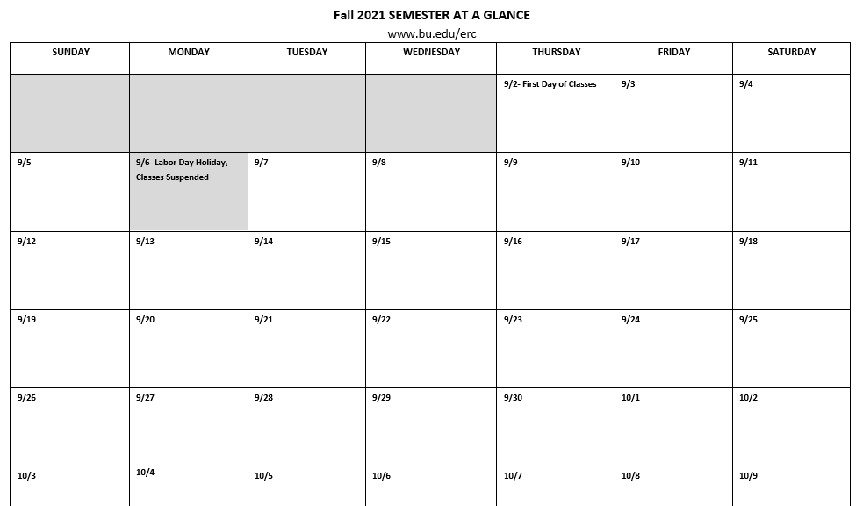
Semester at a Glance

Slide 13
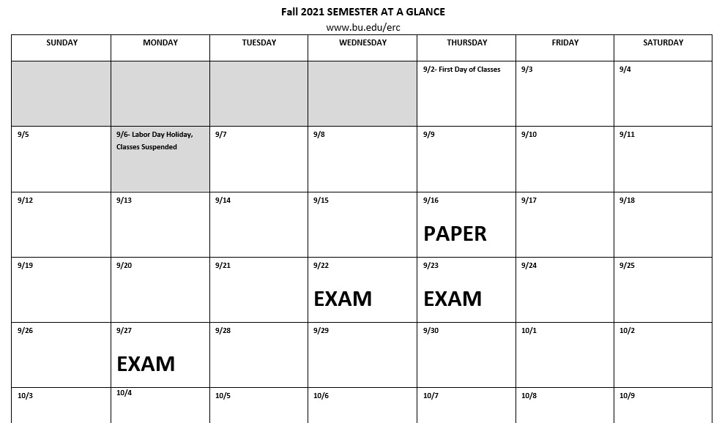
Semester at a Glance

Slide 14
Community Involvement
BU Student Activities Office
Community Service Center
BU Arts Initiative
Howard Thurman Center
Establish connections with peers outside of the classroom

Slide 15
International Peer Mentors
Zorka, Rishav and Zaineb

Slide 16
Establishing Relationships with Professors
Office hours
Email etiquette
Confusion about a topic
Requirements and expectations for assignments
Topics that you’re interested in
The professor’s research
Exam preparation
How to improve in the course
Mentorship

Slide 17
International Peer Mentors
Zorka, Rishav and Zaineb

Slide 18
Academic Peer Support

Slide 19
International Peer Mentors
Zorka, Rishav and Zaineb

Slide 20
Breakout Rooms
Time Management and Community Engagement
Establishing Relationships with Professors
Academic Peer Support

Slide 21
BU First Class and Compass

Slide 22
Q & A

Slide 23
References
Alhola, P., & Polo-Kantola, P. (2007). Sleep deprivation: Impact on cognitive performance. Neuropsychiatric disease and treatment, 3(5), 553–567.
Anton, M. M., Spirduso, W. W., & Tanaka, H. I. R. O. F. U. M. I. (2004). Age-related declines in anaerobic muscular performance: weightlifting and powerlifting. Medicine and science in sports and exercise, 36(1), 143-147.
Armstrong (2017, August 14). The roles of glucose in the brain. Retrieved from https://healthfully.com/358622-the-roles-of-glucose-in-the-brain.html
Armstrong, L. E., Pumerantz, A. C., Roti, M. W., Judelson, D. A., Watson, G., Dias, J. C., Sokmen, B., Casa, D. J., Maresh, C. M., Lieberman, H., & Kellogg, M. (2005). Fluid, electrolyte, and renal indices of hydration during 11 days of controlled caffeine consumption. International journal of sport nutrition and exercise metabolism, 15(3), 252–265. https://doi.org/10.1123/ijsnem.15.3.252
Berchtold, N. C., Castello, N., & Cotman, C. W. (2010). Exercise and time-dependent benefits to learning and memory. Neuroscience, 167(3), 588–597. https://doi.org/10.1016/j.neuroscience.2010.02.050
Berman, M. G., Jonides, J., & Kaplan, S. (2008). The cognitive benefits of interacting with nature. Psychological Science,19, 1207–1212. doi:10.1111/j.1467-9280.2008.02225.x
Blumenthal, J. A., Babyak, M. A., Doraiswamy, P. M., Watkins, L., Hoffman, B. M., Barbour, K. A., ... & Sherwood, A. (2007). Exercise and pharmacotherapy in the treatment of major depressive disorder. Psychosomatic medicine, 69(7), 587.

Slide 24
References
Diekelmann, S., & Born, J. (2010). The memory function of sleep. Nature Reviews Neuroscience, 11, 114–126. doi:10.1038/nrn2762
Doyle, T., & Zakrajsek, T. (2019). The new science of learning: How to learn in harmony with your brain (2nd ed.). Stylus Publishing.
Epley, N., & Schroeder, J. (2014). Mistakenly seeking solitude. Journal of Experimental Psychology: General, 143(5), 1980.
Goel, N., Rao, H., Durmer, J. S., & Dinges, D. F. (2009). Neurocognitive consequences of sleep deprivation. Seminars in Neurology, 29, 320–339. doi:10.1055/s-0029-1237117
Howard, N., & Stavrianeas, S. (2017). In-season high-intensity interval training improves conditioning in high school soccer players. International journal of exercise science, 10(5), 713.
Hirshkowitz, M., Whiton, K., Albert, S. M., Alessi, C., Bruni, O., DonCarlos, L., ... & Hillard, P. J. A. (2015). National Sleep Foundation’s sleep time duration recommendations: methodology and results summary. Sleep health, 1(1), 40-43.
Jayakody, K., Gunadasa, S., & Hosker, C. (2014). Exercise for anxiety disorders: systematic review. British journal of sports medicine, 48(3), 187–196. https://doi.org/10.1136/bjsports-2012-091287

Slide 25
References
Johnson, D. T., & Price, J. E. (2019). Will This Be on the Test?: What Your Professors Really Want You to Know about Succeeding in College. Princeton University Press.
Kasai, N., Kojima, C., Sumi, D., Takahashi, H., Goto, K., & Suzuki, Y. (2017). Impact of 5 days of sprint training in hypoxia on performance and muscle energy substances. International journal of sports medicine, 38(13), 983-991.
Killgore W. D. (2010). Effects of sleep deprivation on cognition. Progress in brain research, 185, 105–129. https://doi.org/10.1016/B978-0-444-53702-7.00007-5
Masento, N. A., Golightly, M., Field, D. T., Butler, L. T., & van Reekum, C. M. (2014). Effects of hydration status on cognitive performance and mood. The British journal of nutrition, 111(10), 1841–1852. https://doi.org/10.1017/S0007114513004455
McGuire, S. Y. (2018). Teach Yourself How to Learn: Strategies You Can Use to Ace Any Course at Any Level. Stylus Publishing.
Medina, J. (2008). Brain rules: 12 principles for surviving and thriving at work, home, and school. Pear Press.

Slide 26
References
Nelson, M. E., Rejeski, W. J., Blair, S. N., Duncan, P. W., Judge, J. O., King, A. C., ... & Castaneda-Sceppa, C. (2007). Physical activity and public health in older adults: recommendation from the American College of Sports Medicine and the American Heart Association. Circulation, 116(9), 1094.
Penedo, F. J., & Dahn, J. R. (2005). Exercise and well-being: a review of mental and physical health benefits associated with physical activity. Current opinion in psychiatry, 18(2), 189–193. https://doi.org/10.1097/00001504-200503000-00013
Pilcher, J. J., & Walters, A. S. (1997). How sleep deprivation affects psychological variables related to college students’ cognitive performance. Journal of American College Health, 46, 121–126. doi:10.1080/07448489709595597
Rasch, B., & Born, J. (2013). About sleep’s role in memory. Physiological Review, 93, 681–766. doi:10.1152/physrev.00032.2012
Sandstrom, G. M., & Dunn, E. W. (2014). Social Interactions and Well-Being: The Surprising Power of Weak Ties. Personality and Social Psychology Bulletin, 40(7), 910–922. https://doi.org/10.1177/0146167214529799
Verleger, R., Rose, M., Wagner, U., Yordanova, J., & Kolev, V. (2013). Insights into sleep’s role for insight: Studies with the number reduction task. Advances in Cognitive Psychology, 9, 160–172. doi:10.5709/acp-0143-8

