Slide 1
Tips for Teaching in Summer: Pre-College Programs May 2025
Deborah Breen
Assistant Director,
Teaching Strategies and Professional Development

Slide 2
Opening Reflection
Think and Write: Imagine that you run into one of your summer term students 5 years from now. What do you hope they still know, are able to do, or value as a result of having taken your course? (1 min)
Pair: Introduce yourself and share your goal for student learning with a neighbor. (2 min)
Notes:
10:25 - 10:35
Think-Pair-Share (2 min / 5 min / 3 min)
(SMH) Think of the best teaching you’ve ever experienced: what characteristics made the instructor so effective?
(2 min) Independent reflection
(5 min) Share your experiences with neighbor; together, come up with 3 qualities of effective educators
SMH, BW and JO circulate among the groups and listen in
(3 min) Debrief as a large group (“as we circulated around the room, we overheard these three things over and over…”)
“In my corner, I overheard...what did you hear, BW?,” etc.
Meeting students where they are, recognizing when students are struggling, enthusiasm, humor, providing feedback and opportunities for growth
Be thinking about how you could demonstrate these qualities as a teacher.
Note to participants (JO):
What we just did was think-pair-share, a common teaching strategy that you can use in your class. This is described in more detail in the “Active Learning” handout in the left-hand side.
If your instructor does this in a class you’re TFing for, you can circulate, as we did, among students and collect information for the large group debrief → esp useful for larger classes.
If you’re serving as a TF for a smaller class, you might be able to go into more depth or call on students to share their answers.

Slide 3
Workshop Topics
Setting and maintaining expectations
Building a sense of community
Engaging students
Encouraging discussion and participation
Notes:
10:25 - 10:35
Think-Pair-Share (2 min / 5 min / 3 min)
(SMH) Think of the best teaching you’ve ever experienced: what characteristics made the instructor so effective?
(2 min) Independent reflection
(5 min) Share your experiences with neighbor; together, come up with 3 qualities of effective educators
SMH, BW and JO circulate among the groups and listen in
(3 min) Debrief as a large group (“as we circulated around the room, we overheard these three things over and over…”)
“In my corner, I overheard...what did you hear, BW?,” etc.
Meeting students where they are, recognizing when students are struggling, enthusiasm, humor, providing feedback and opportunities for growth
Be thinking about how you could demonstrate these qualities as a teacher.
Note to participants (JO):
What we just did was think-pair-share, a common teaching strategy that you can use in your class. This is described in more detail in the “Active Learning” handout in the left-hand side.
If your instructor does this in a class you’re TFing for, you can circulate, as we did, among students and collect information for the large group debrief → esp useful for larger classes.
If you’re serving as a TF for a smaller class, you might be able to go into more depth or call on students to share their answers.

Slide 4
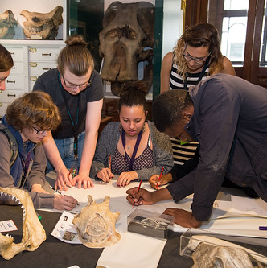
Who are your Learners?
What can you find out before classes?
(pre-class survey)
Fluctuating motivation
Anxiety at being away from home
Not used to college expectations
Social development
Need consistency and kindness
This Photo by Unknown Author is licensed under CC BY-NC-ND

Slide 5
Setting Expectations

Slide 6
Some Principles for Expectation Setting
Clear Communication
Transparent Facilitation
Repetition
General Consistency, but allow for flexibility
Collaborative Norm-Setting, where appropriate

Slide 7
Example: Phones in the Classroom
Clear Communication
Discuss your phone policy on Day 1 (phones off and in bags)
Syllabus Information: Include your phone policy in the syllabus
Transparent facilitation
Explain why it’s important to the class dynamics and learning to not have phones out all the time
Repetition
Start each class/session with a reminder about policy
General Consistency, but allow for flexibility
Consider integrating an occasional activity that involves phone use
Collaborative Norm-Setting
In Week 2-3, have a discussion with class about phone usage

Slide 8
Other Tips for Expectations
Visual reminder of daily agenda on board or slides
Review the syllabus regularly
Gamify finding information in the syllabus
Create community agreement
What does it look like to feel included in this class?
What does participation look like in this class?
This Photo by Unknown Author is licensed under CC BY-NC-ND

Slide 9
Building Community

Slide 10
Why Build Community?
Students who feel valued as part of the classroom community are more likely to:
Remain in the class
01
Be able to focus on learning
02
Participate more willingly
03
Engage in learning activities
04
Be open with you about concerns
05

Slide 11
Ideas for Building Community
Use low-stakes ice-breakers often!
Use student names
Encourage students to learn each other’s names
Ask students to introduce each other
Have name tents (decorated by students)
Include student interests on name tents
Create PPT with student bios to loop before class
Have partner or small group check-ins during breaks
This Photo by Unknown Author is licensed under CC BY-SA-NC
This Photo by Unknown Author is licensed under CC BY

Slide 12
Student Engagement

Slide 13
What is Active Learning?
Any teaching strategy that causes students to engage cognitively in the learning process
It significantly impacts
Student motivation
Knowledge retention
Academic achievement
Prince, M. (2004), Does Active Learning Work? A Review of the Research. Journal of Engineering Education, 93: 223-231.

Slide 14
Tips for Student Engagement
Break up classes into “episodes” of 15-30 minutes
Integrate active learning: polls; group activities; individual reflection or tasks
Have quick “re-set” moments (ice-breakers; movement)
Vary modality (videos; audio; lecture; discussion; reflection time)
Connect to relevance

Slide 15
More Ideas for Engagement
Group creative assignments (collaborative photo essays using phones; infographics;)
Quick research task followed by short presentations
“Be the teacher” group presentations
“Gallery Walks”
Kinesthetic activities

Slide 16
Encouraging Participation

Slide 17
Principles for Participation
1
Model inclusive participation
2
Acknowledge different ways of participating
3
Provide opportunities for participating in different ways
4
Affirm all contributions
5
Kindly redirect when needed
6
Make connections between student comments
Encourage students to set their own goals for participation
7

Slide 18
Practicing Participation
Allow preparation time
Homework writing
In-class writing
Think-Pair-Share
Sentence starters/discussion prompts ahead of time
Warm calling
Question/Comment cards
Vary group reporters
Allow options for presentations
This Photo by Unknown Author is licensed under CC BY-NC-ND

Slide 19
Crowdsourcing Ideas
What is one tip you’d like to share with colleagues about teaching in the summer term:
An activity
Creating classroom community
Advice on managing the schedule
Anything you can think of!

Slide 20
Summer Resources
Resources for Summer Teaching on former CTL website: https://www.bu.edu/ctl/teaching-and-learning-in-the-summer/
Come talk with us!
Schedule a consultation:
excellence@bu.edu
This Photo by Unknown Author is licensed under CC BY-NC
Notes:
10:25 - 10:35
Think-Pair-Share (2 min / 5 min / 3 min)
(SMH) Think of the best teaching you’ve ever experienced: what characteristics made the instructor so effective?
(2 min) Independent reflection
(5 min) Share your experiences with neighbor; together, come up with 3 qualities of effective educators
SMH, BW and JO circulate among the groups and listen in
(3 min) Debrief as a large group (“as we circulated around the room, we overheard these three things over and over…”)
“In my corner, I overheard...what did you hear, BW?,” etc.
Meeting students where they are, recognizing when students are struggling, enthusiasm, humor, providing feedback and opportunities for growth
Be thinking about how you could demonstrate these qualities as a teacher.
Note to participants (JO):
What we just did was think-pair-share, a common teaching strategy that you can use in your class. This is described in more detail in the “Active Learning” handout in the left-hand side.
If your instructor does this in a class you’re TFing for, you can circulate, as we did, among students and collect information for the large group debrief → esp useful for larger classes.
If you’re serving as a TF for a smaller class, you might be able to go into more depth or call on students to share their answers.

Slide 21
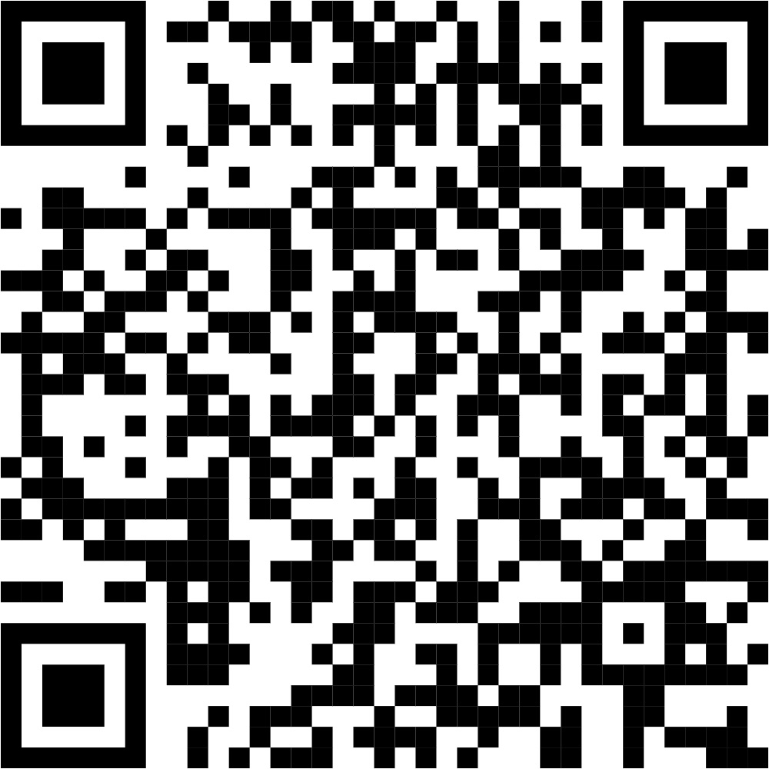
Asking for Feedback: Exit Ticket

Slide 22
Deborah Breen
dfbreen@bu.edu
Institute for Excellence in Teaching & Learning
excellence@bu.edu

