Slide 1
Africans Resist Colonialism: The Mau Mau Story
Breeanna Elliott
NERC 2016
“​Mzungu Arudi Ulaya, Mwafrika​ ​Apate Uhuru”

Slide 2
The Rise of Anti-Imperialism
Most colonies had an African elite who had a European education → initially supportive of mother country but later became leaders of independence
During the world wars, the colonies were needed to provide resources (foodstuffs) AND soldiers
European powers promised reforms (and greater independence) for colonies if they helped the mother country
The reforms never came and after the Great Depression, the colonies were given no assistance or aid → led to resistance

Slide 3
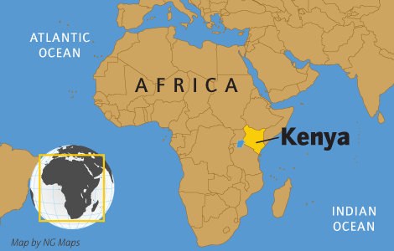
Africa is a Continent: Highlighting Kenya
British established the East Africa Protectorate in 1895
Considered as a settler colony – white settlers took the best land for their own and moved native groups to reserves
In 1920, it became known as the Kenya Colony
Kenya received its independence in 1963

Slide 4
Mau Mau Uprising - Review
Initiated by an ethnic group known as the Kikuyu but grew to include many different ethnic groups in Kenya
Biggest frustration: LAND → supposedly “vacant” land was taken over by the British settlers
Africans, especially the Kikuyu who traditionally occupied the most fertile lands, were forcibly removed and placed in resource-poor areas
Initial attempts at peaceful negotiations failed → resistance became violent as British resorted to detention camps and the Mau Mau became a mythical source of inspiration to many Kenyans

Slide 5
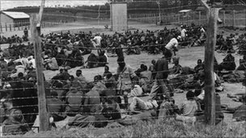
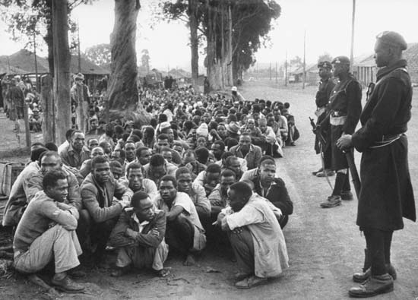
The Mau Mau Rebellion (1953-56): A Case Study

Slide 6
Resistance – An Ongoing Struggle
In the 1940s – members of the Kikuyu, Embu, Meru, and Kamba tribes took oaths to fight for freedom
Increasing British concern about the resistance led them to jail Jomo Kenyatta (future 1st president of Kenya) as a leader of the Mau Mau in 1953.
Led to a state of emergency being declared – Oct 1952 – Dec 1959
Officially, the number of rebels killed included 11,000, including 1,090 hangings. The Kenya Human Rights Commission says 90,000 Kenyans were executed, tortured or maimed during the crackdown, and 160,000 were detained in appalling conditions.
Only 32 white settlers were killed.

Slide 7
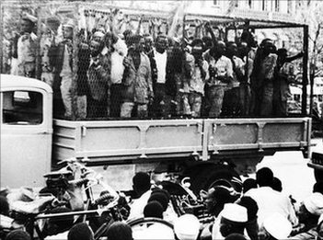
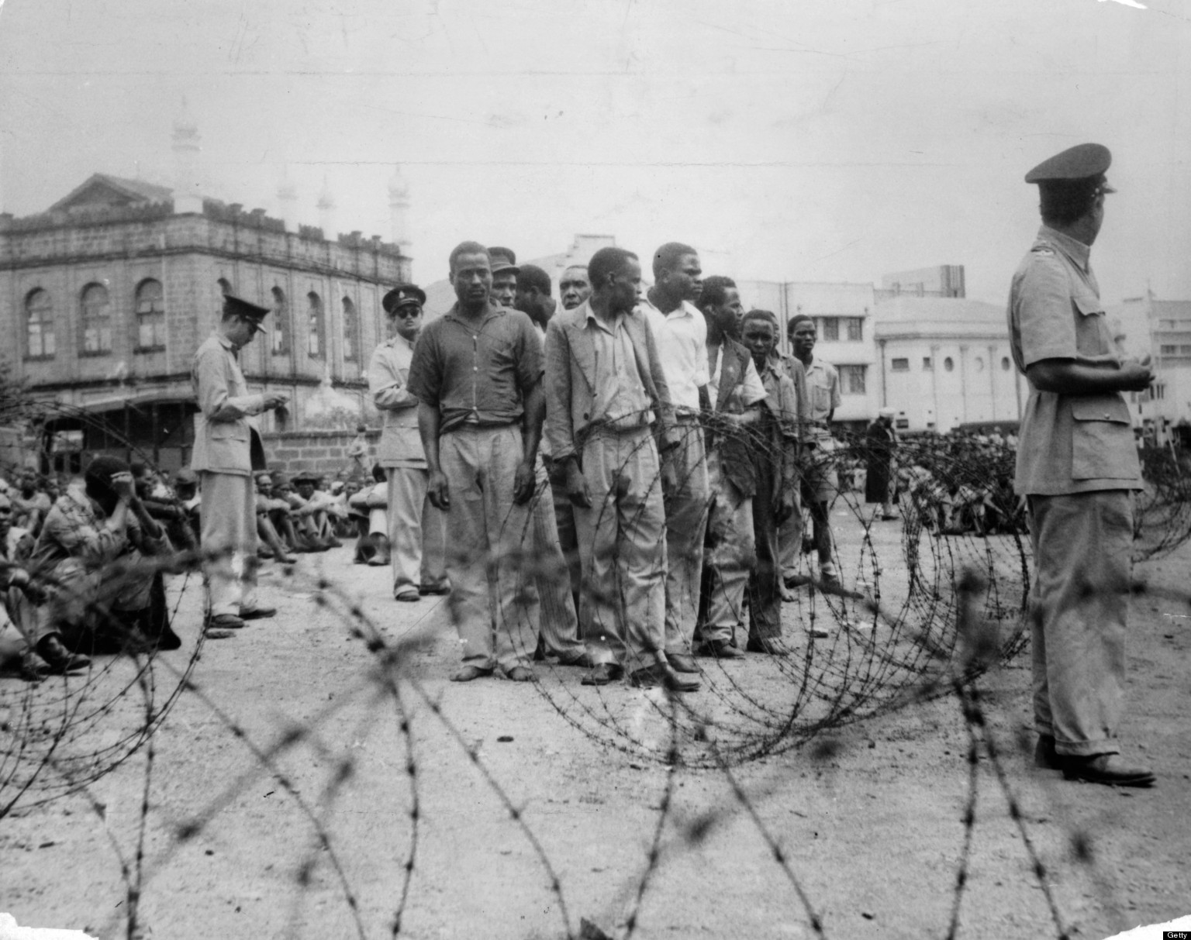

Slide 8
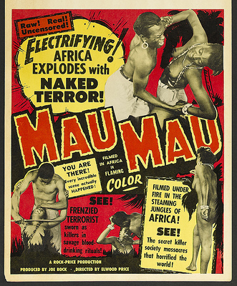
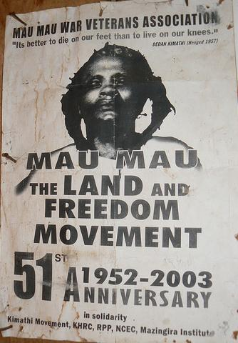

Slide 9
Impact of the Resistance - Legacies
Undoubtedly the Mau Mau rebellion contributed to the expediency of Kenyan independence
2013 - legal suit against the British government on behalf of the Mau Mau survivors → paid out £19.9m to 5,228 Kenyans who were victims of torture
2016 - new legal suit against the British government on behalf of those affected by additional offenses (e.g., false imprisonment, forced labor, interruption to their right to education)

