Slide 1
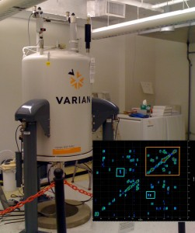
Nuclear Magnetic Resonance
Obtaining Good Quality Spectra on the CIC Instruments

Slide 2
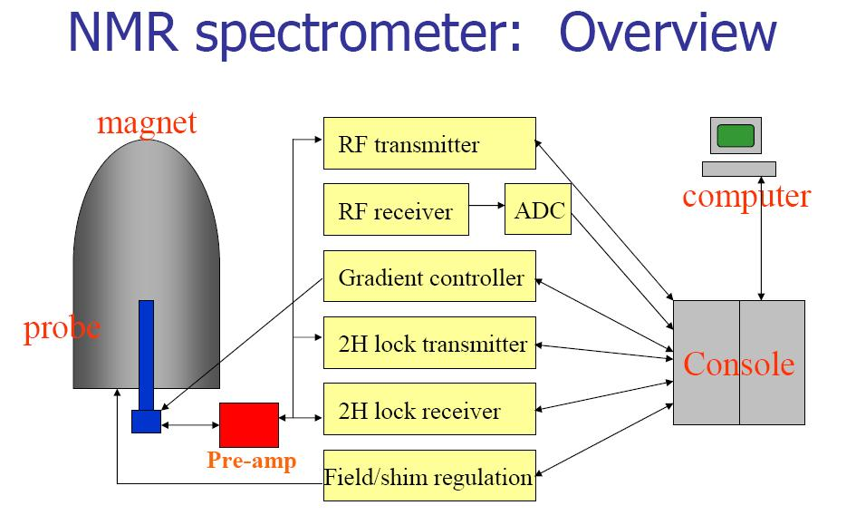

Slide 3
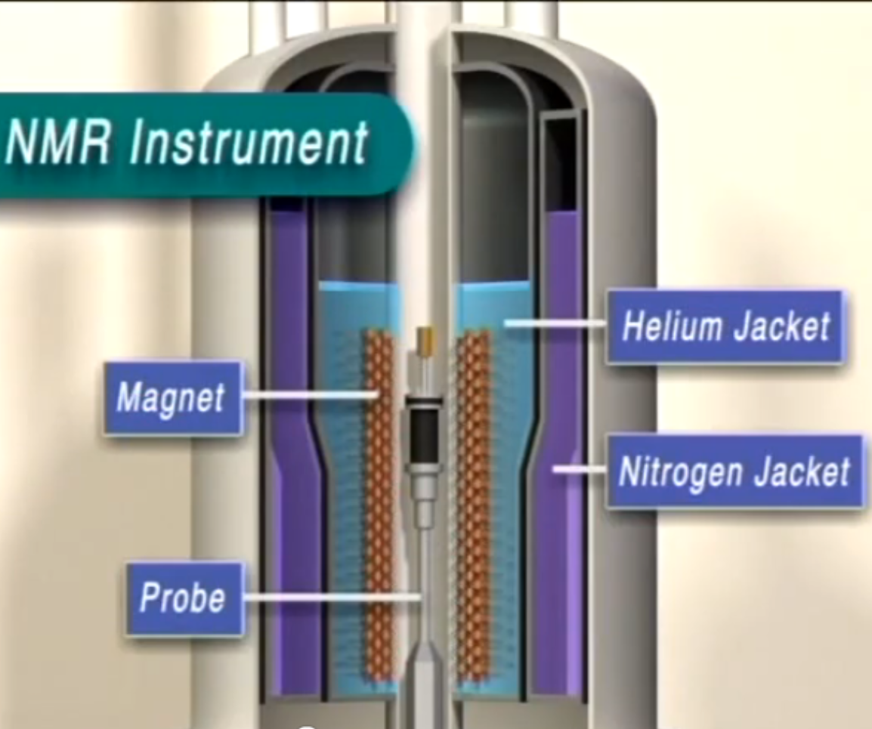

Slide 4
Basic Steps of Running an NMR experiment?
Determining NMR experiment to run
Sample preparation
Tuning
Shimming
Locking
Experiments – Tips and Tricks

Slide 5
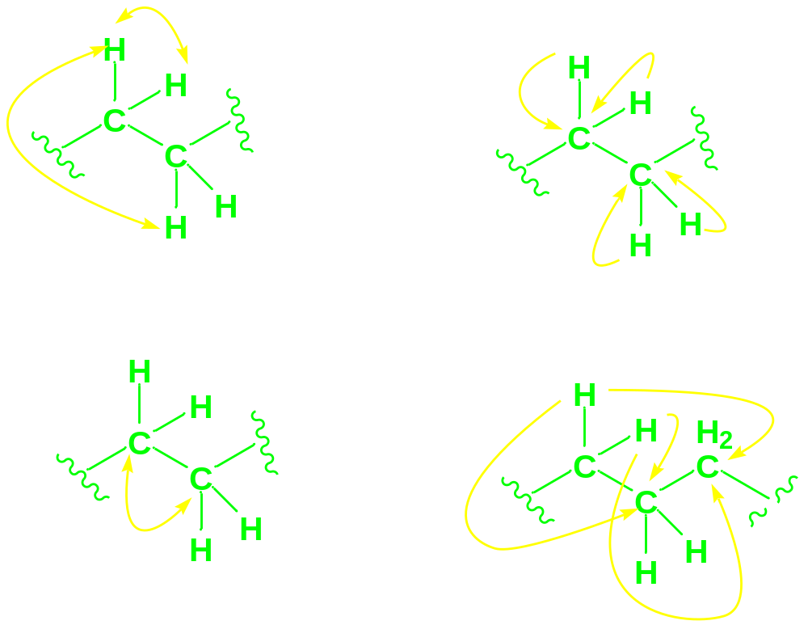
Determining NMR experiment to run
and plan appropriately
gCOSY
gHSQC, gHMQC
NOESY
ROESY
TOCSY
INADEQUATE
gHMBC

Slide 6
Sample preparation
Sample tubes (5mm x 8”)
    Never dry NMR tubes in the oven
Amount of Sample should be dependant on the experiments you will run ,
    ¹H NMR -5-20 mg
    ¹³C NMR >10 mg
    Inverse detected experiments , 2D >10 mg
Samples should be soluble in solvent and filtering is highly recommended
Sample volume should be close to 700uL (0.75ml), You can use less solvent, as long as you are within the sample gauge depth requirements –gradient shimming wont be great – be prepared to manually shim.
Use sample depth gauge to properly align the sample in probe

Slide 7
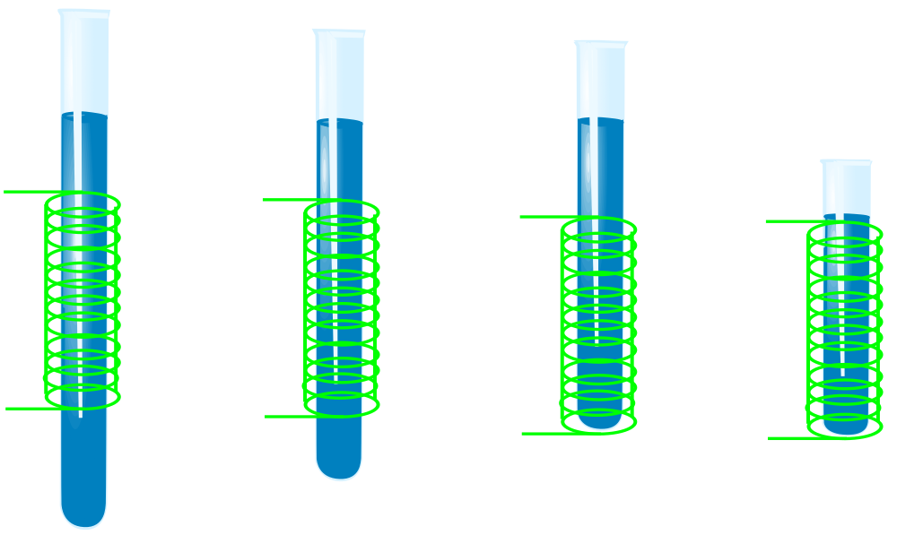
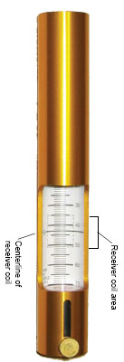
Sample preparation
the magnetic susceptibilities of the solution inside the coil and the air outside the coil are very different and will result in a severe distortion of the magnetic field. It is very difficult to shim the magnet to compensate for this effect and the resolution and signal-to-noise ratio in your spectrum will suffer greatly.
5mm
High window
15 mm
High
window
5mm
High window

Slide 8
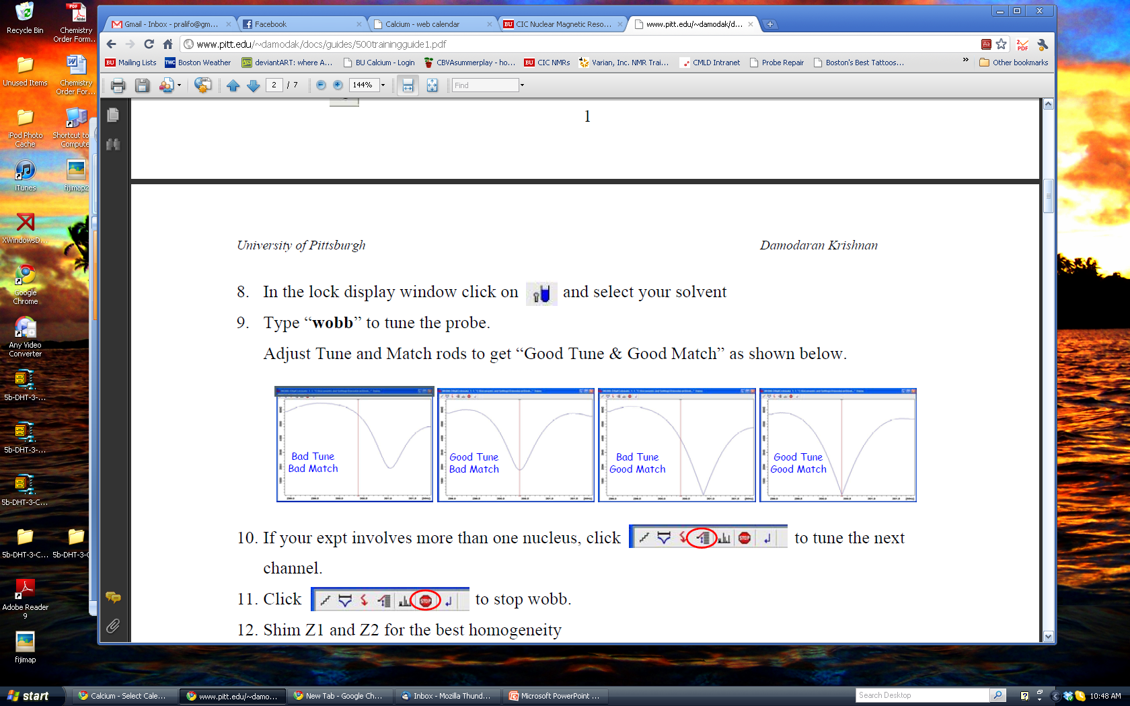
Tuning
Probe tuning
  maximizes the forward power and minimizes the reflected power
  maximizes the transmission of the NMR signal from your sample to the receiver
a poorly tuned NMR probe will cause a great deal of damage to the instrument because the power intended for the sample will instead be reflected back into some other part of the instrument not designed to dissipate large amounts of power
a poorly tuned probe will often give no signal and just show noise – even if the sample is concentrated

Slide 9
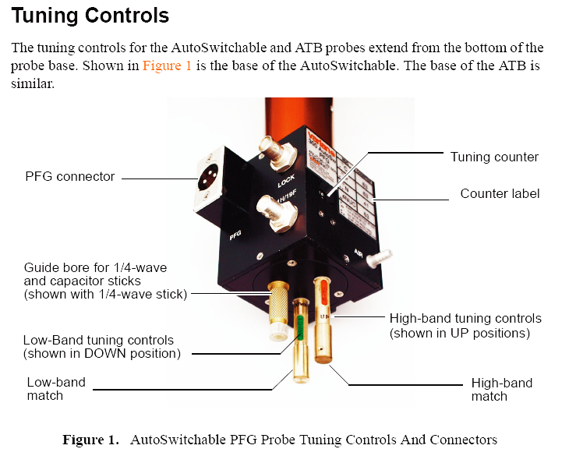
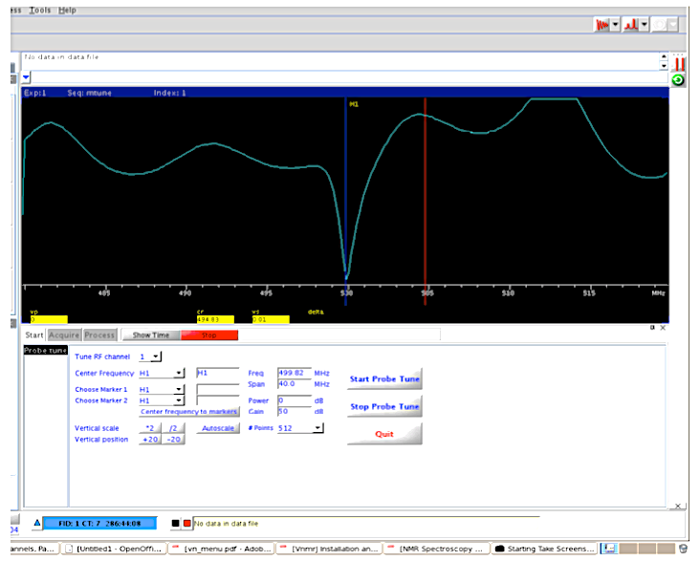
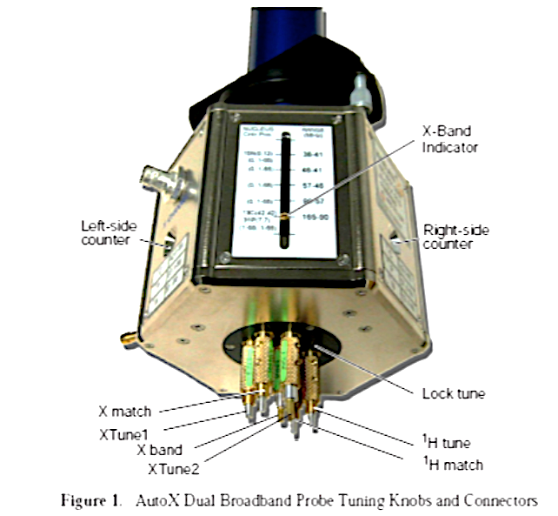
Tuning
VNMRJ: Tools> Probe Tuning> Manually Tune Probe menu
Channel 1: Tune 1H and 19F
Channel 2: Tune 13C, 11B, 31P, 59Co, 15N

Slide 10
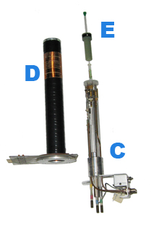
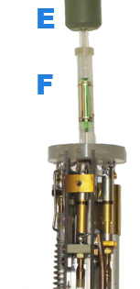
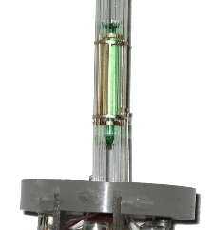
Shimming
Shimming is adjusting the resolution of the signal by optimizing the homogeneity of the magnetic field
D - Shim coils,
E - Sample tube in spinner,
C - Probe,
F - 2 rf coils around the sample volume (green)

Slide 11
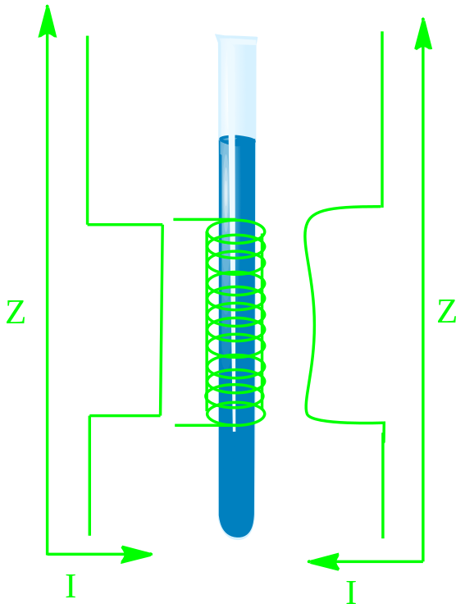
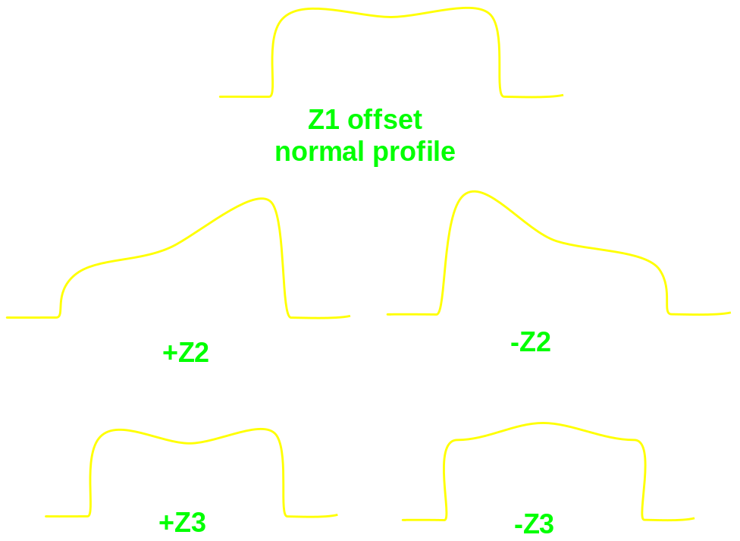
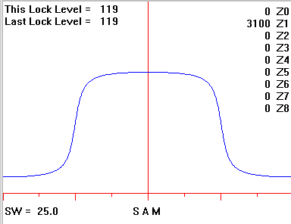
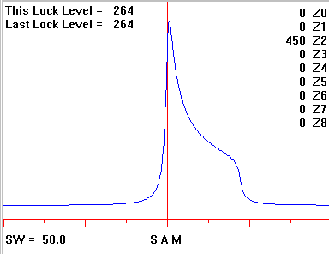
Shimming
Odd shims:
Symmetrical broadening
Even shims:
Shoulders or asymmetric broadening

Slide 12
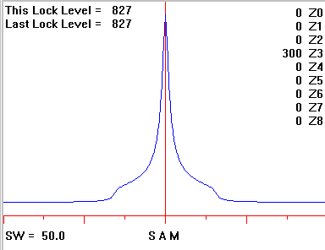
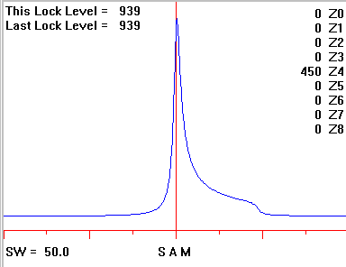
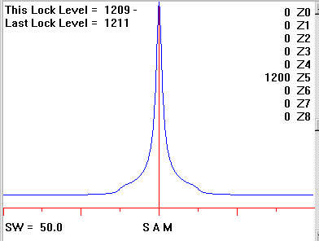
Shimming

Slide 13
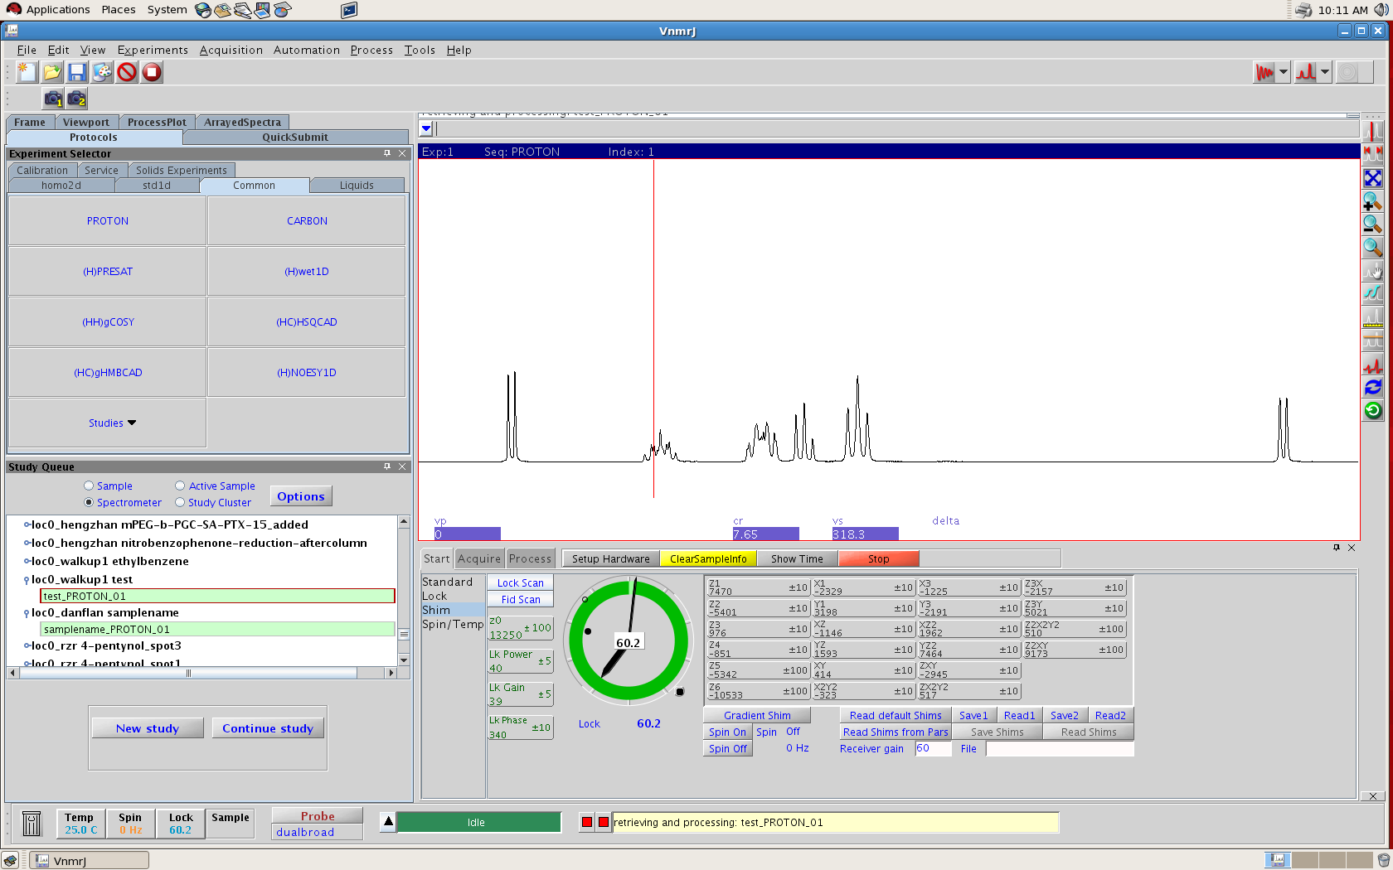
Shimming

Slide 14
Shimming - manual shimming
Left mouse button decrease value of the shim
right mouse button increase value of the shim
mouse
The aim is to increase the lock level
Middle mouse button changes the number of increments

Slide 15
Shimming
The most common reasons for poor shims are:
  1.Bad starting shims (did not load a good starting shim set)
  2. Low quality and or flawed NMR tube
  3. Insufficient volume of solution
  4. Improperly positioned NMR tube, not enough sample volume
  5. Unusual nature of sample, e.g., highly concentrated
Keep in mind that linewidths are sample dependent. PFG, or gradient, shimming cannot overcome aggregating or suspended samples, solvent bubbles, too little solvent height (use susceptibility inserts!!), scratched sample tubes, etc. And many samples simply will not shim to better than 1 (or even 2 or higher) Hz linewidths due to their intrinsic relaxation properties in the solvent and temperature being used; i.e. their natural linewidths are >1 or 2 Hz.

Slide 16
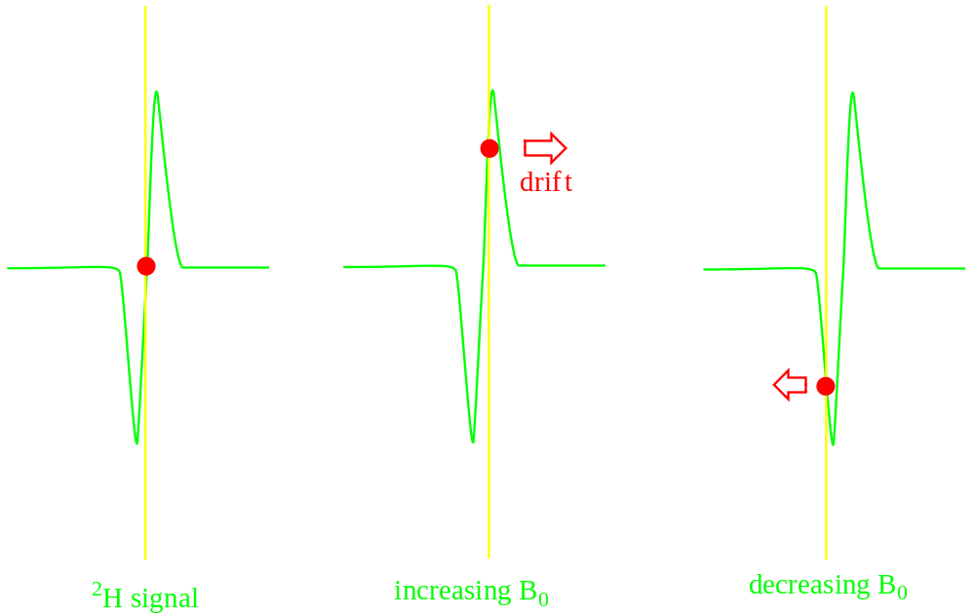
Locking on to the deuterium signal
Locking is a means of compensating for transient variations of the magnetic field strength
  - when you are locking on the deuterium signal of your solvent, you are essentially keeping the field from drifting while running your experiment.
The field lock works by using the proportionality of the resonant frequency of the deuteron to the resonant frequency of the NMR active nucleus of interest, e.g., ¹H, ¹³C, ³¹P, etc.

Slide 17
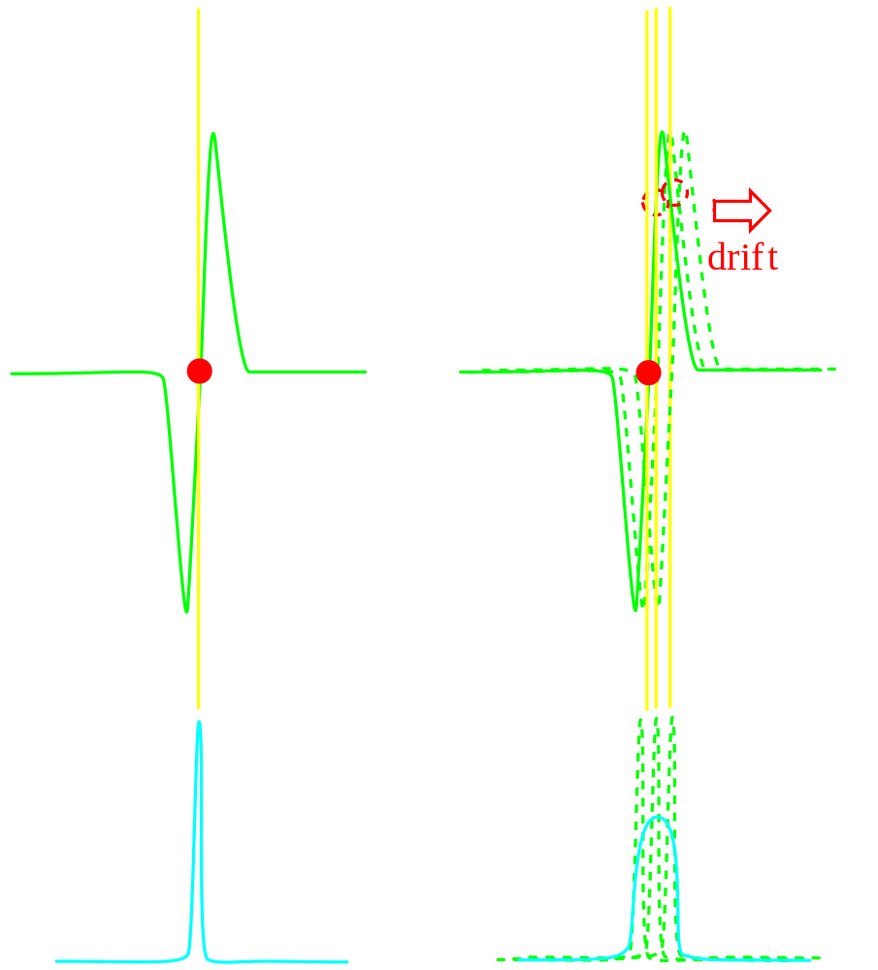
Locking on to the deuterium signal
If the magnetic field drift, so will the peak frequencies

Slide 18
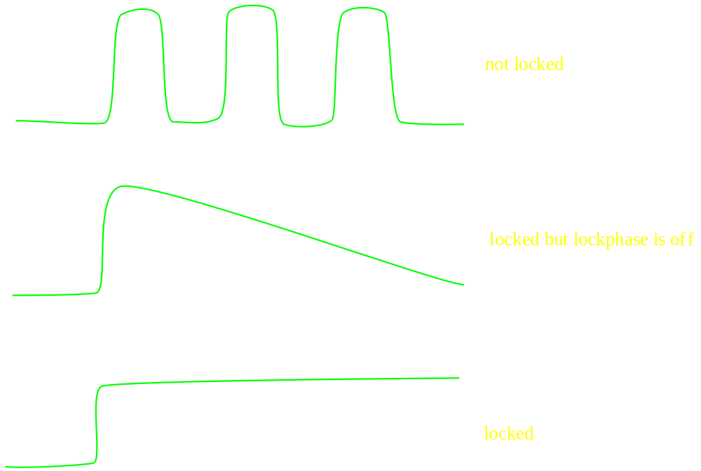
Lock – Find z0
Note: always maximize lock gain and maximize lock power to just below the point of saturation

Slide 19
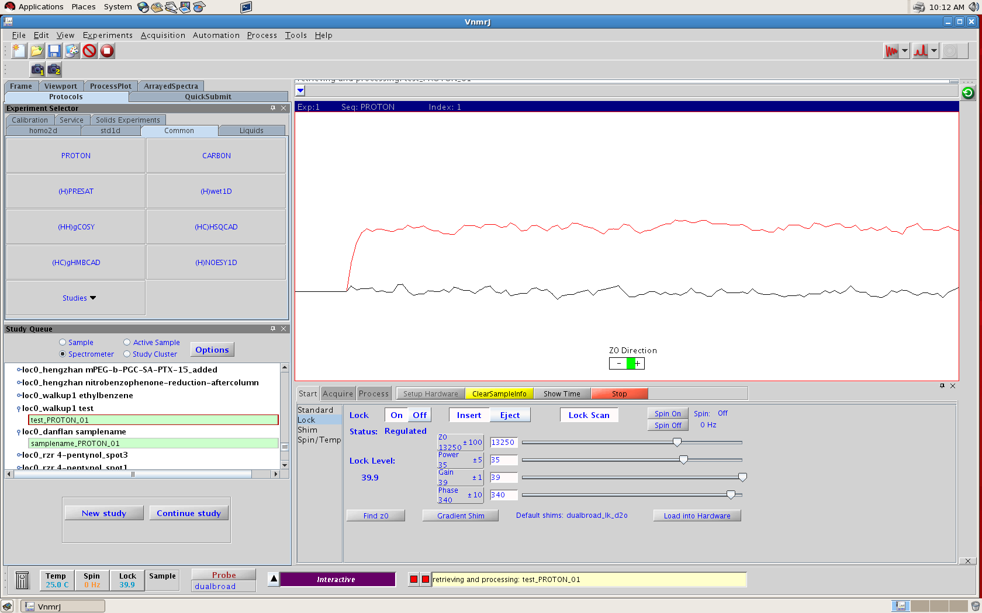
Lock – Find z0

Slide 20
Lock – Find z0
How High Should the ²H Lock Signal Be?
There isn't really an answer to the question.
The height of the lock signal depends on all of the following: which solvent is used, the amount of solvent in the NMR tube, the lock power, the lock gain, the lock phase and the magnet homogeneity.
The lock signal is high enough when any further shimming cannot improve on the height.

Slide 21
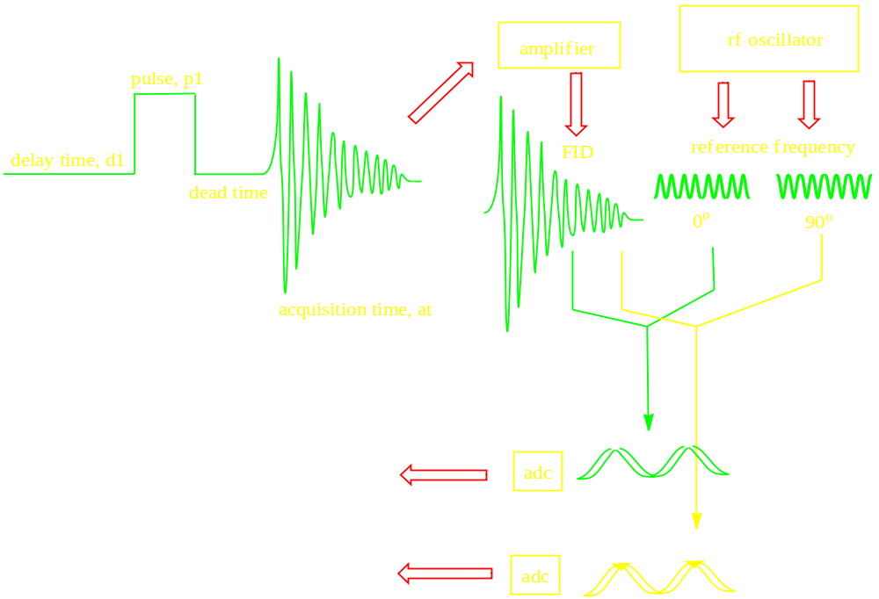
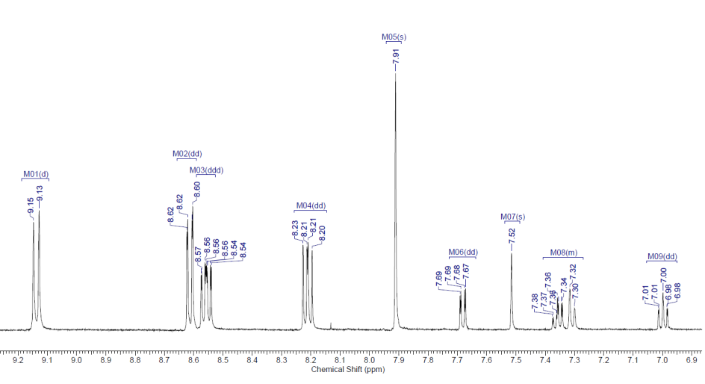
Acquisition

Slide 22
TIPS AND TRICKS ON THE MOST COMMON NMR EXPERIMENTS EXECUTED HERE AT BU
gCOSY
NOESY
ROESY
TOCSY
gHSQC, gHMQC. ASAPHMQC
INADEQUATE
gHMBC

Slide 23
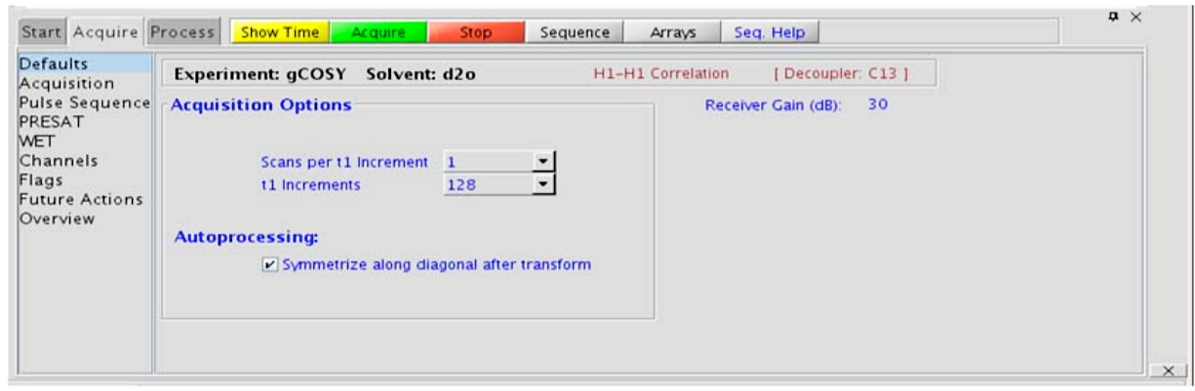
gCOSY: 2 – 3 through bonds H-H
Better alternative to the COSY experiment: cleaner less T1 noise
Spectral symmetrization can help clean up the T1-noise but can produce false cross peaks. When in doubt compare symmetrized to un-symmetrized spectrum
10 min long experiments are sufficient for most molecules (> 3mg)
Complex molecules with overlapping signals – try zTOCSY.

Slide 24
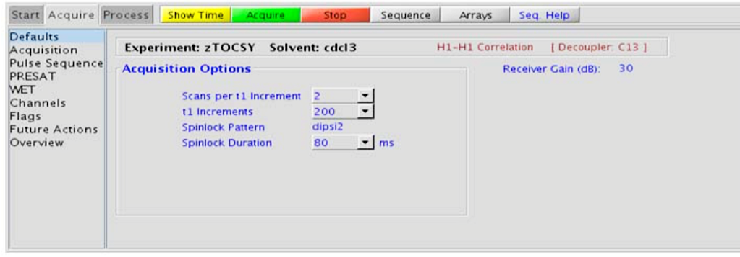
zTOCSY: 2 - 3 through bonds H-H
Total correlation – identifies a scalar coupled spin system, with zero quantum filter for artifact suppression
The spinlock time (in addition to the magnitude of the coupling constants) ultimately controls how far along the spin system the correlations extend. Use spinlock durations exceeding 150ms with caution, as this can result in sample heating.
To show primarily vicinal and geminal couplings (such as for a COSY), select a shorter spinlock time, for example, 30ms or less.

Slide 25
zTOCSY: 2 - 3 through bonds H-H
Such short spinlock zTOCSY is a good alternative to gCOSY as zTOCSY gives pure absorptive lineshape and potentially improved resolution.
Spinlock Pattern - Pull-down menu on the “Pulse Sequence” panel- DIPSI2 works well for small molecules, DIPSI3 is a good choice for large molecules

Slide 26
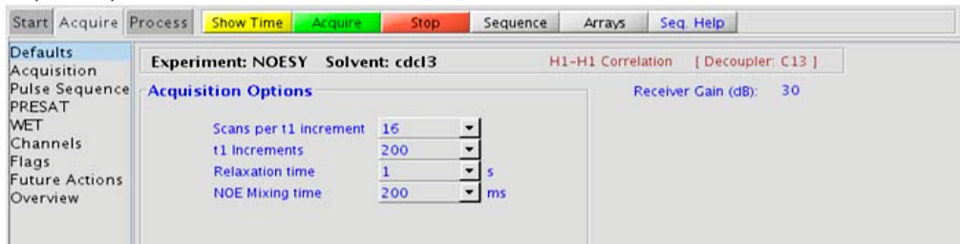
NOESY: through space H-H correlations (relative stereochemistry)
This experiment produces a 2-dimensional spectrum with peaks along the diagonal corresponding to the peaks in a 1D PROTON and crosspeaks between protons that are close in space (typically <5 Å).
Degas samples, use more viscous solvents.
A mixing time of 500ms is a good starting place for most small molecules.
Very small molecules and/or weak NOE interactions can require longer mixing times (up to ~1s)
The NOE correlation can be confirmed by acquiring a build-up curve, whereby the mixing time is slowly increased in 50-100ms increments until the NOE intensity ceases to increase, and levels off. This time is the optimal mixing time.

Slide 27
NOESY: through space H-H correlations (relative stereochemistry)
Medium-sized molecules (MW >700), depending on the molecule and spectrometer frequency, can exhibit zero or very small NOEs. Consider acquiring a ROESY for these molecules.
Small molecules can have crosspeaks arising from chemical exchange during the NOE mixing time and have the same phase as the diagonal. The exchange crosspeaks provide information about interconverting molecular conformations and can be used to recognize such molecular dynamic processes.

Slide 28
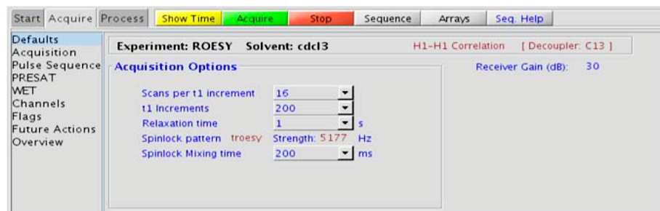
ROESY: through space H-H correlations (relative stereochemistry)
Two-Dimensional through-space correlation spectroscopy in the rotating frame.
This experiment produces a 2-dimensional spectrum with peaks along the diagonal corresponding to the peaks in a 1D PROTON and crosspeaks between protons that are close in space (typically <4 Å).
Good for rigid ring systems.
The ROESY is the experiment of choice for intermediate-sized molecules (typically between 800-1000 MW) where the NOE can be zero.

Slide 29
ROESY: through space H-H correlations (relative stereochemistry)
A mixing time of 200ms is a good starting place for most small molecules.
Weak ROE interactions can require longer mixing times (up to ~500ms), but keep the mixing time shorter as longer spinlocks can result in sample heating. It is a good idea not to exceed a 500ms spinlock.
Consider running a NOESY if you need more mixing time

Slide 30
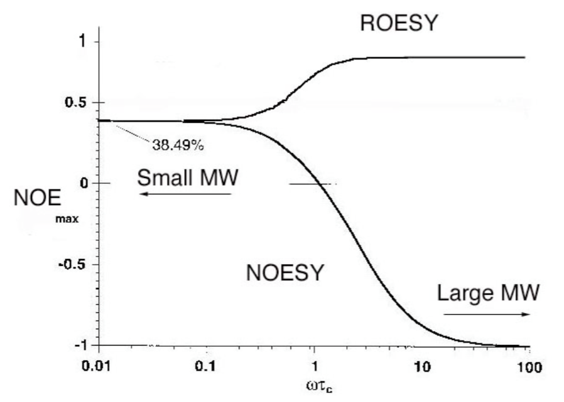
ROESY vs NOESY (?)
Choice of mixing time is a critical factor. There are two opposing factors which must be considered:
build up the NOE for as long as possible during the mixing time
lose as little signal as possible to relaxation during mixing time
Ideally the mixing time should be as close as possible to the T1 of proton signals you want to observe.
Newhaus and Williamson text

Slide 31
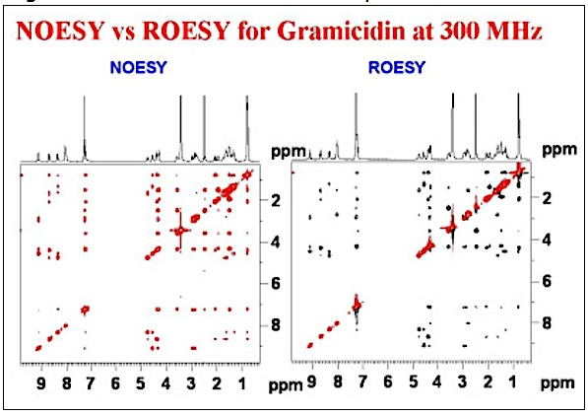
ROESY vs NOESY (?)
NOESY experiments work well for molecules of very low (<700) and very high (>2000) molecular weight
A ROESY experiment can be used to get NOE information for molecule in this intermediate molecular mass regime.

Slide 32
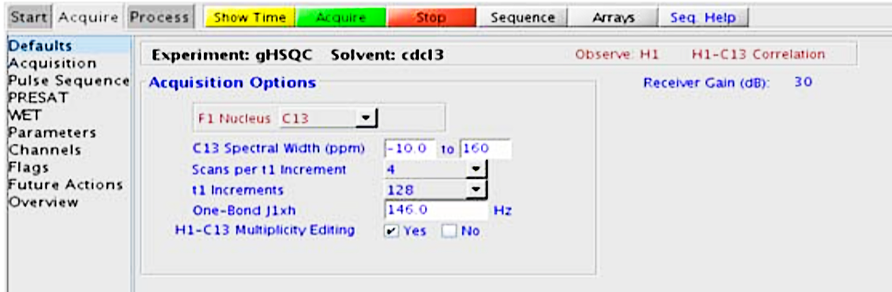
gHSQC : H → C, 1-Bond Correlation
The gHSQC experiment is used to acquire a 2-dimensional spectrum to correlate protons with directly attached carbons.
In general, the HSQC-type experiments provide spectra with narrower peaks shapes (by suppressing 1H-1H homonuclear coupling modulation in F1) than the HMQC-types, leading to typically better S/N and resolution.
The HSQC experiment has a sensitivity advantage (factor of ~1.4) over the gHSQC. If you do not have very strong signals like –OCH₃ or tertButyl groups you may run HSQC.
Use at least 8 scans per increment and for less concentrated sample, increase the number of scans.
NUS option can reduce the experimental time significantly.

Slide 33
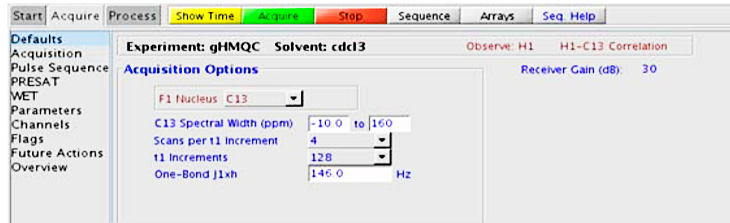
gHMQC : H → C, 1-Bond Correlation
The gHMQC experiment is used to acquire a 2-dimensional spectrum to correlate protons with directly attached carbons.
The HMQC experiment has a sensitivity advantage (factor of ~1.4) over the gHMQC. If you do not have very strong signals like –OCH₃ or tertButyl groups you may run HMQC.
Use at least 8 scans per increment and for less concentrated sample, increase the number of scans.
NUS option can reduce the experimental time significantly.

Slide 34
gHMQC vs gHSQC
Both Experiments give the exact same results!!
The difference :
During the evolution time of an HMQC both proton and ¹³C magnetization are allowed to evolve.
In the HSQC only ¹³C magnetization is allowed to evolve.
What does this mean?
In the HMQC, the resolution in the F1 dimension is affected by Proton J coupling and manifests itself in line broadening.
HSQC is better?
HSQC gives sharper less broad signals, but since it has more pulses in its PS, it is more susceptible to signal loss
HMQC may produce broader line shapes in the F1 dimension but it is more robust to imperfect pulse calibrations or poorly tuned systems.

Slide 35
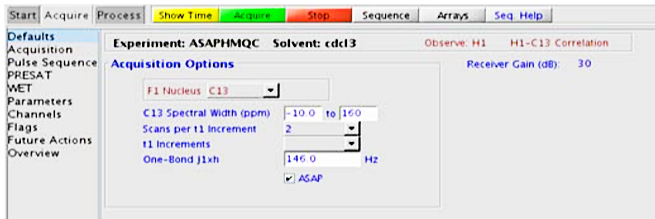
ASAPHMQC : H → C, 1-Bond Correlation
Two dimensional heteronuclear multiple-quantum 1-bond J-correlation spectroscopy with adiabatic 180o X-nuclei pulses and an “ASAP” feature for rapid recycle times.
With a reasonably concentrated sample, it is possible to obtain an ASAPHMQC spectrum with adequate resolution in about 1 minute.
During the short relaxation delay (d1), the ASAPHMQC employs a TOCSY-type magnetization transfer from 12C-attached protons to the observed 13C-attached protons.
Note that because of this transfer, the ASAPHMQC works best if one or several protons are in the neighborhood (i.e., spin system) of the observed 13C-1H pair.
This is a great experiment to use for quick Carbon survey of molecules.

Slide 36
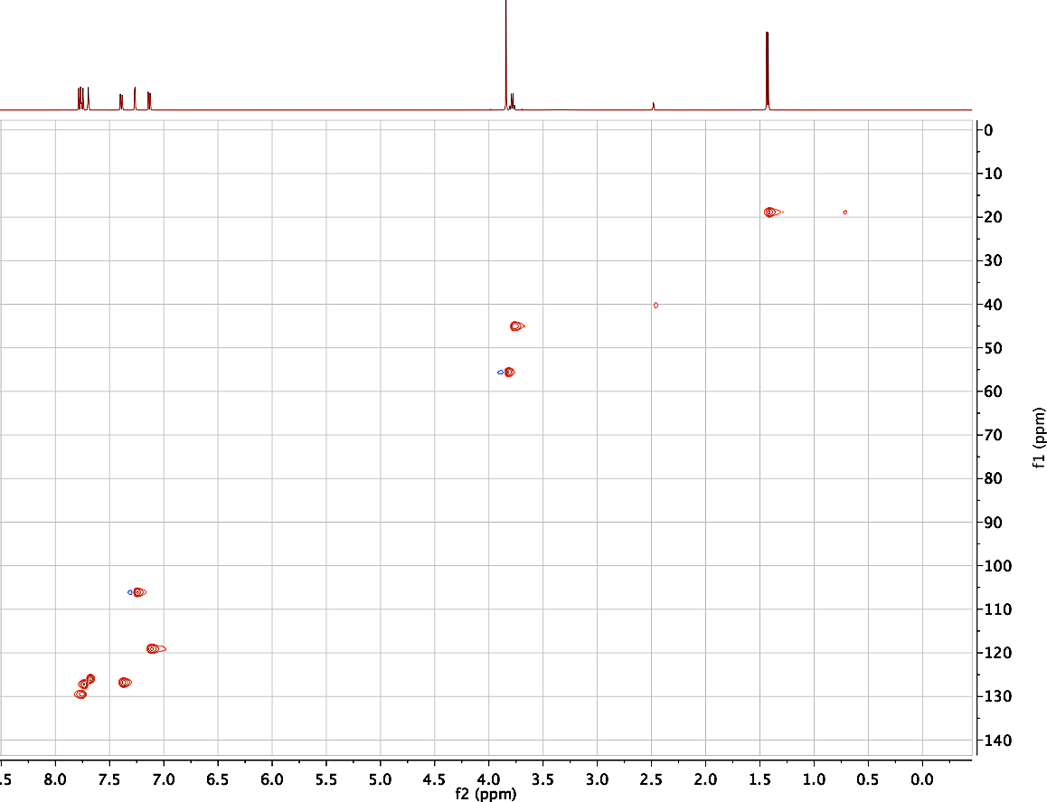
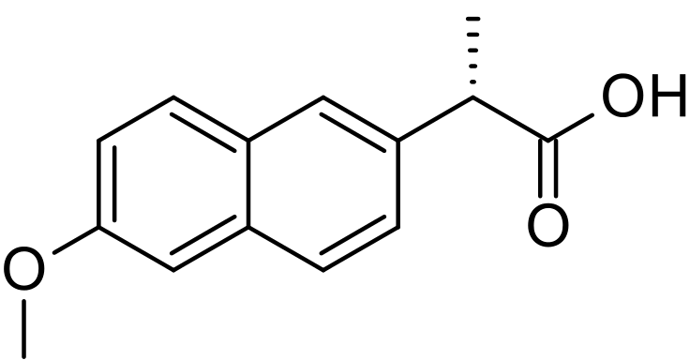
ASAPHMQC : H → C, 1-Bond Correlation
Naproxene
30 mg/ 1mL DMSO-d6
Number of scans = 8
Experimental time = 3mins
CIC500 NMR
NUS option is available

Slide 37
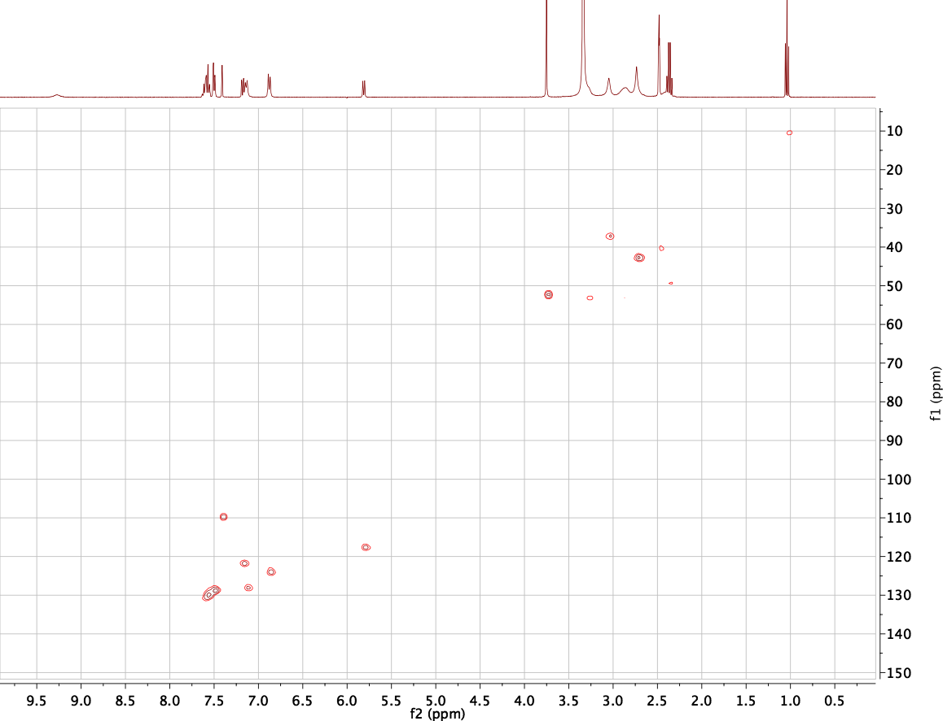
ASAPHMQC : H → C, 1-Bond Correlation
Random compound
12 mg/ 0.7mL DMSO-d6
Number of scans = 16
Experimental time = 7mins
CIC400 NMR

Slide 38
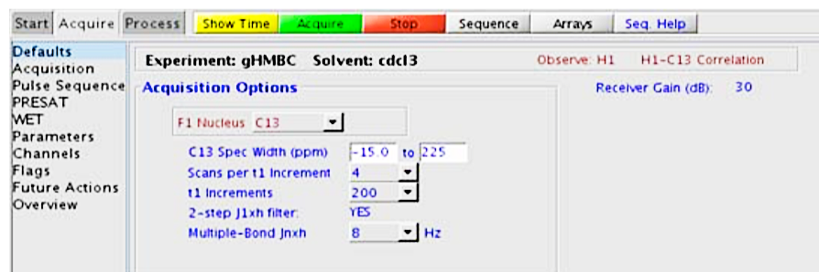
gHMBC : H → C, 2 to 3-Bond Correlation
The gHMBC experiment is used to acquire a 2-dimensional spectrum to correlate protons with carbons, usually over 2-3 bonds with the 3-bond correlations typically being stronger.
The gHMBC (or HMBC) experiment is also one of the most sensitive ways to obtain information about quaternary carbon chemical shifts and connectivities.
Use at least 8 scans per increment for most sample concentrations. Use more (32 or more scans) for more dilute samples.
NUS option is available for shorter experimental times.
If your molecule doesn’t have very strong signals, try running the HMBC (non gradient) experiment for more sensitivity.

Slide 39
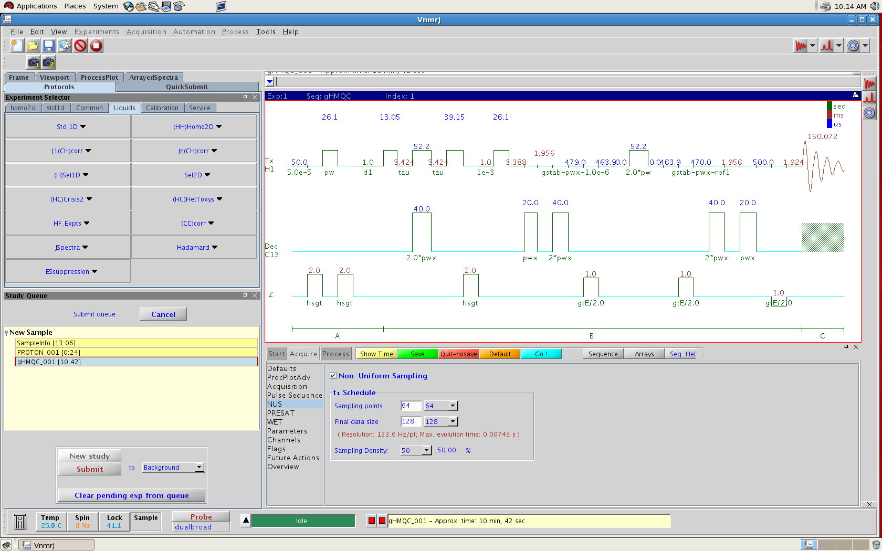
NUS: Non Uniform Sampling
Shortens experiment times of some 2D experiments

Slide 40
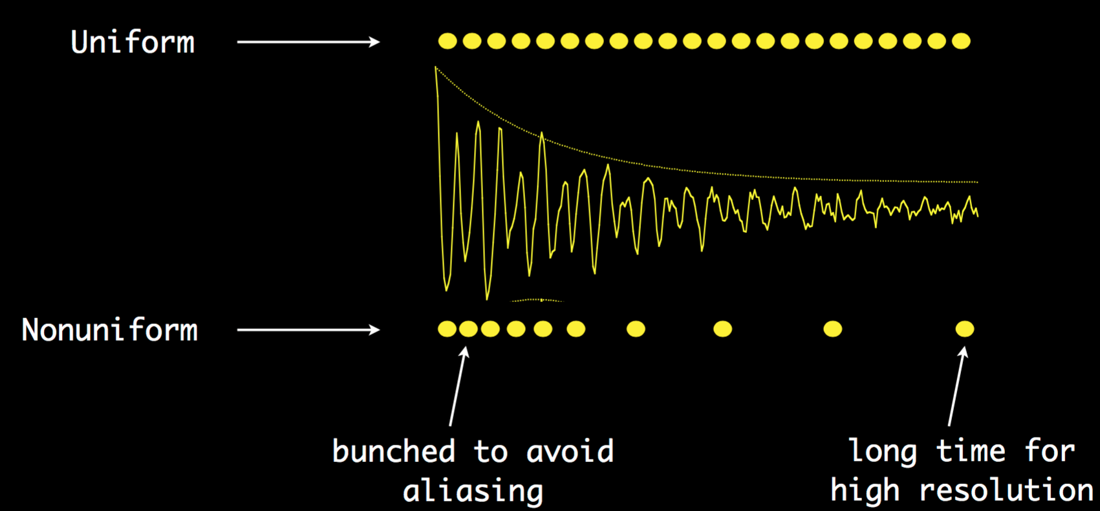
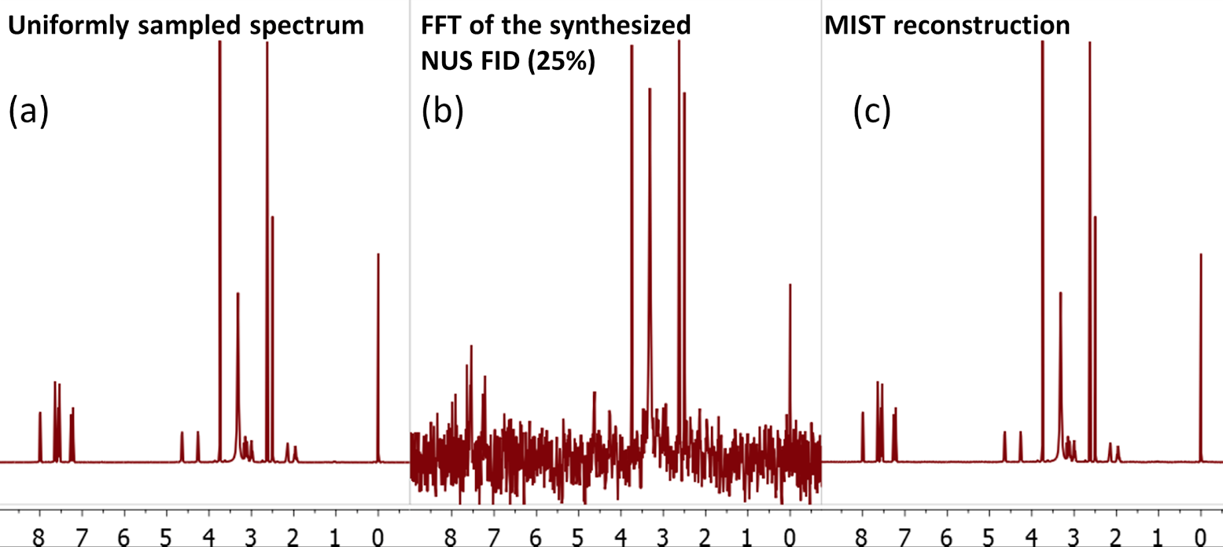
NUS: Non Uniform Sampling
With NUS, only a subset of the usual linearly sampled data is recorded, according to a user-definable sampling schedule
A conventional Fourier Transform of a NUS dataset does not yield a useable spectrum; special processing techniques are needed to reconstruct the spectrum from the raw data.

Slide 41
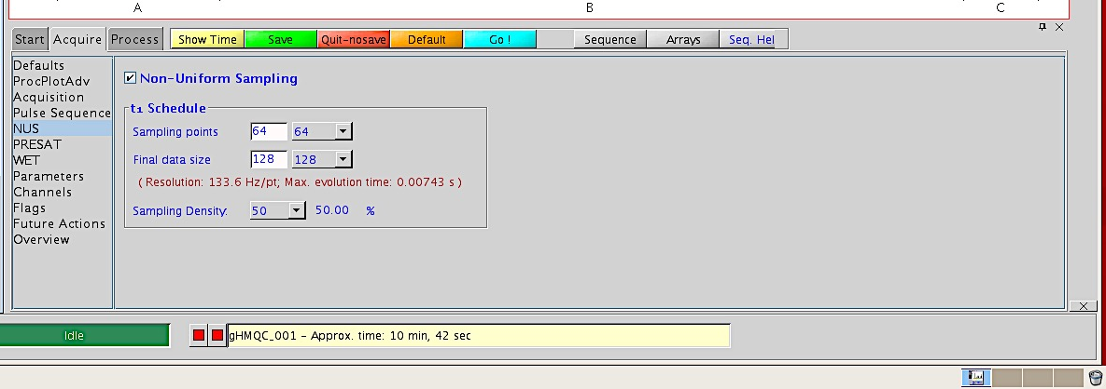
NUS: Non Uniform Sampling
Make sure that t1 increments is at least 128. For dilute samples increase t1 increments
Set sampling density to at least 50%
Data can be processed in MNOVA version 10 only

Slide 42
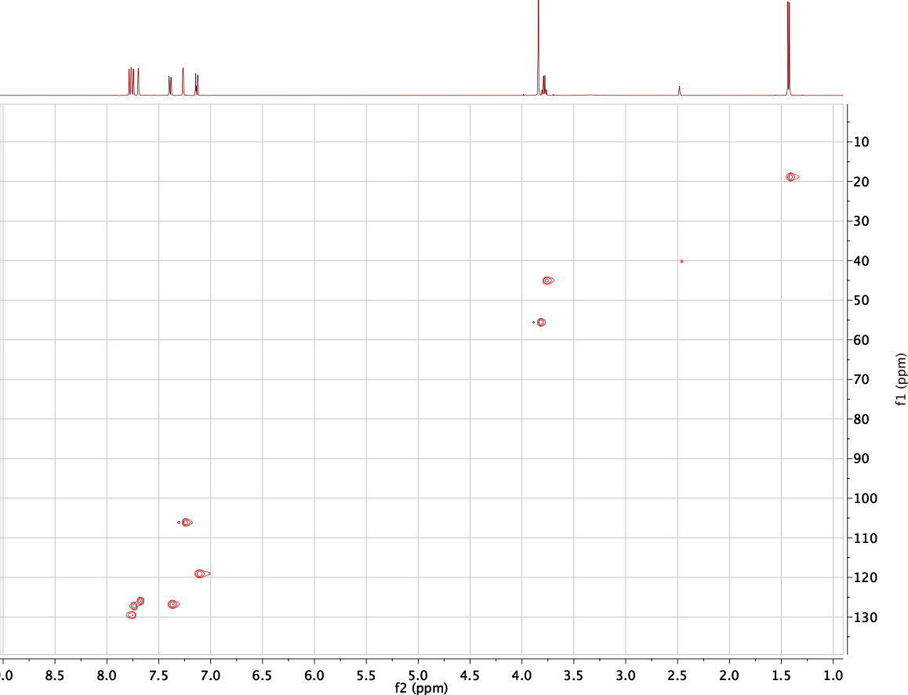
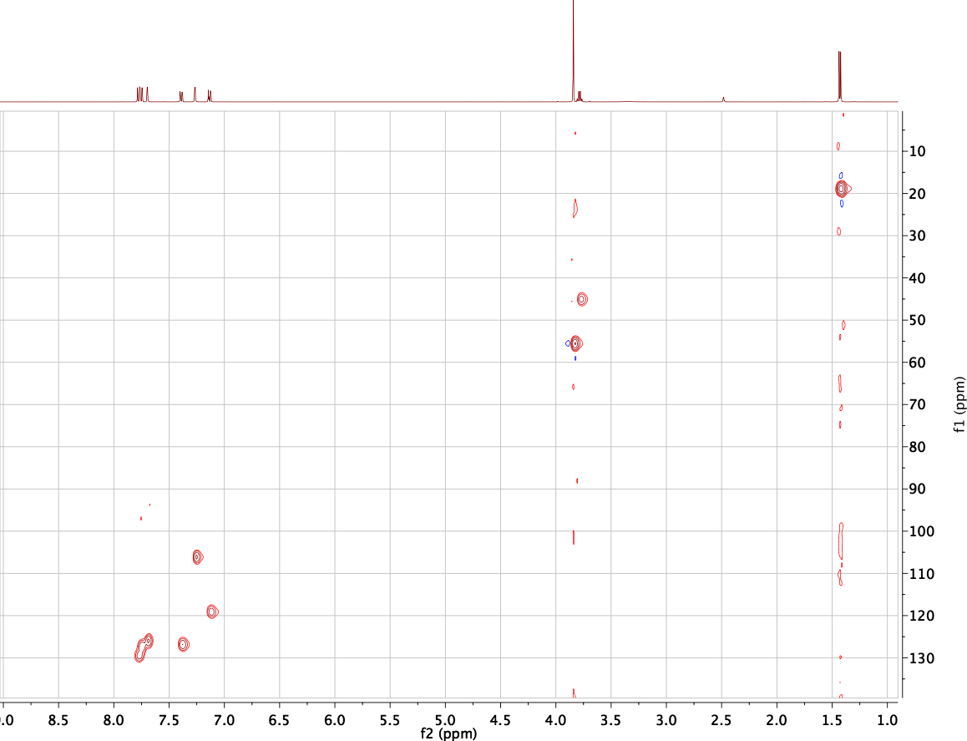
NUS: Non Uniform Sampling
Number of scans 4, t1 increments 128, NUS sampling points 64, final data size is 128 on the CIC 500, 30mg sample – naproxene in dmso-d6
Data processed in MNOVA
(disclaimer by MNOVA: Presently, NUS algorithm implemented in Mnova 9.0 supports HSQC and HMBC experiments, both magnitude and phase sensitive. We have also found good results with COSY spectra. We have also tried it successfully with some NOESY/ROESY experiments although we have to warn that with a few of them the performance has not been so good)
Regular HMQC
HMQC with NUS
Experimental time =20 mins
Experimental time =10 mins

Slide 43
How Many Scans Should I Collect?
You should collect enough scans until the signal-to-noise ratio is adequate for your needs.
For long Experiments like Carbon and 2D-heteronuclear experiments, tune the probe first – this ensures maximum sensitivity.
The signal -to-noise ratio increases as the square root of the number of scans. In order to double the signal-to-noise ratio in a particular spectrum one must collect 4 times as many scans as were collected in the original spectrum.
Experiment | T1 increments for 2D | Time | 400 MHz | 500 Mhz
1H |  | >30sec | > 5 mMol | >5 mMol
13C |  | >15 mins | > 25 mMol | >20 mMol
COSY | >256 | >10 mins | >20 mMol | >20 mMol
HSQC/HMQC | >128 | >1 hours | > 20 mMol | > 25 mMol
HMBC | >128 | >1 hours | > 20 mMol | > 25 mMol
NOESY/ROESY | >128 | >1 hour | > 20 mMol | > 20 mMol
Recommended concentrations and experimental time for optimal signal to noise.

Slide 44
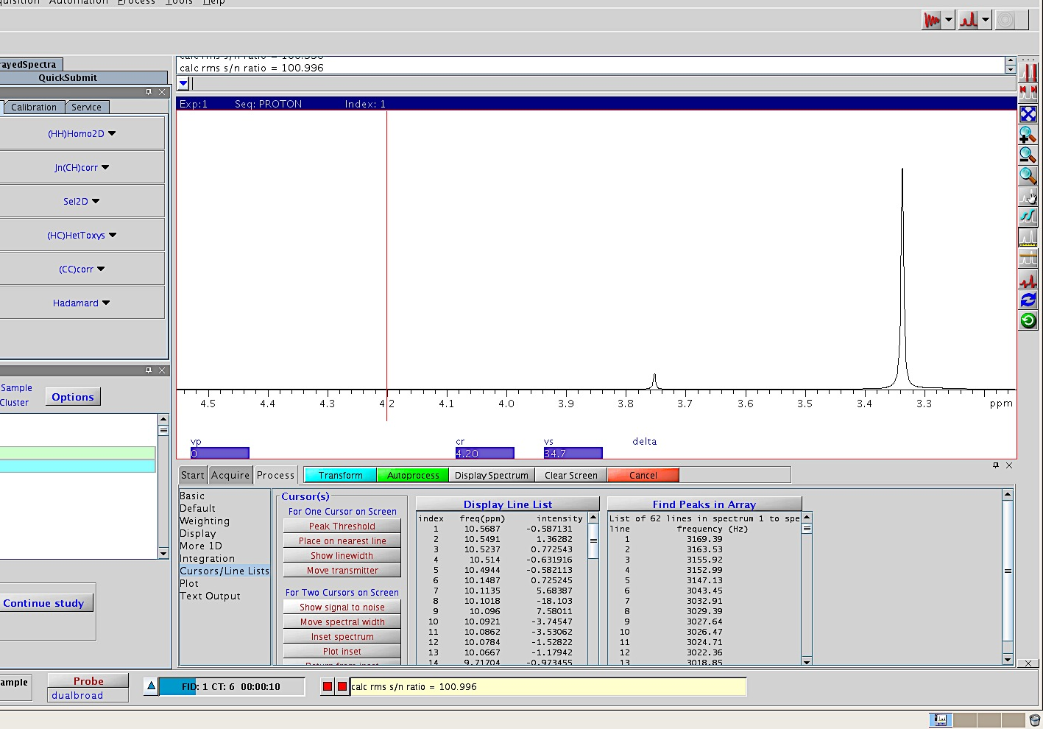
How Many Scans Should I Collect?
Measuring signal to noise

Slide 45
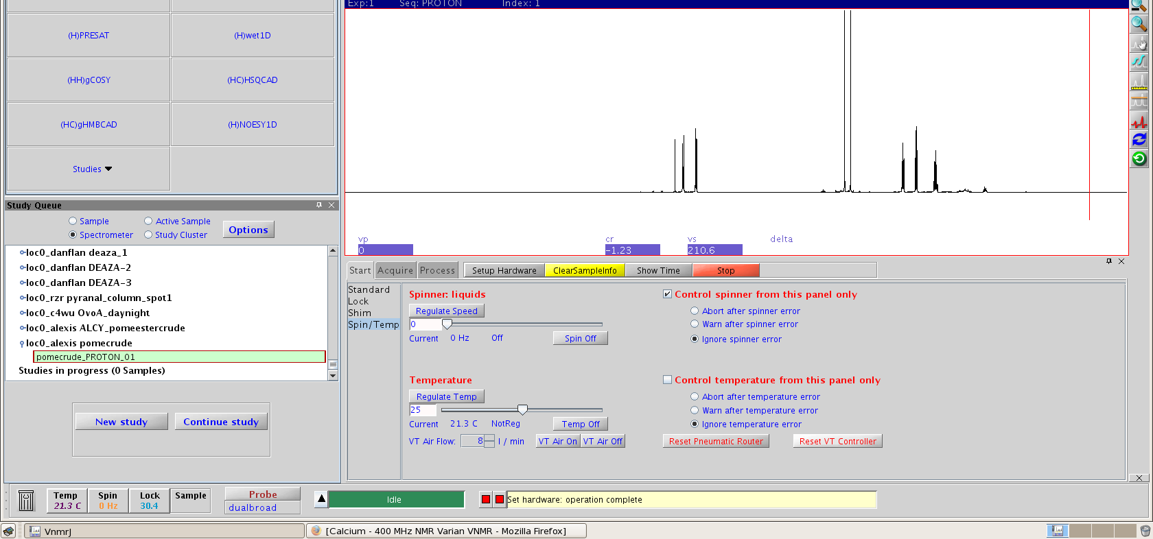
Running VT Experiments
Short Expts (<30 mins), 10º – 65ºC
Longer Experiments or higher or lower temps will need Nitrogen!!!
Why?
Danger of oxidizing the probe coils
Repairs can cost >$2000
Instrument downtime
Start > Spin/Temp tab
Click Reset VT controller
Click Reset Pneumatic Router
Enter desired temp and click Regulate Temp
After end of Experiment bring temp back down to 25ºC
Can not use in Automation
If temperature won’t regulate, contact me!!

Slide 46
Summary
SAMPLE PREPARATION IS KEY !!
Good shimming and maximum lock level without saturating the lock signal.
  Good knowledge of basic line shapes can help you
Plan your NMR experiments well: What experiments will give the right answers
Ask for help and do not guess your way around

