Slide 1
Chapter 13:
The Economics of the Environment

Slide 2
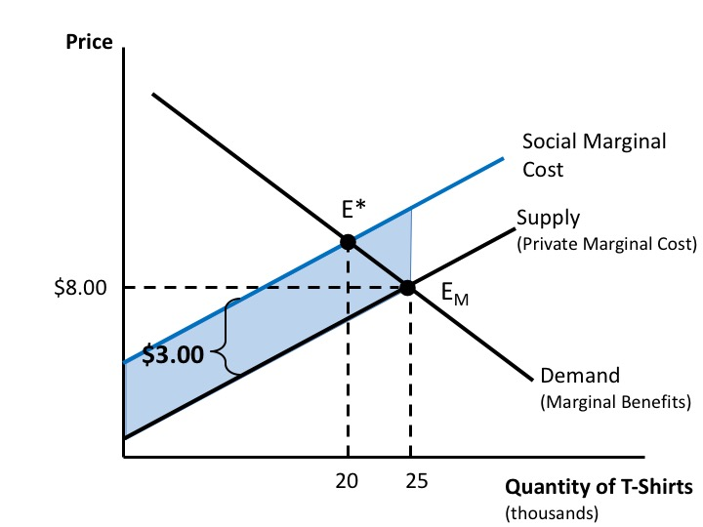
Figure 13.1 The Negative Externalities of T-Shirt Production

Slide 3
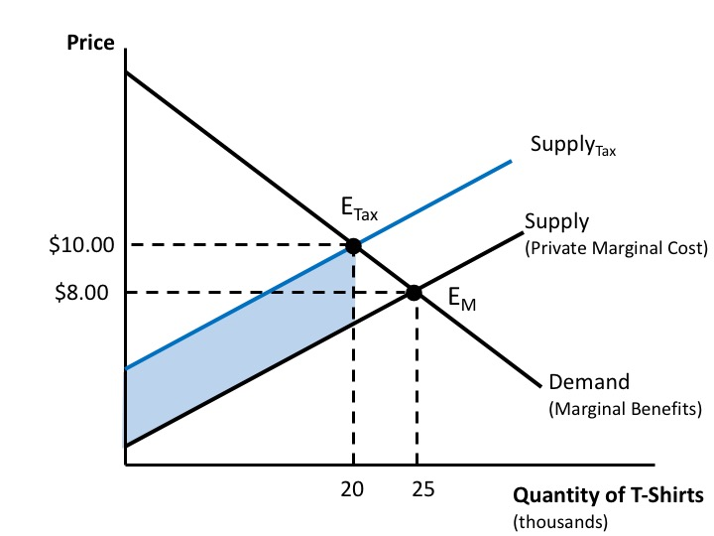
Figure 13.2 Internalizing a Negative Externality with a Pigovian Tax

Slide 4
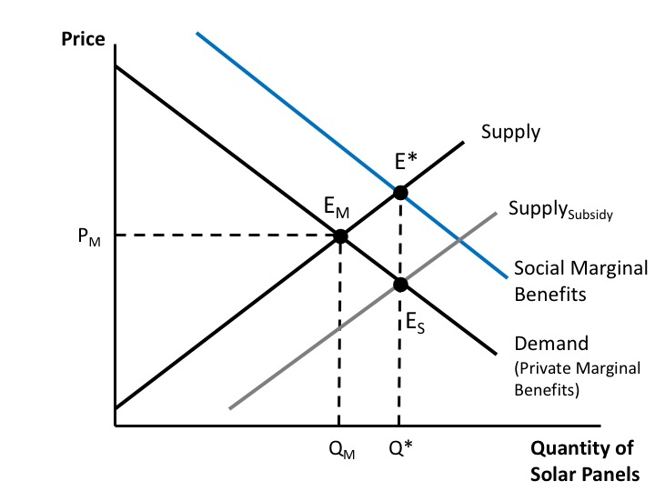
Figure 13.3 Analysis of a Positive Externality

Slide 5
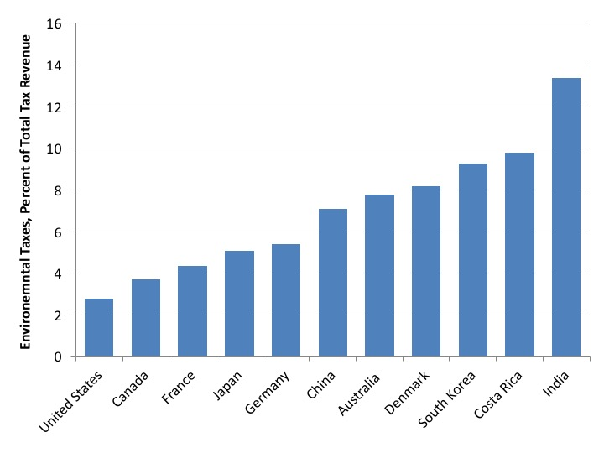
Figure 13.4 Environmental Taxes as a Percentage of Total Tax Revenue, Select Countries, 2014
Source: OECD, Environmental Taxation, http://www.oecd.org/env/toolsevaluation/environmentaltaxation.htm.

Slide 6
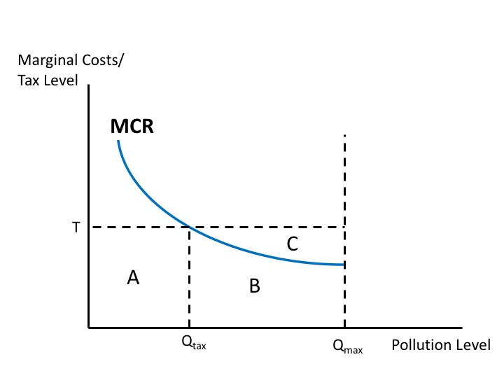
Figure 13.5 A Firm’s Response to a Pollution Tax

Slide 7
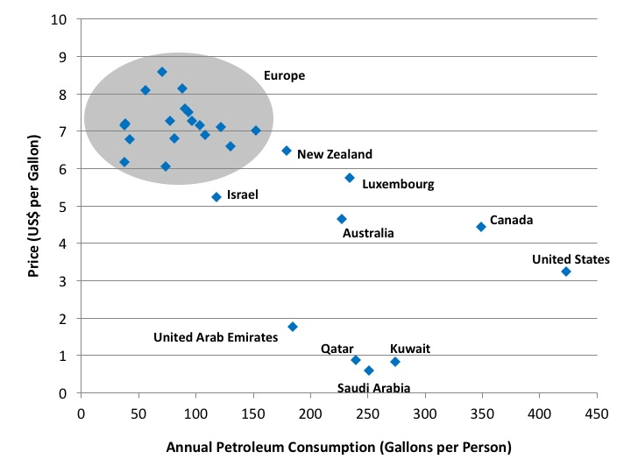
Figure 13.6 Gasoline Prices and Consumption, Select Development Countries, 2014
Source: GIZ, 2014; GlobalPetrolPrices.com, “Gasoline Consumption per Capita around the World,” August 4, 2016, http://www.globalpetrolprices.com/articles/52/.

Slide 8
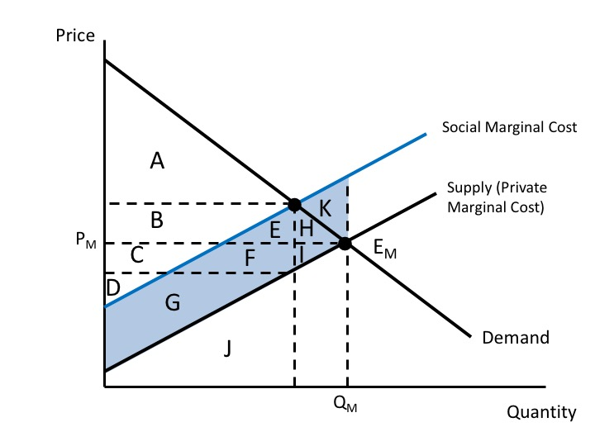
Figure 13.7 Welfare Analysis of a Negative Externality, Without a Pigovian Tax

Slide 9
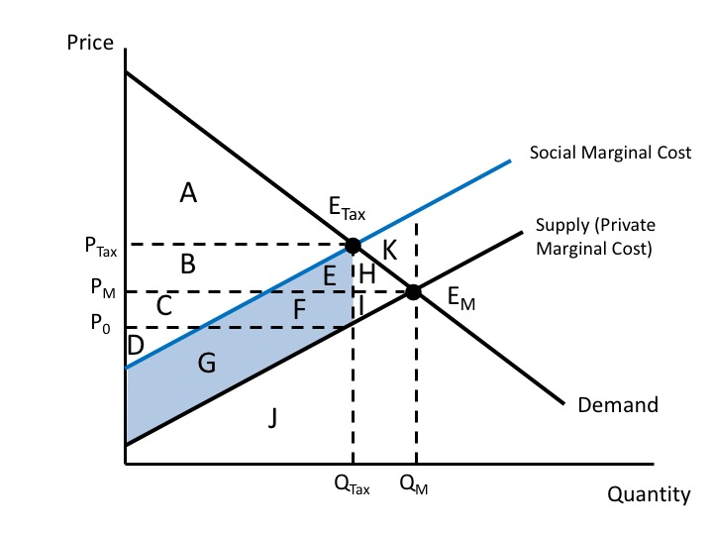
Figure 13.8 Welfare Analysis of a Negative Externality, With a Pigovian Tax

