Slide 1
Chapter 6:
Welfare Analysis

Slide 2
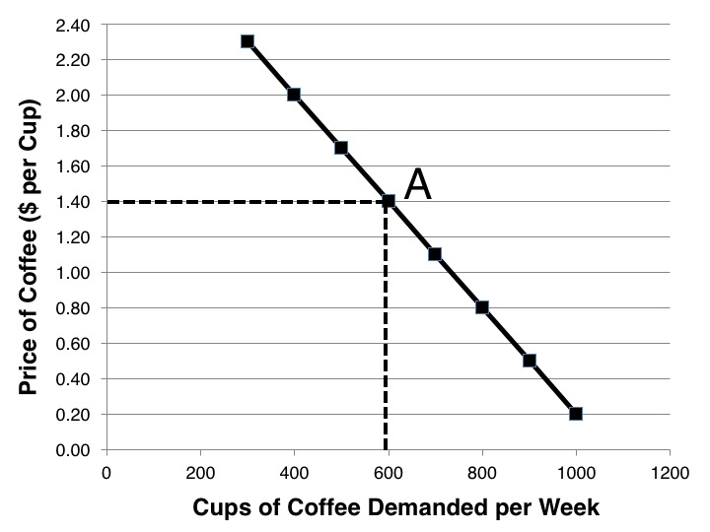
Figure 6.1 Demand Curve for Cups of Coffee

Slide 3
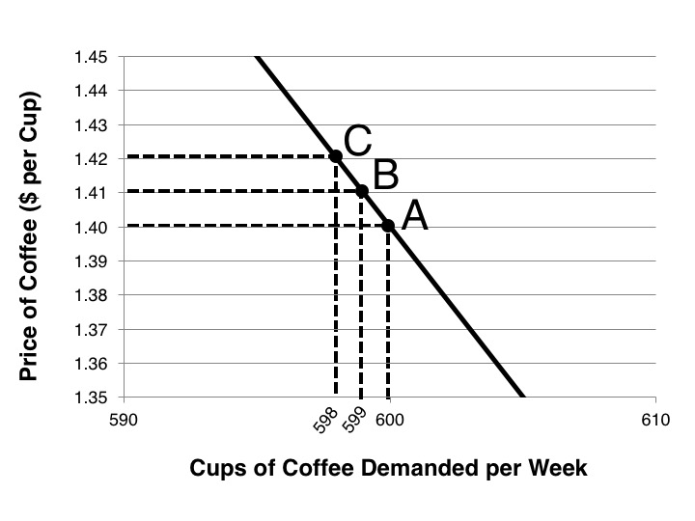
Figure 6.2 Detailed Demand Curve for Cups of Coffee

Slide 4
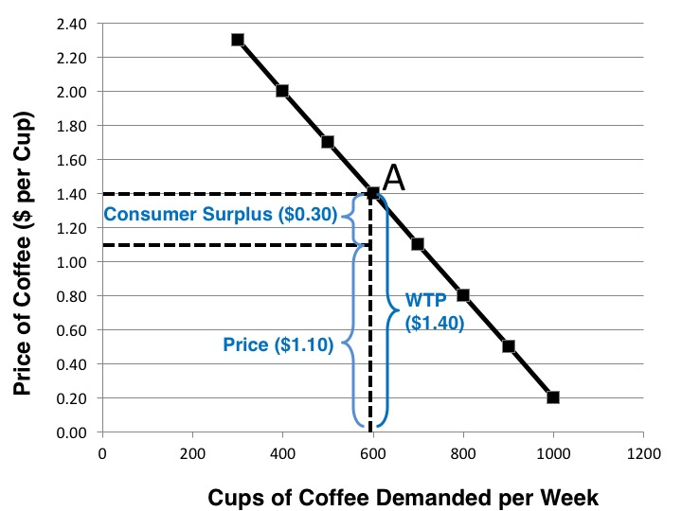
Figure 6.3 Consumer Surplus and a Demand Curve

Slide 5
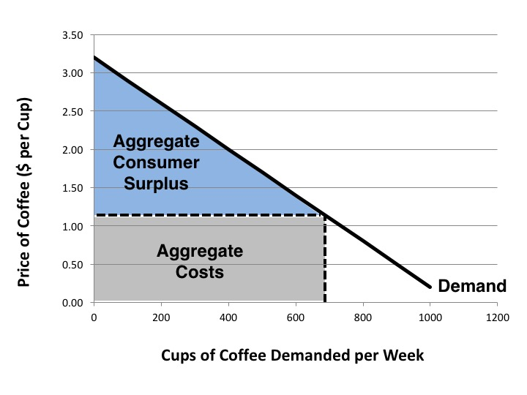
Figure 6.4 Market Consumer Surplus

Slide 6
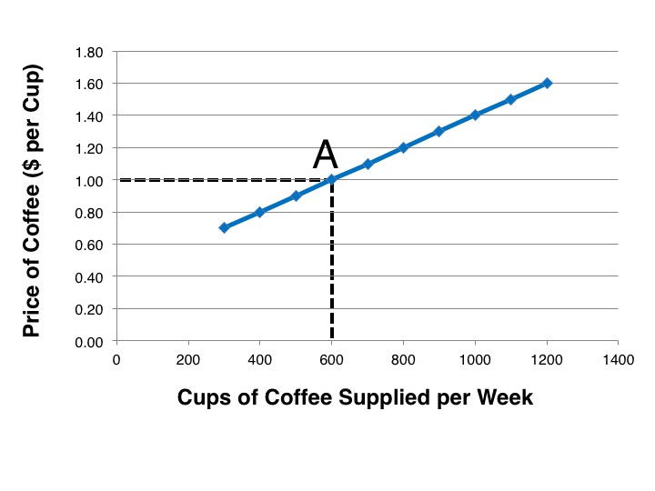
Figure 6.5 Supply Curve for Cups of Coffee

Slide 7
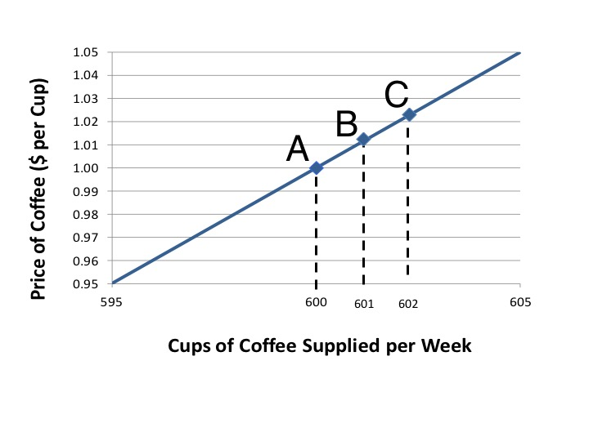
Figure 6.6 Detailed Supply Curve for Cups of Coffee

Slide 8
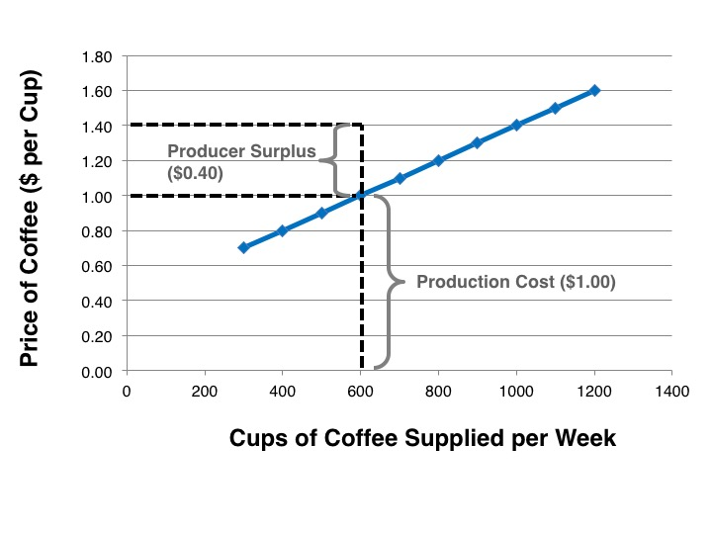
Figure 6.7 Producer Surplus and a Supply Curve

Slide 9
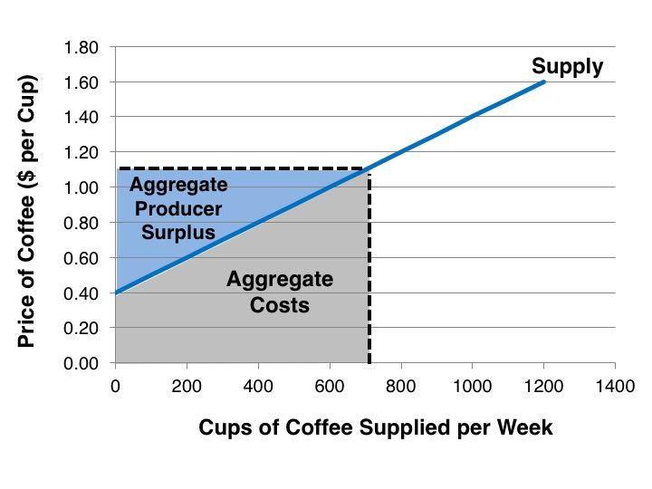
Figure 6.8 Market Producer Surplus

Slide 10
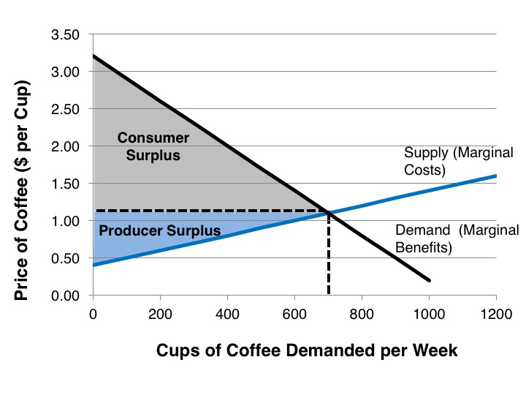
Figure 6.9 Social Welfare at Market Equilibrium

Slide 11
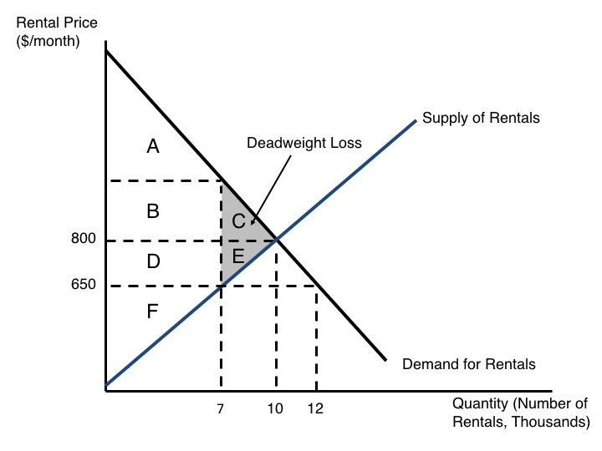
Figure 6.10 Welfare Analysis of a Price Ceiling

Slide 12
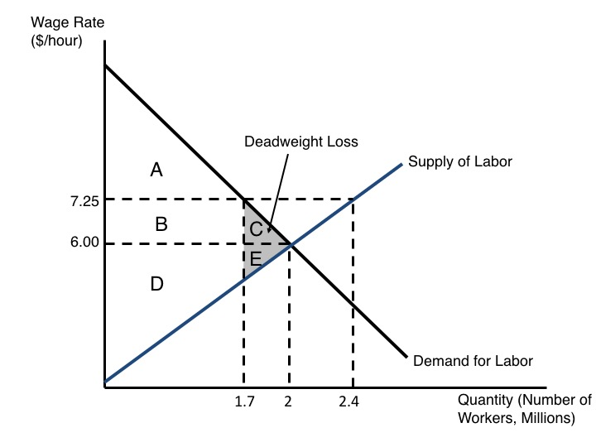
Figure 6.11 Welfare Analysis of a Price Floor

