Slide 1
Chapter 3
Supply and Demand

Slide 2
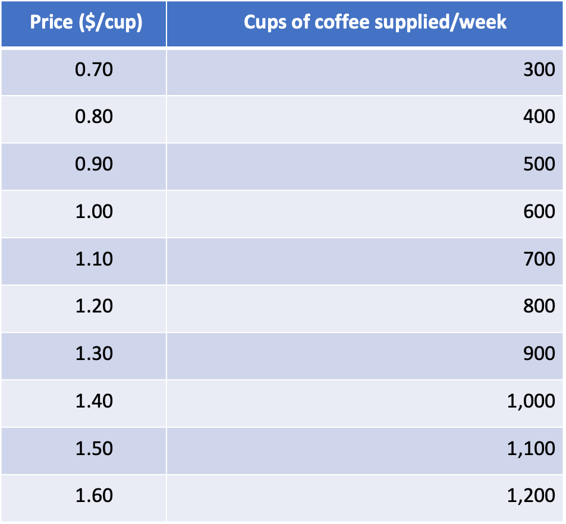
Table 3.1: A Supply Schedule for Coffee

Slide 3
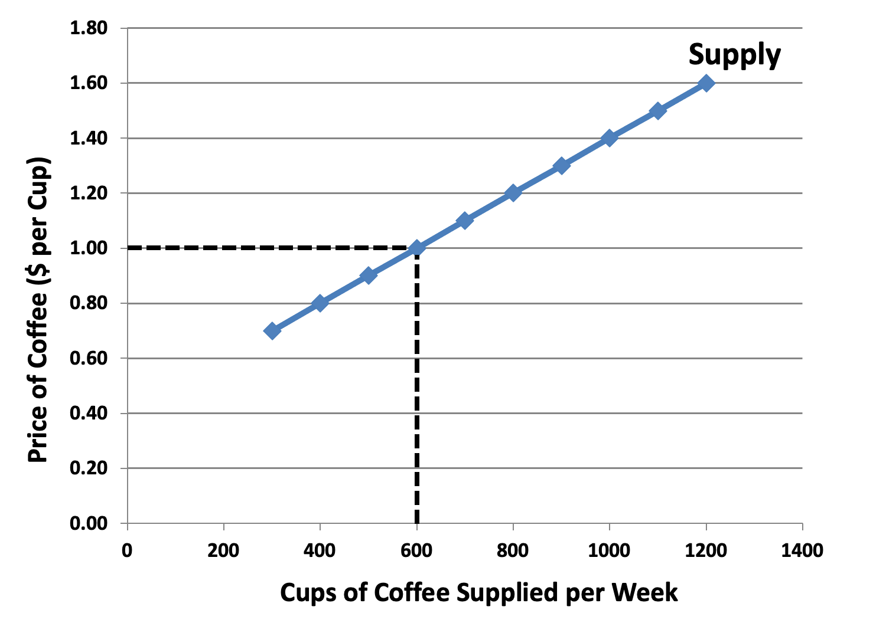
Figure 3.1: The Supply Curve for Cups of Coffee

Slide 4
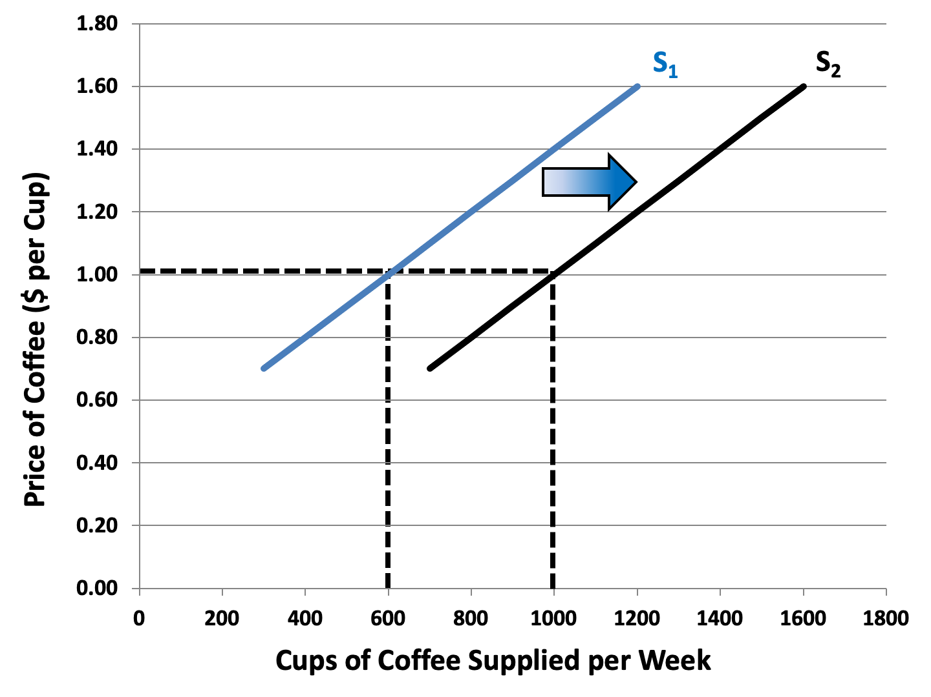
Figure 3.2: An Increase in Supply

Slide 5
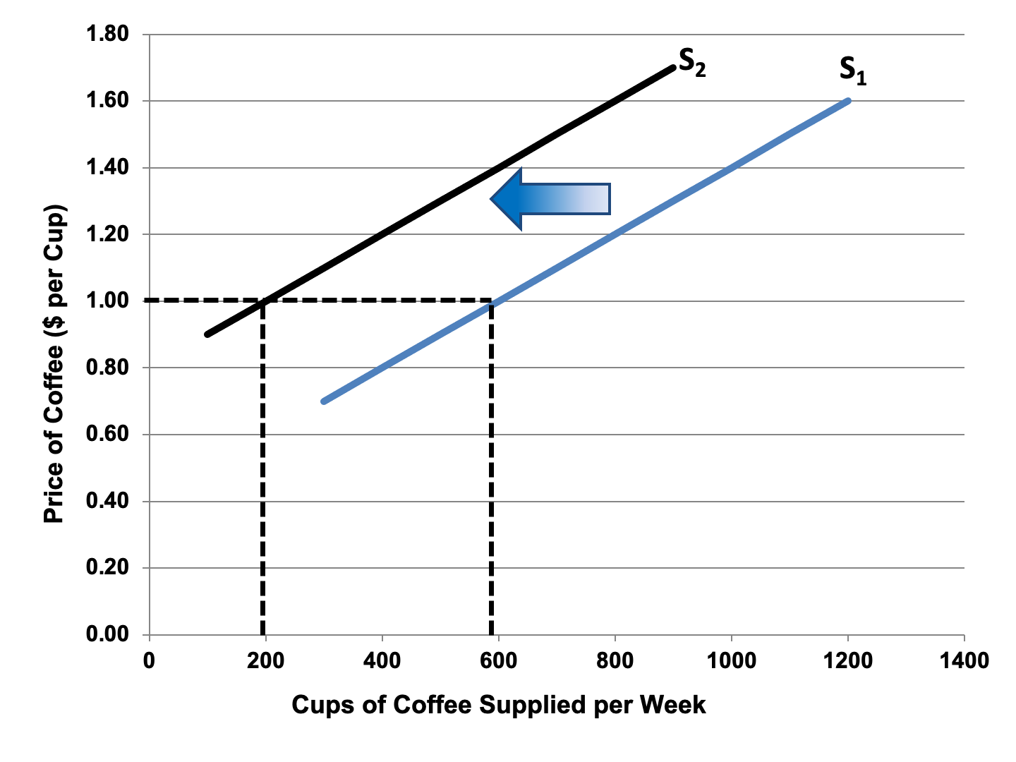
Figure 3.3: A Decrease in Supply

Slide 6
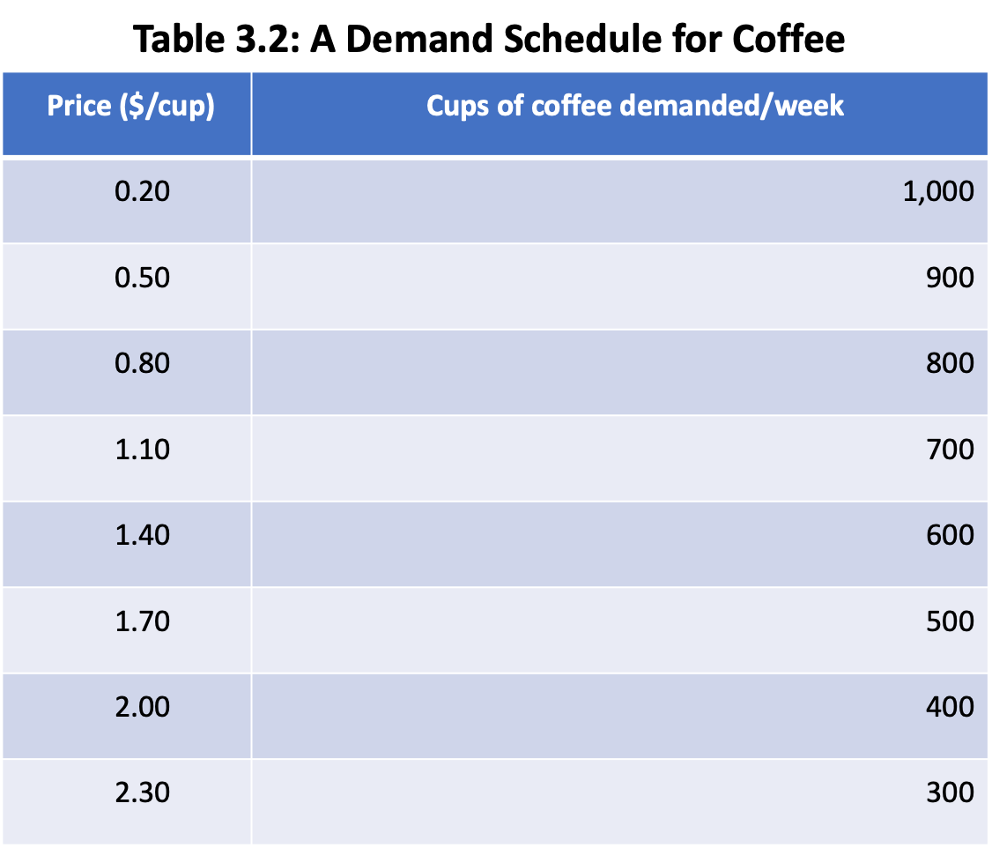

Slide 7
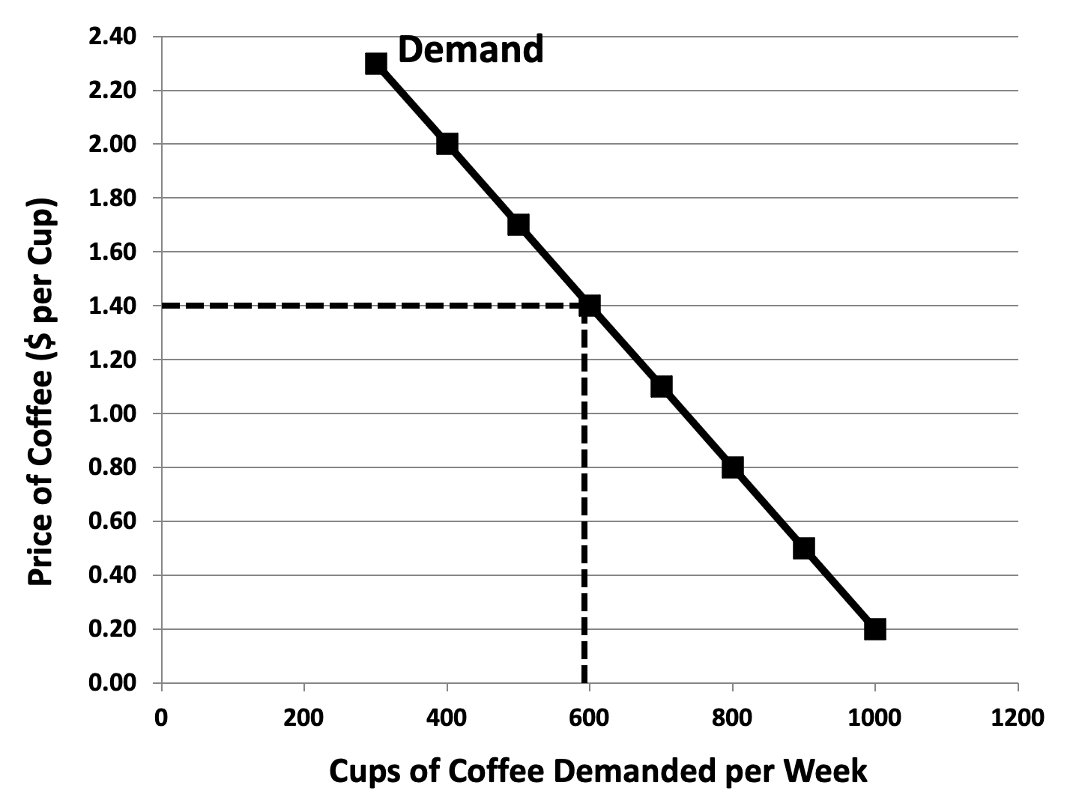
Figure 3.4: The Demand Curve for Cups of Coffee

Slide 8
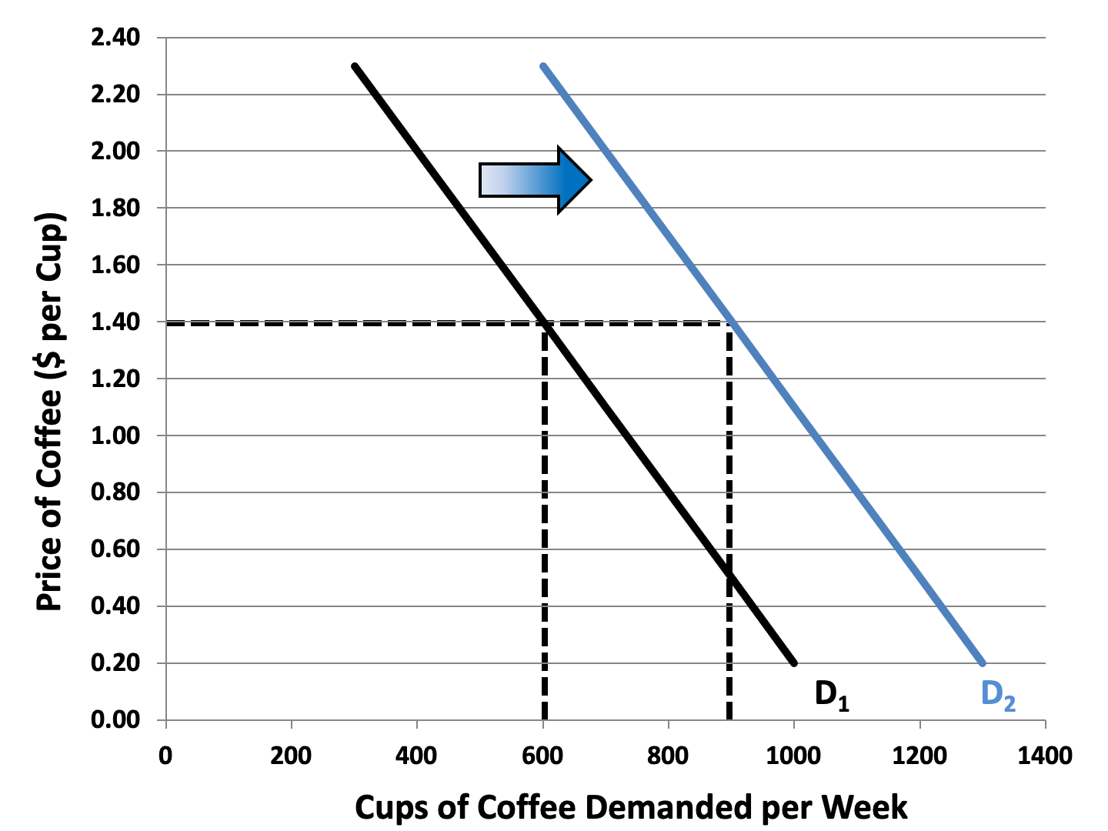
Figure 3.5: An Increase in Demand

Slide 9
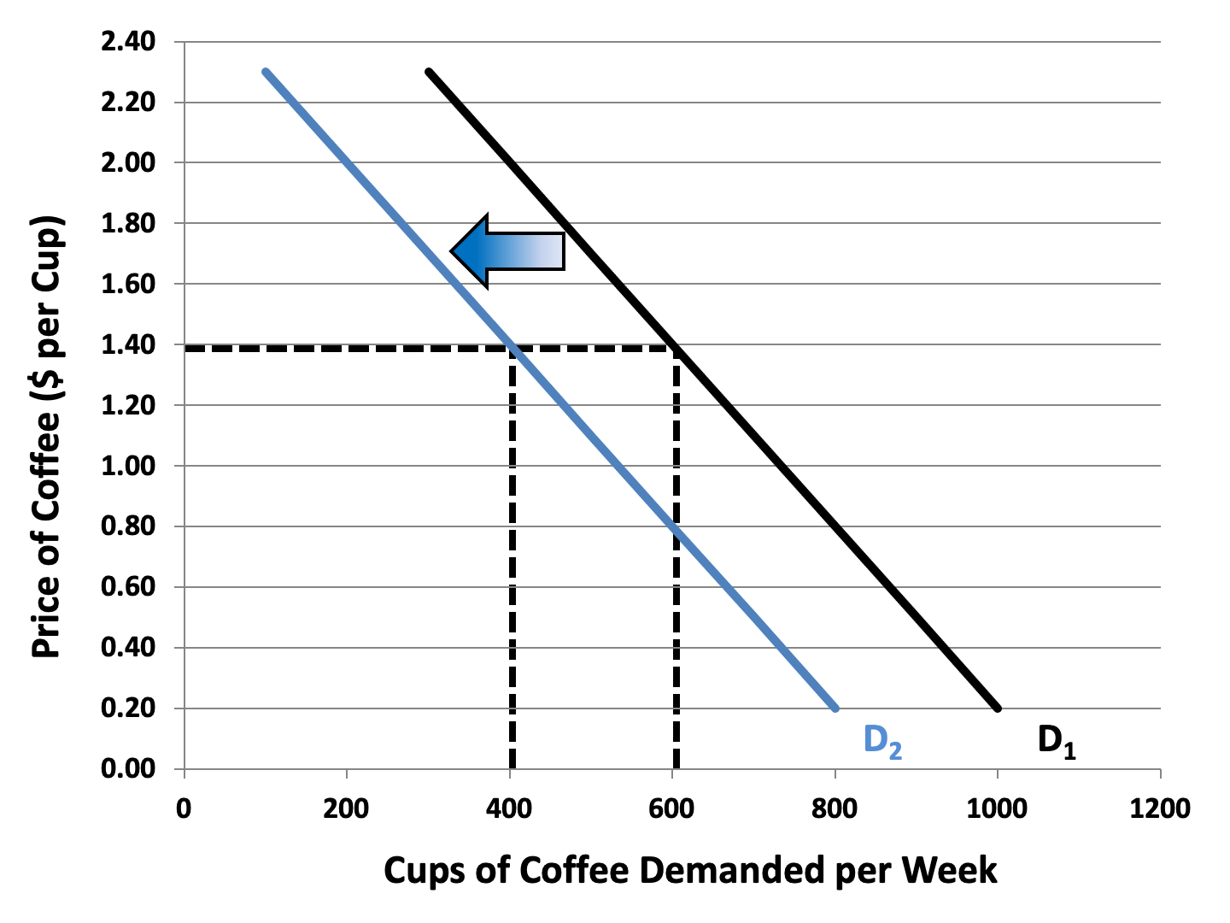
Figure 3.6: A Decrease in Demand

Slide 10
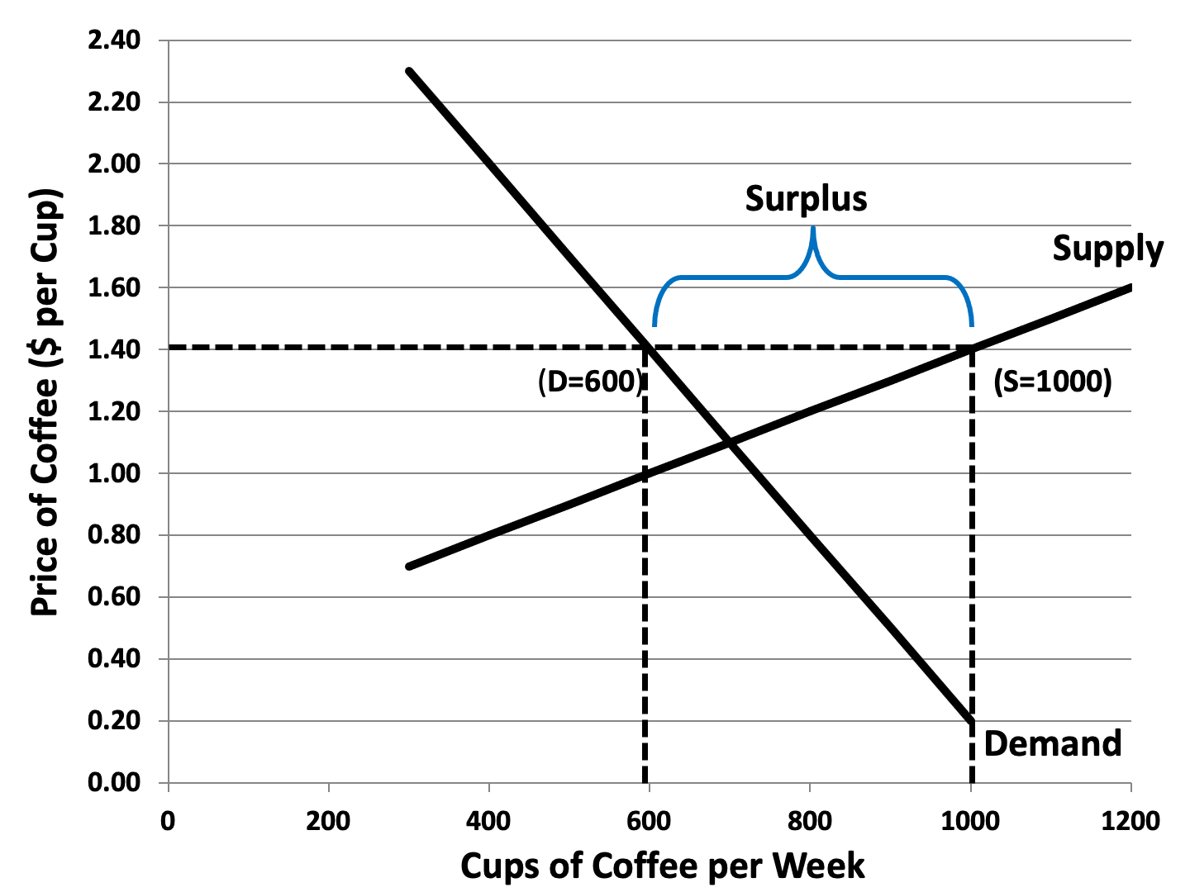
Figure 3.7: A Market Surplus

Slide 11
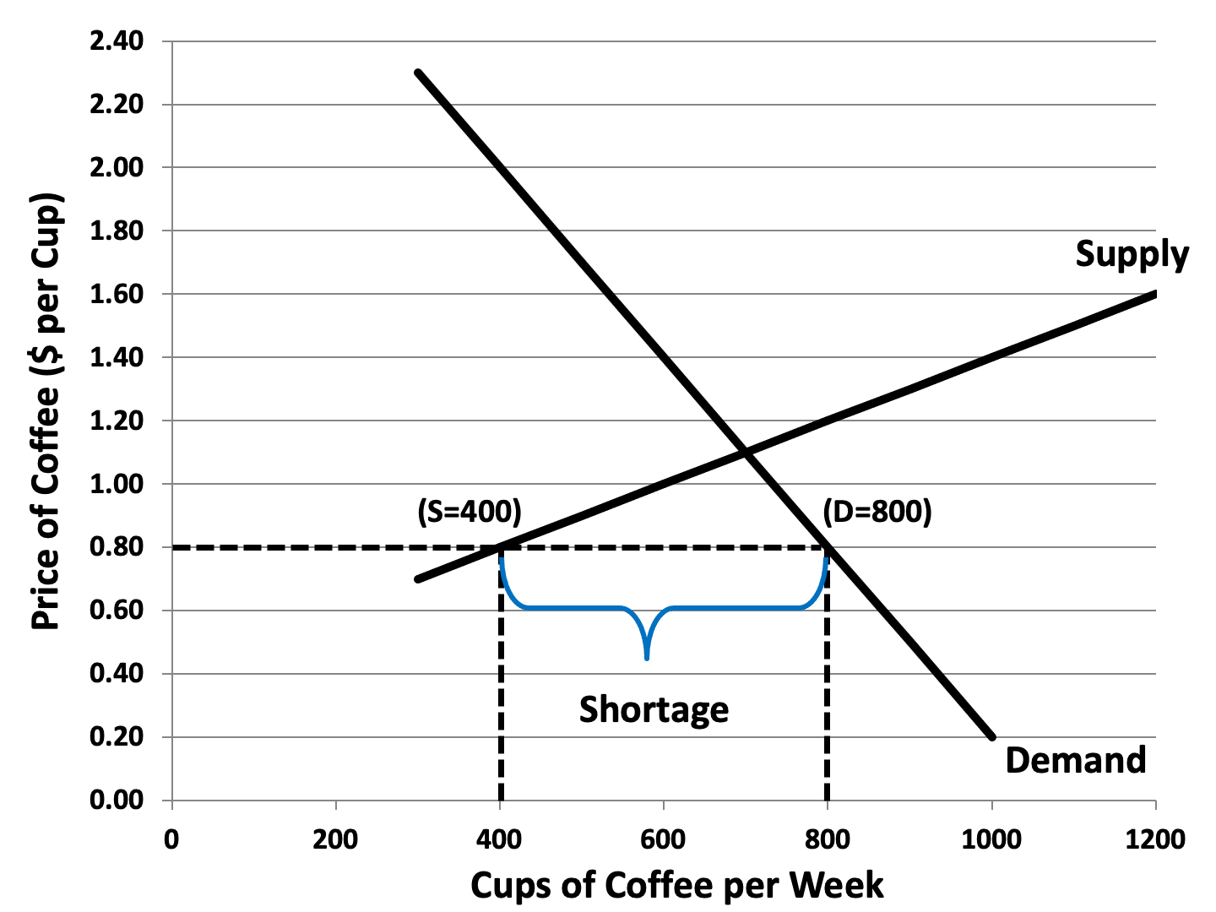
Figure 3.8: A Market Shortage

Slide 12
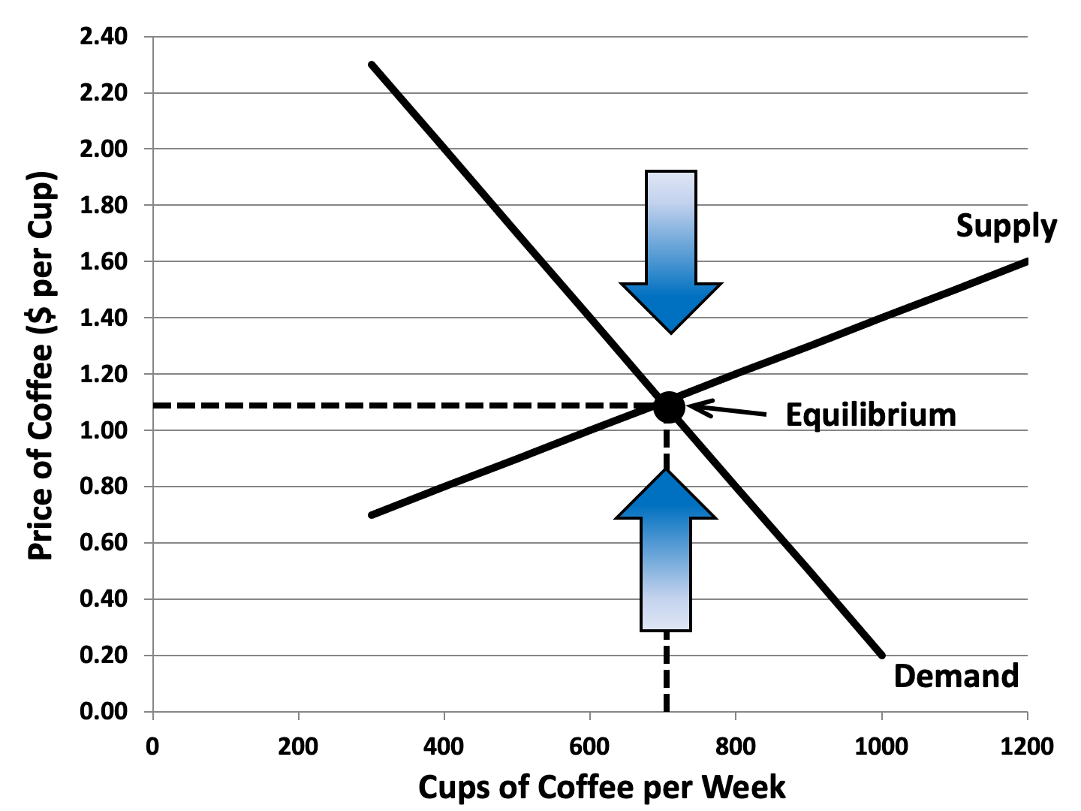
Figure 3.9: Market Equilibrium

Slide 13
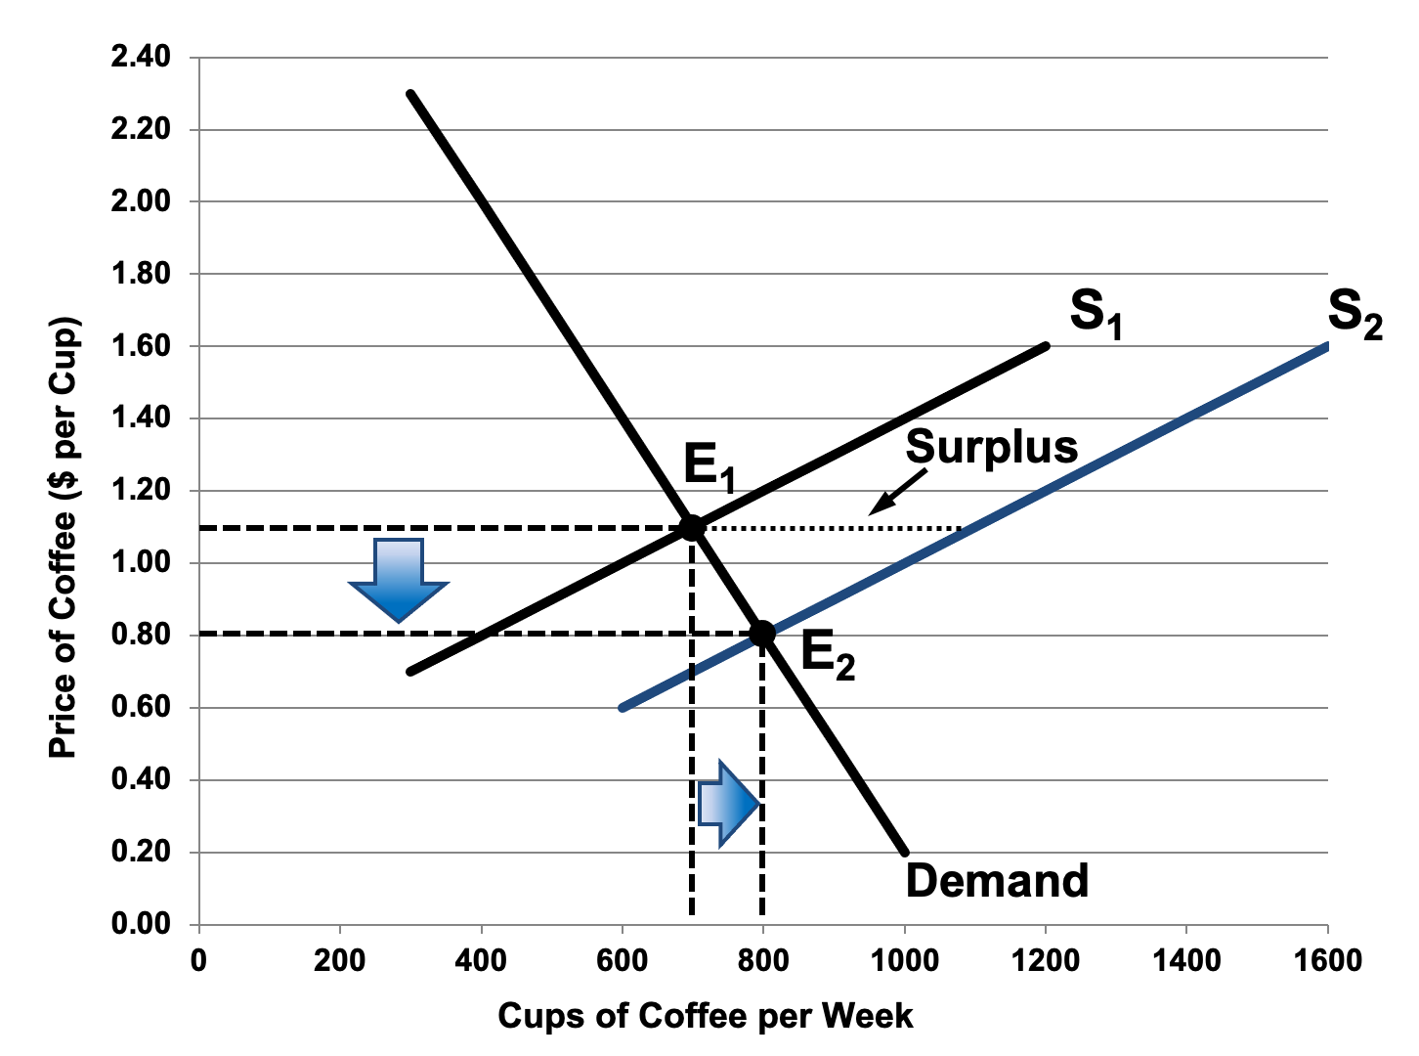
Figure 3.10: Market Adjustment to an Increase in Supply

Slide 14
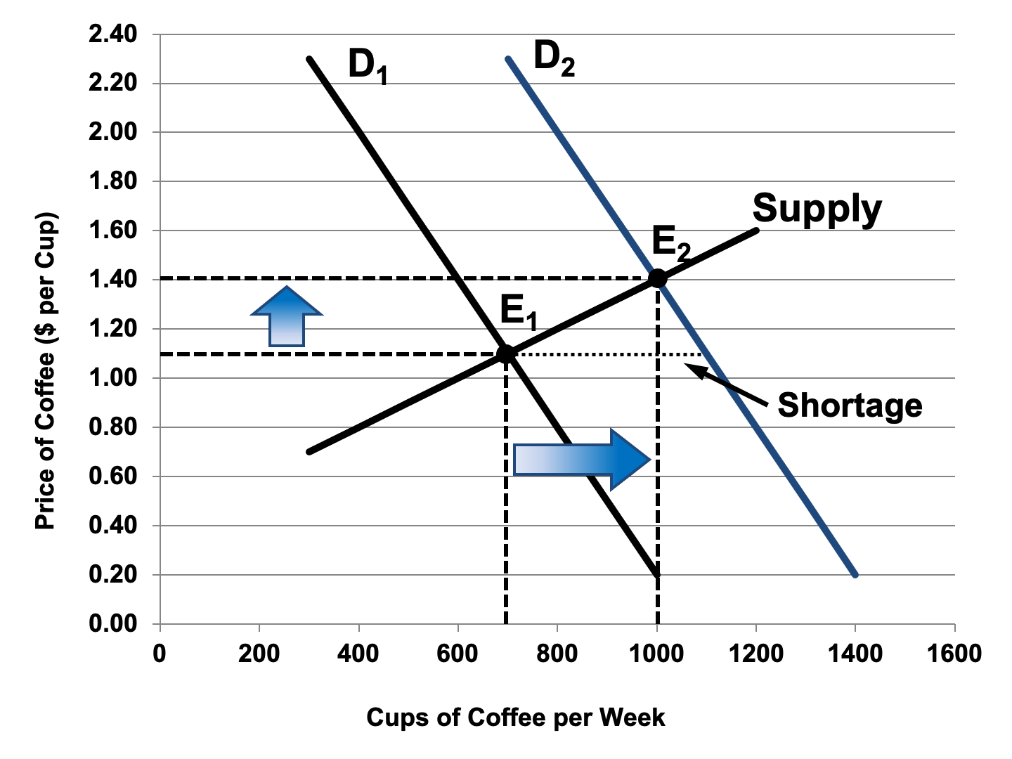
Figure 3.11: Market Adjustment to an Increase in Demand

Slide 16
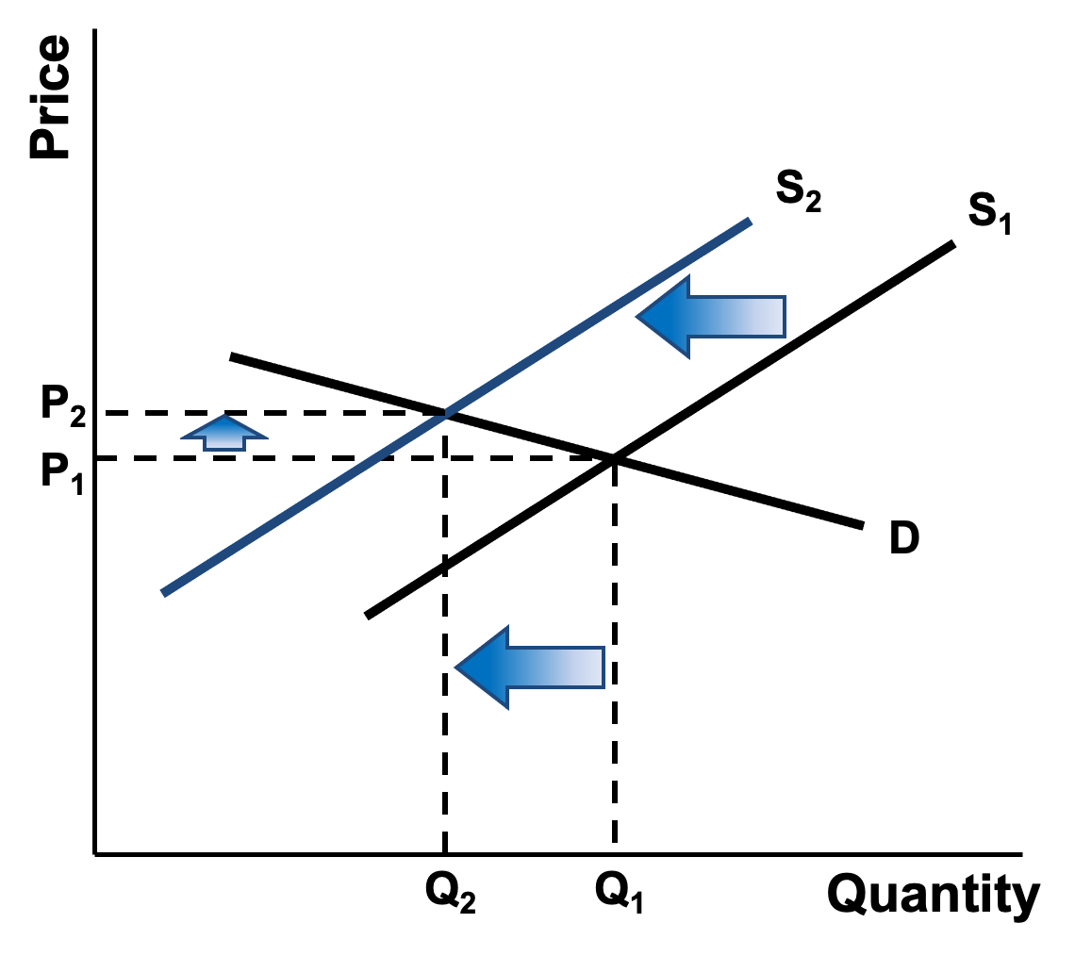
Figure 3.12a: Price Elasticity of Demand – Relatively Price Elastic Demand
Notes:
16

Slide 17
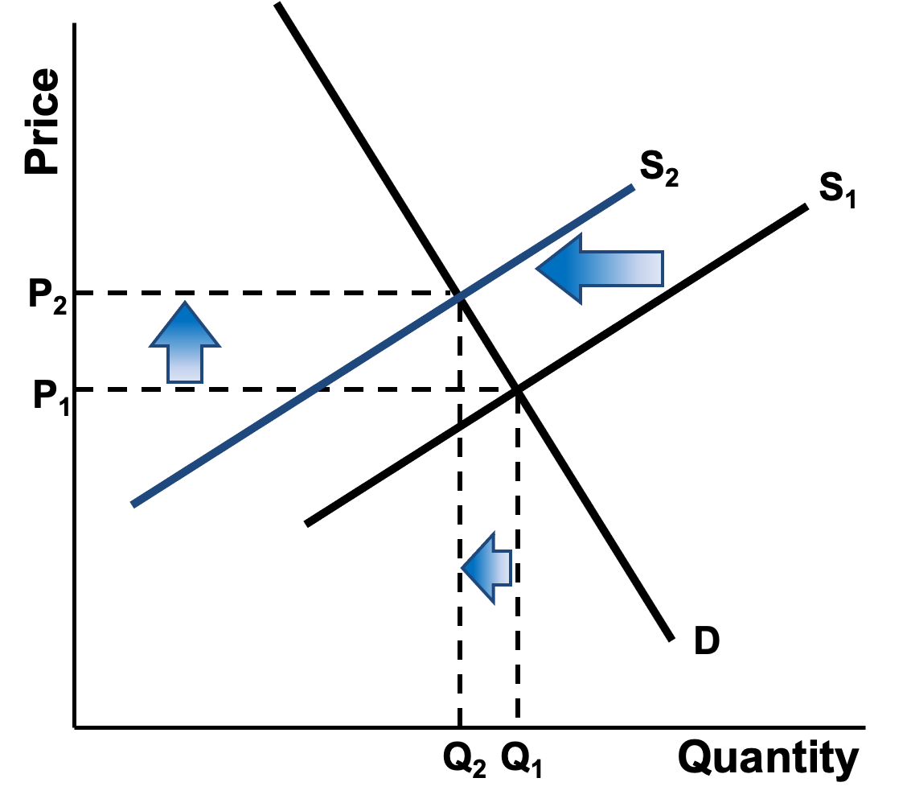
Figure 3.12b: Price Elasticity of Demand – Relatively Price Inelastic Demand

Slide 18
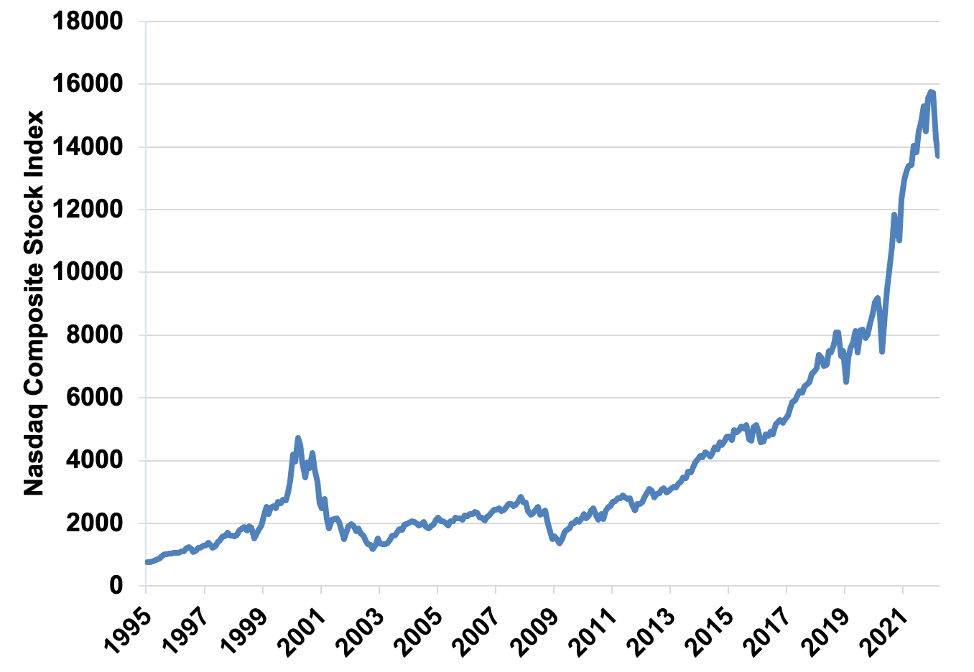
Figure 3.13 The Nasdaq Composite Index, 1995-2022
Source: Yahoo! Finance, Monthly data

