Slide 1

Chapter 0: Microeconomics and Well-Being

Slide 2
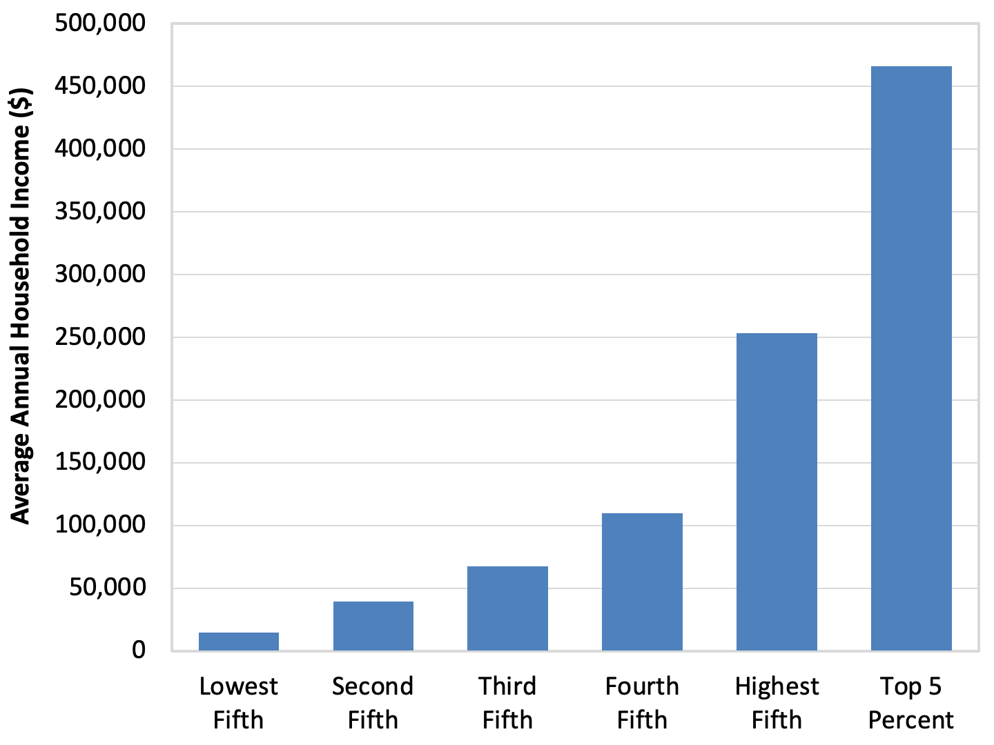
Figure 0.1: Economic Inequality
Source: Shrider, Emily A., Melissa Kollar, Frances Chen, and Jessica Semeg. 2021. Income and Poverty in the United States: 2020. U.S. Census Bureau, Current Population Report 60-273.

Slide 3
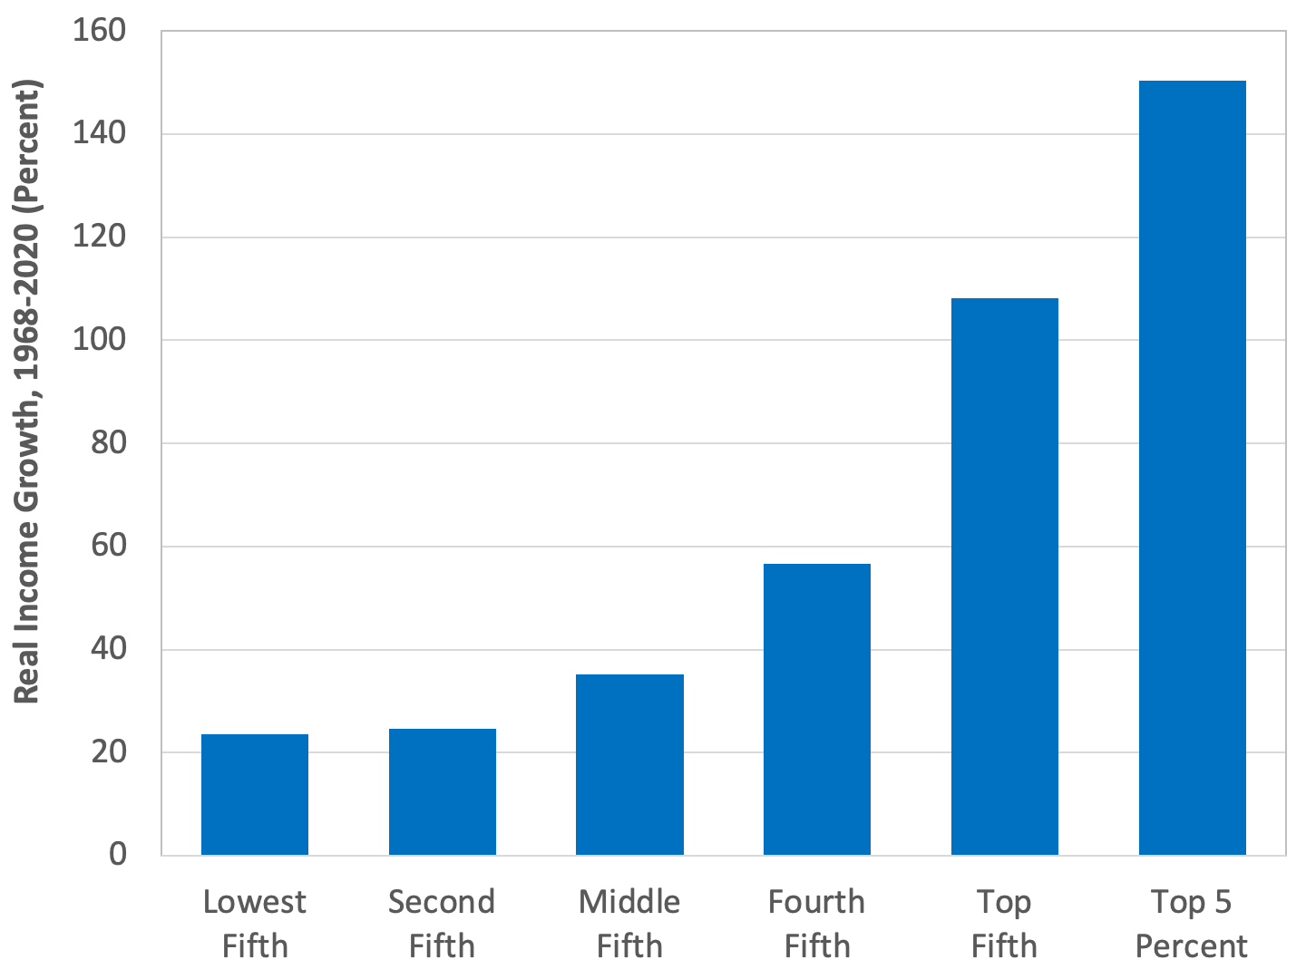
Figure 0.2: Unequal Income Growth
Source: Shrider, Emily A., Melissa Kollar, Frances Chen, and Jessica Semeg. 2021. Income and Poverty in the United States: 2020. U.S. Census Bureau, Current Population Report 60-273.
Note: We use 1968 as the starting year in this analysis because it is the year in which income inequality in the United States started to increase, as we will discuss in Chapter 10.

Slide 4
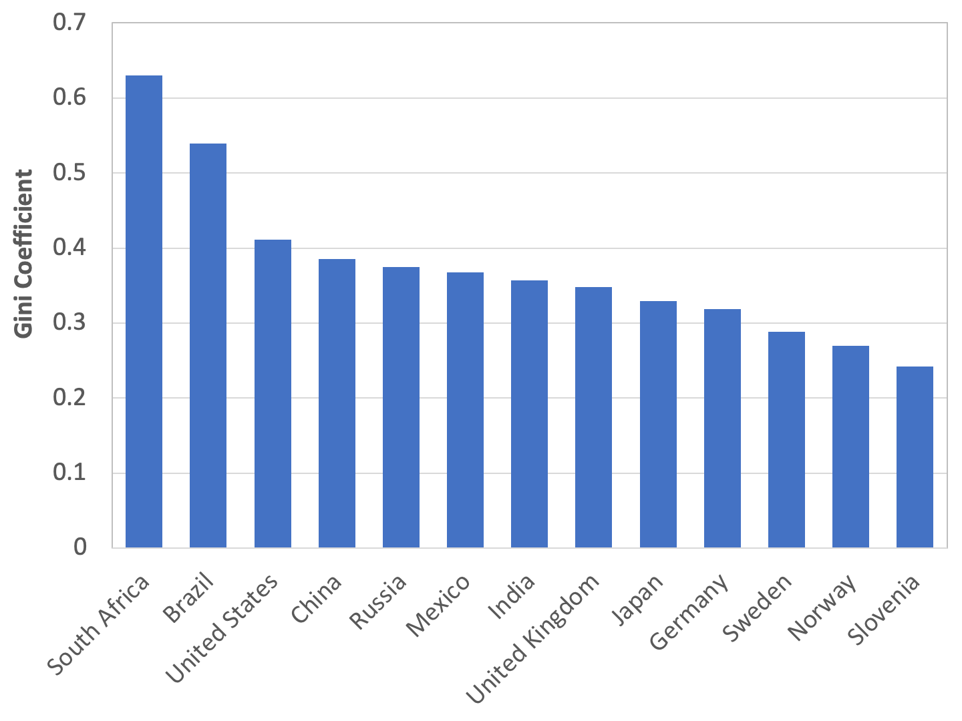
Figure 0.3: Economic Inequality – International Comparisons
Source: U.S. Central Intelligence Agency, CIA World Factbook. Note: Year of data varies.

Slide 5
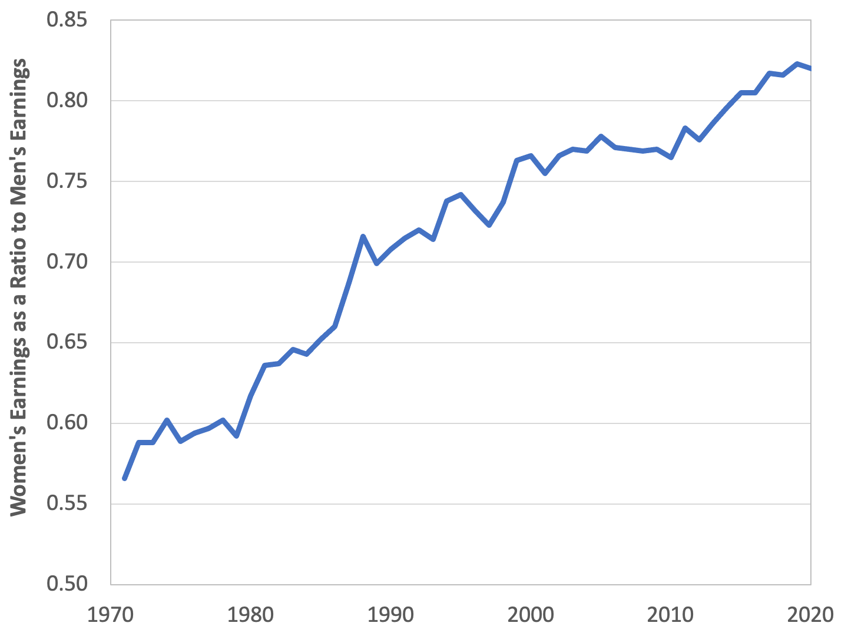
Figure 0.4: Gender-Based Earnings Inequality
Source: U.S. Census Bureau. 2021. Current Population Survey, Annual Social and Economic Supplement, Table A-7, March.

Slide 6
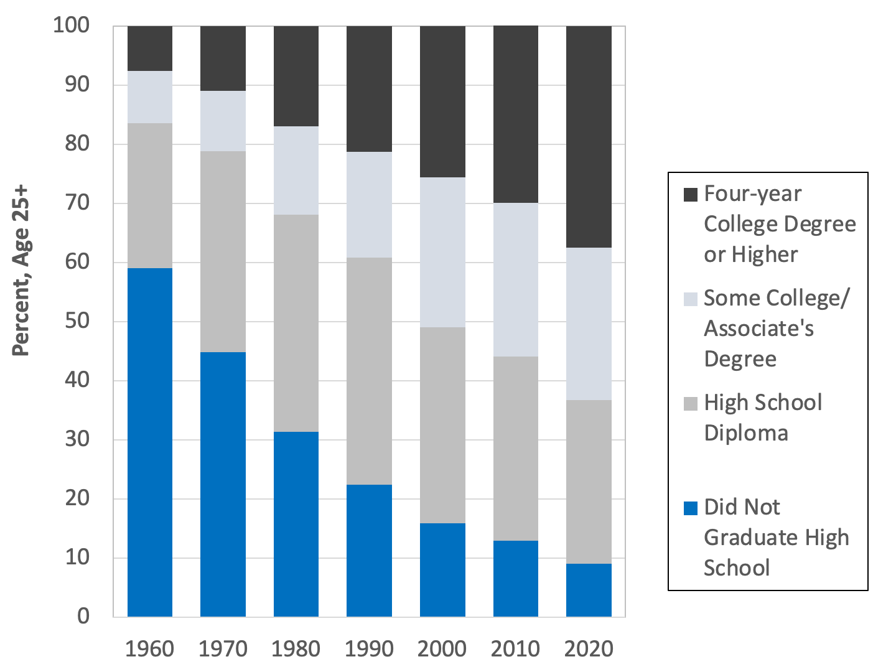
Figure 0.5: Educational Attainment
Source: U.S. Census Bureau. 2021. Educational Attainment Attainment in the United States: 2020, Table 1. April.

Slide 7
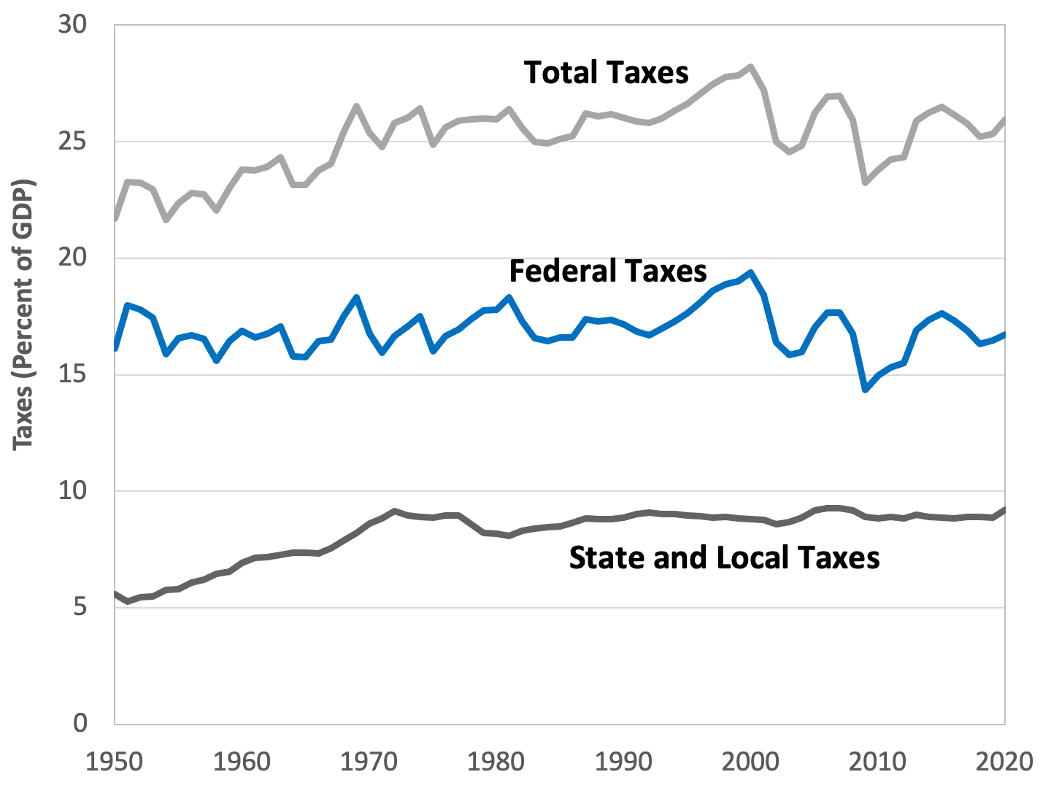
Figure 0.6: Taxes as a Percentage of GDP
Source: U.S. Bureau of Economic Analysis, National Income and Product Accounts online database.

Slide 8
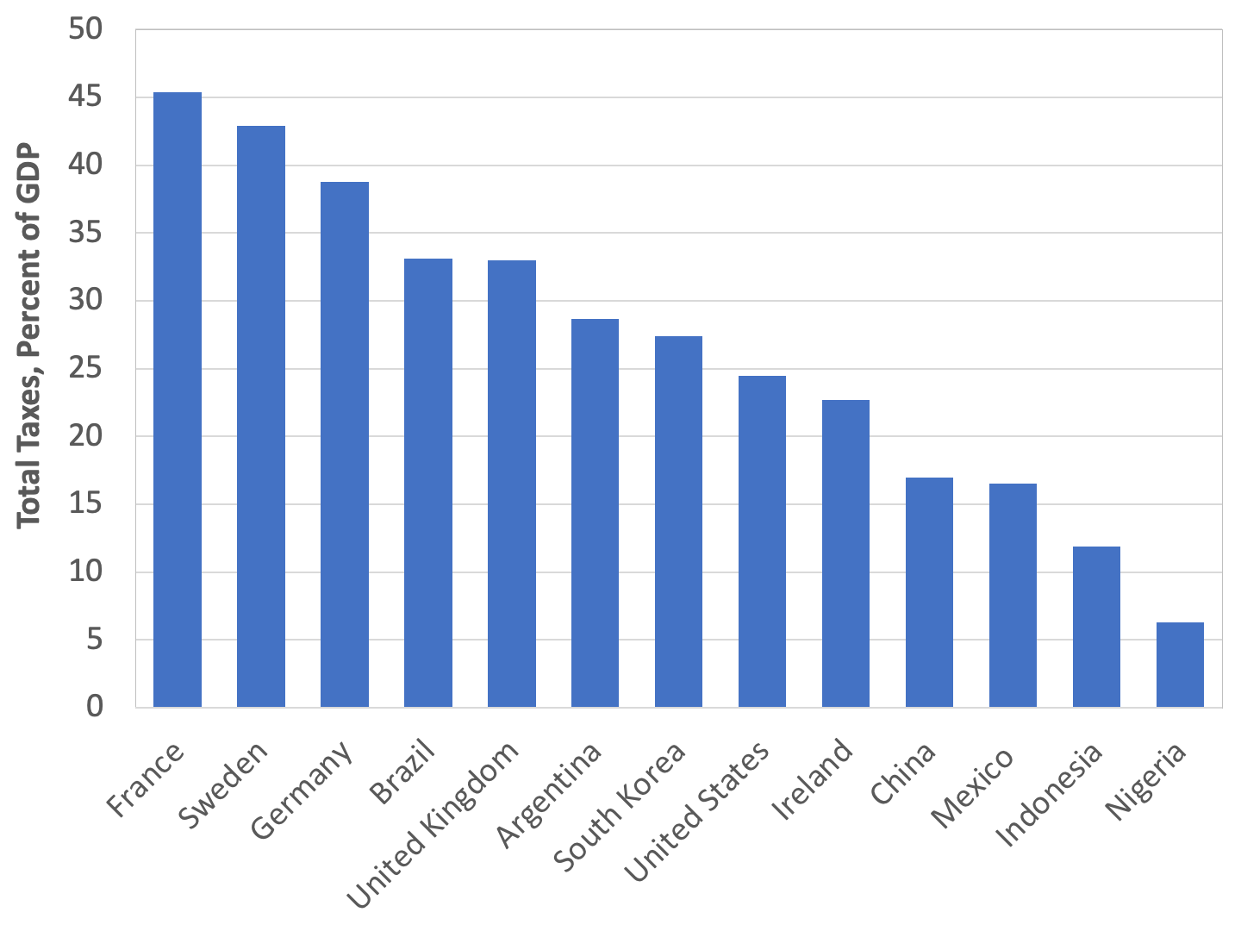
Figure 0.7: Taxes – International Comparisons
Source: Organisation for Economic Co-operation and Development. OECD.Stat, Global Revenue Statistics Database.
Note: Data are for 2019, except for China, Japan, and Nigeria (2018).

Slide 9
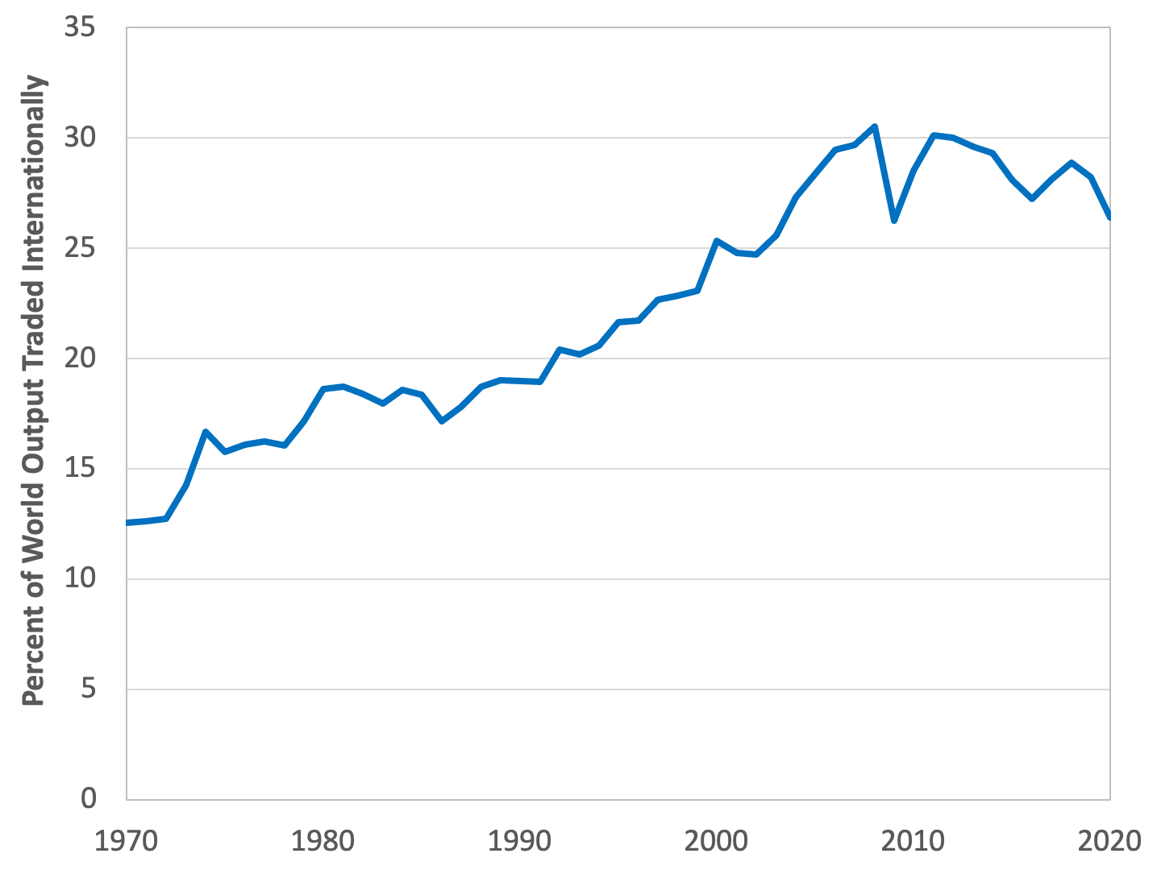
Figure 0.8: Global International Trade
Source: World Bank, World Development Indicators database.

Slide 10
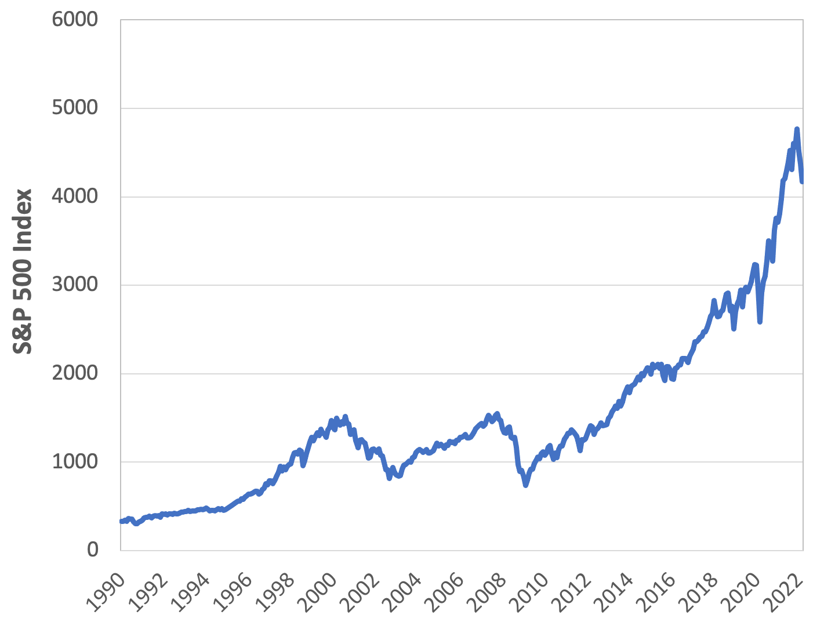
Figure 0.9: Stock Market Performance
Source: Yahoo Finance.
Note: Data are weekly closing prices.

Slide 11
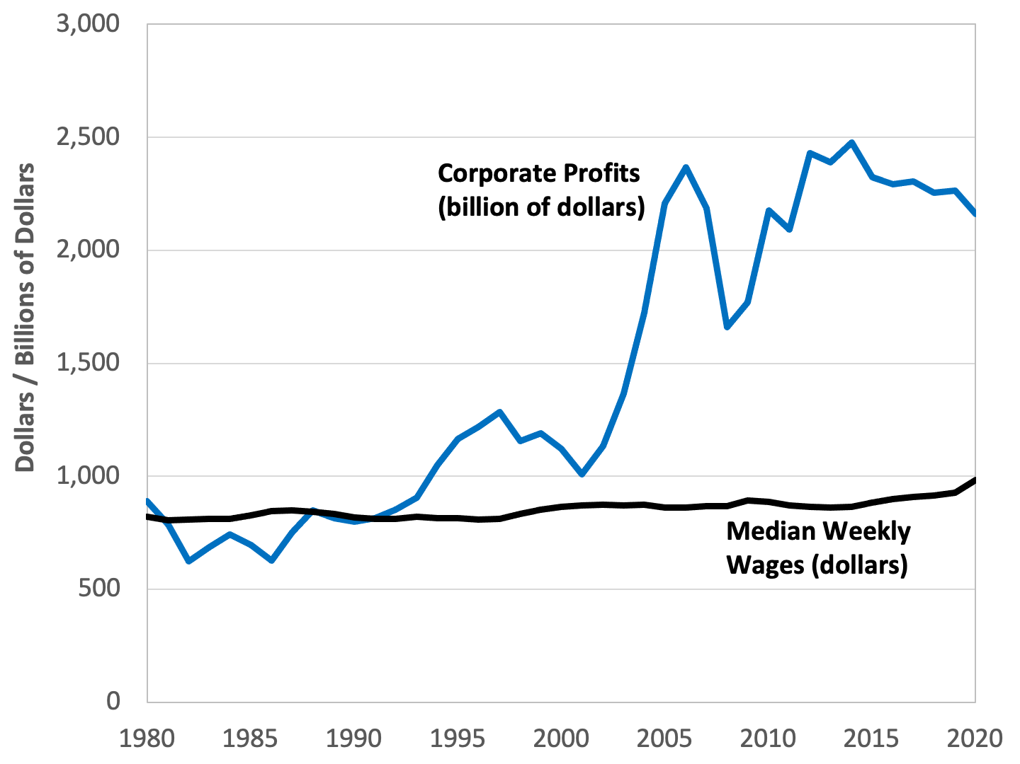
Figure 0.10: Median Worker Earnings vs. Corporate Profits
Source: Federal Reserve Bank of St. Louis, Federal Reserve Economic Data (FRED). “Corporate Profits after Tax” and “Median Usual Weekly Real Earnings”.

Slide 12
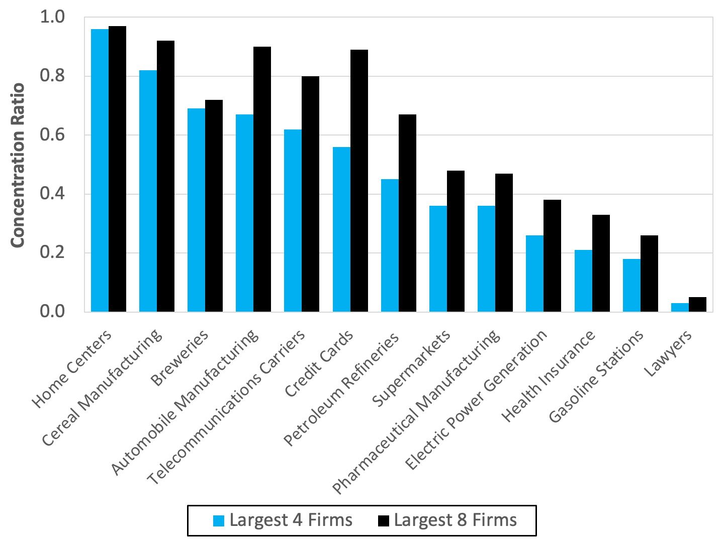
Figure 0.11: Industrial Concentration Ratios
Source: U.S. Census Bureau. 2017 Economic Census, “Establishment and Firm-Size Statistics for the U.S.

Slide 13
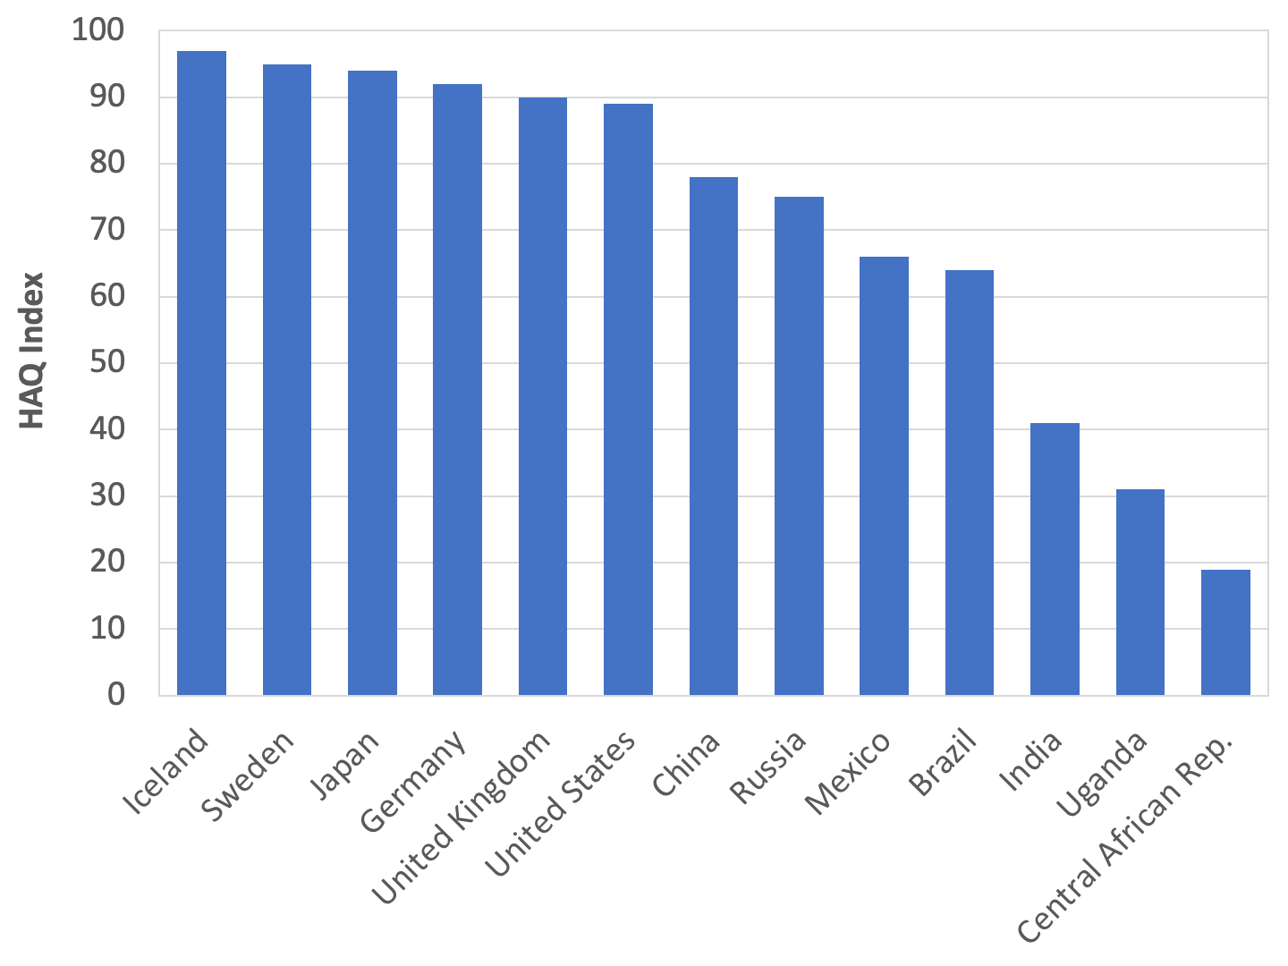
Figure 0.12: Health Care Systems – International Comparisons
Source: Fullman, Nancy, et al. 2018. “Measuring Performance on the Healthcare Access and Quality Index for 195 Countries and Territories and Selected Subnational Locations: A Systematic Analysis from the Global Burden of Disease Study 2016.” The Lancet, 391:2236–2271.

Slide 14
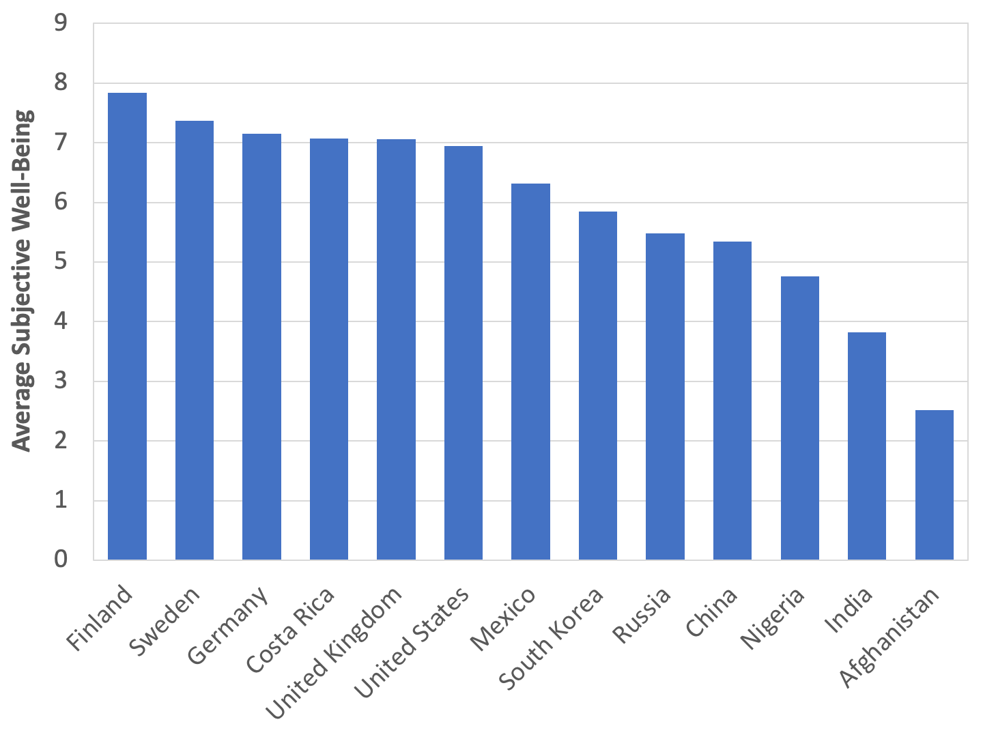
Figure 0.13: Subjective Well-Being – International Comparisons
Source: Helliwell, John F., et al. 2021. World Happiness Report 2021. New York: Sustainable Development Solutions Network.

Slide 15
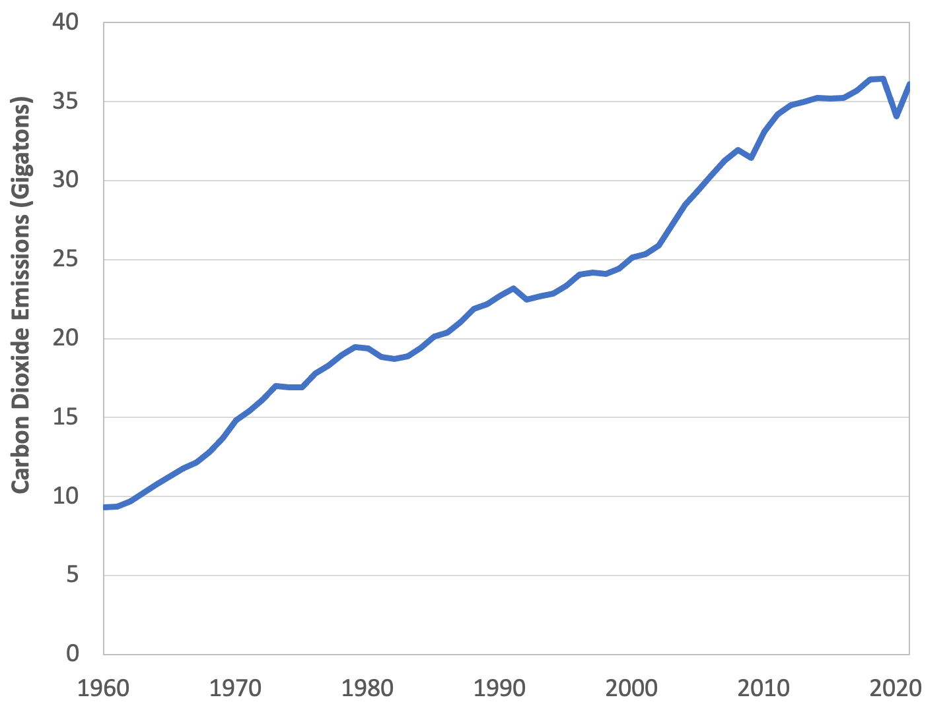
Figure 0.14: Global Carbon Dioxide Emissions
Source: Global Carbon Project. Global Carbon Atlas.

Slide 16
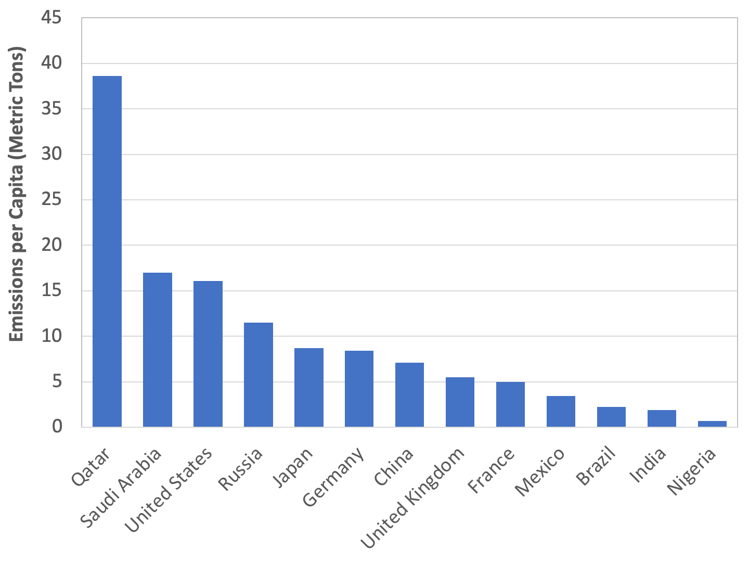
Figure 0.15: Per-Capita Carbon Dioxide Emissions-International Comparisons
Source: Ritchie, Hannah. 2019. "Where in the World Do People Emit the Most CO2?". Our World in Data, Oct. 4.

