Slide 1
Energy Investment Tax Credits and Environmental Outcomes:
Evidence from Electric Utilities
Jesse Chan and Darci Fischer
Impact Measurement and Allocation Program
January 30, 2025
Notes:
Currently revising this paper for resubmission and we’re excited to present today to get everyone’s thoughts on our updates.

Slide 2
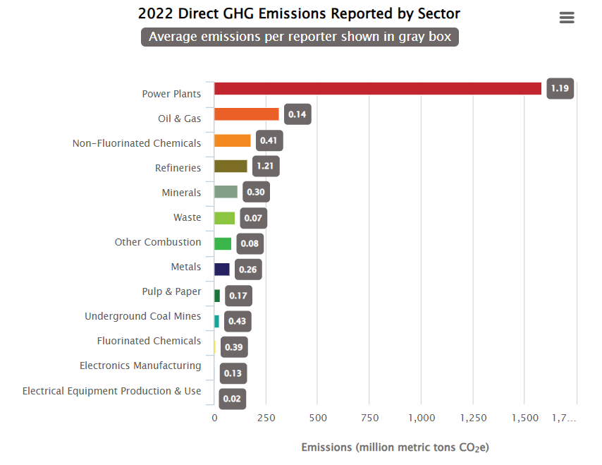
https://www.epa.gov/ghgreporting/ghgrp-reported-data
Notes:
https://www.epa.gov/ghgreporting/ghgrp-reported-data
Power plants have the majority of direct GHG emissions in the US

Slide 3
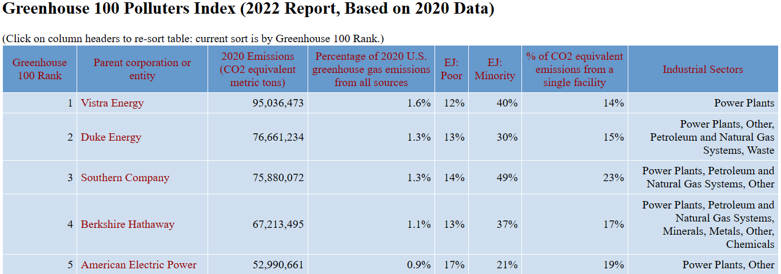
All have power plants in our sample!
https://peri.umass.edu/greenhouse-100-polluters-index-current
Notes:
https://www.epa.gov/ghgreporting/ghgrp-reported-data
Another way of looking at firms impact on environment
So, it’s important to study utilities and include utilities in any plan to reduce emissions, even though they are often dropped in other studies

Slide 4
Overview
Motivation
Research Question
Setting
Electric utilities: 31% of total US emissions
Economically significant
Significant tax incentives to transition to clean energy
What is the effect of energy investment tax credits (ITCs) on firms’ environmental outcomes?
US ITCs from 2001-2022 for electric utilities
Electricity generation portfolios and carbon emissions
Notes:
The utilities industry is also economically significant, largest US electric and gas utilities plan to spend a record-breaking $169.4 billion in 2023” on various capital projects (Deloitte 2022).
They are also significant in terms of the tax incentives provided by the government to transition to clean energy. Despite this, there is little evidence on their effectiveness.
Association effect – can you infer that these are green firms if they take ITC based on real outcomes? We find that their “type” is that they are poor performers on environment dimensions (GHG and generation mix).
We use DiD analyses, but power issues and difficult to claim causal evidence. However, there is a lack of empirical evidence in this area and our small sample does give us the flexibility to look at each firm in a granular way. We can describe the firms that choose to take ITC and what happens and consider how that meets policy goals. Prior papers in evaluating ITC are from econ using structural models and highlight the complexity of this setting.

Slide 5
Setting – Investment Tax Credit
US estimates $60 billion of expenditures on ITCs from 2021-2031
  $40 billion for child tax credits
Percentage credit of 10-30% of basis in an eligible energy project
Specific rules vary by year and source fuel
ITCs form a key role in US clean energy policy
Notes:
Coal projects must be pre-approved and plan to sequester at least 65% of carbon emissions (among other criteria)
With IRA, both ITCs and PTCs will be transferable under the same Tax Credit Transfer Program (Latham and Watkins 2022) and the tax credit in its current form is expected to be available through “at least 2025”, though additional labor requirements are in force for relatively large (>1 Megawatt) projects.
Beginning in 2025, the Inflation Reduction Act replaces the ITC with the Clean Energy Investment Tax Credit which remove project level technology restrictions in favor of a technology agnostic approach that incentivizes any project with zero greenhouse gas emissions (EPA 2023).
Which is right for me, the ITC or the PTC?
The ITC is an upfront tax credit that does not vary by system performance, while the PTC can provide a more attractive cash flow, as the tax credits are earned over time. Whether to choose the ITC or the PTC depends largely on the cost of the project, the amount of sunlight available, and whether it is eligible for any bonus tax credits. See an example calculation below.
In general, large-scale PV projects will receive more value if they opt for the PTC in sunny places, while projects located in less sunny areas, that incur high installation costs, or that qualify for bonus tax credits, are more likely to benefit from the ITC.
Smaller-scale PV projects and CSP projects generally receive more value utilizing the ITC, particularly if they can utilize a low-income bonus, which is not available with a PTC. However, as installed PV and CSP system costs reduce over time (or generate more electricity), the PTC may become more attractive for all sectors.

Slide 6
Setting – Electric Utilities
Clean energy credits often targeted at electric utilities
Choosing this setting means we are looking at a set of firms where the ITC may plausibly change their behavior
Regulated utilities setting allows us to observe ITC over time
  Capitalize/amortize ITC over life of project for financial reporting
  Allows us to identify firms that take ITC

Slide 7
Prior Literature
ESG literature:
  Real effects of corporate sustainability reporting (e.g., Tomar 2023; Bonetti et al. 2023)
Tax literature:
  Carbon and emissions taxes result in lower investment and emissions (Jacob and Kerwer 2024; Martinsson et al. 2024)
  Signaling role of R&D and Work Opportunity tax credits (Hepfer et al. 2021; Hutchens et al. 2021)
Economics literature
Our paper: Is an environmentally motivated tax subsidy associated with firms’ operating outcomes?
Notes:
ESG - Contribute by examining how tax incentives shape corporate sustainability reporting and operating behavior
- Hutchens, Richter, Stomberg and Williams (2021) investigate the determinants and consequences of the Work Opportunity Tax Credit (“WOTC”), a federal tax program that rewards businesses for hiring underrepresented workers. They find that firms disclosing WOTC receive higher ESG ratings on social issues and are more likely to be owned by socially responsible investment funds.
Hepfer, Judd, and Rice (2021) test whether firms can signal the innovation quality by claiming R&D tax credits in an IPO setting. They find that these firms realize higher IPO proceeds. Furthermore, results are concentrated among firms limited in their ability to obtain tax benefits from the credit, providing evidence of non-tax signaling benefits.

Slide 8
Hypothesis Development
ITC balances could indicate sustainability efforts
  ITC subsidies adjust the prices of polluting energy sources up relative to non-polluting energy sources
  More credits = more eligible renewable energy projects
However, ITC could have no effect or be a negative indicator:
  Interactions with other federal and state energy policies
  Difficult to design subsidies such that they equalize the cost per unit of emissions for all electricity-producing technologies, which could have distorting effects
  Incentive provisions could motivate pursuit of relatively inefficient projects and substitutions from other projects
Notes:
To the extent ITC subsidies successfully adjust the prices of polluting energy sources up relative to non-polluting energy sources, we would expect electric utilities claiming these ITCs to exhibit greater increases in renewable power generation and steeper declines in greenhouse gas emissions relative to peer firms (Metcalf 2009).
However, it is possible that ITC usage had little effect due to interactions with other federal and state renewable energy policies and investor pressure to shift power generation portfolios. Given that utilities claim ITCs as a percentage of their eligible cost basis, projects for which firms claim ITC rather than the PTC may require substantial capital expenditures and be relatively inefficient.
Finally, it is possible that ITC is associated with a lower percentage of energy generated from renewable sources and higher emissions. It is difficult to design subsidies such that they equalize the cost per unit of emissions for all electricity-producing technologies, which could have distorting effects

Slide 9
Research Question
RQ: Do electric utilities claiming investment tax credits incrementally increase (reduce) their renewable electricity generation (carbon emissions) versus their non-claiming peers?
Notes:
We are currently in the middle of rephrasing this as a research question.

Slide 10
Data
2001-2022 (pre-IRA)
US EPA Greenhouse Gas Reporting Program
Energy Information Administration
Thomson Reuters Refinitiv (additional analyses)
Notes:
- Small sample size but focusing within industry, estimating coefs with probably the same amount of variation as when you include industry fixed effects, and focusing on sample of firms that will be sensitive to the tax incentives we are studying.

Slide 11
Research Design
Stacked cohort differences-in-differences design
Intuition:
  Different utilities begin using ITCs at different points in time across our sample period
    Utility A may begin in 2002 while Utility B begins in 2010 and Utility C begins in 2014
    For each initiator, we identify rate-regulated control firms who never claim ITCs during our sample period
    Then we retain firm-year level data for +/- 5 years surrounding the ITC initiation year for the treatment firm
  This develops our sample, and we apply the above differences-in-differences regression to identify the effects of ITC adoption on operational outcomes

Slide 12
Outcomes of Interest
Our design explores how the initial adoption of ITC impacts various operational outcomes, including:
Overall electricity generation, non-renewable electricity generation, renewable electricity generation, proportion of renewable electricity generated
    Decomposed by fuel type (wind, solar, other renewables, natural gas, coal)
Emissions, emissions intensity (emissions per MWh)
Capital expenditures, PP&E, employees, tax outcomes (cash and GAAP ETRs)
In additional analyses: ESG scores

Slide 13
Summary of Results
After taking the ITC, ITC firms:
electricity from renewable sources (~2% decrease)
wind and other renewables, but solar
emissions, but emissions per MWh
PP&E (adoption year), employees
Cash ETRs but GAAP ETRs
ESG Scores
… as compared to their non-ITC peers.
Notes:
At least in our regulated utilities sample

Slide 14
Figure 1
Firms produce less electricity from renewable sources after taking ITC than non-ITC peers

Slide 15
Figure 2
Absolute emissions come down, but some weak evidence emissions intensity increases

Slide 16
Firms produce less electricity from renewable sources after taking ITC than non-ITC peers
Absolute emissions come down, but some weak evidence emissions intensity increases

Slide 17
ITC adoption appears to drive shift towards solar and away from wind and other renewables

Slide 18
Figure 3
ITC adoption relates to changes in PP&E, employee count, and cash ETRs

Slide 19
ITC adoption relates to changes in PP&E, employee count, and cash ETRs (but not GAAP ETRs)

Slide 20
As firms claim more ITCs, we observe similar patterns

Slide 21
Figure 4
ESG ratings agencies decline following ITC usage as well, implying ITC usage may negatively indicate ESG performance

Slide 22
ESG ratings agencies decline following ITC usage as well, implying ITC usage may negatively indicate ESG performance

Slide 23
Conclusion
Utilities claiming ITCs generate ~2% less renewable electricity relative to pre-ITC generation levels
  This appears driven by utilities substituting away from wind and other renewable sources to solar, consistent with the ITC’s selective technology provisions
ITC firms employ ~7% more people following adoption, but ESG scores decline
Contributions
  Empirical analysis of ITC firms and operating outcomes
  How tax credits predict sustainability performance
  Policy implications

Slide 24
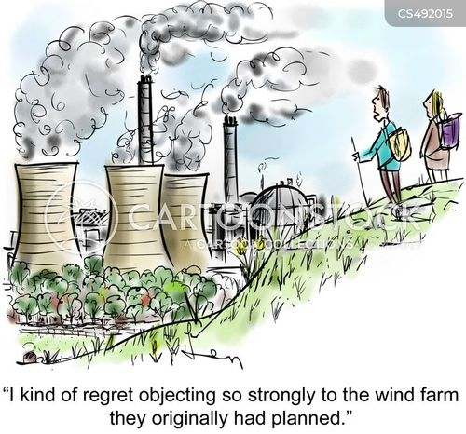

Slide 25
Appendix

Slide 26
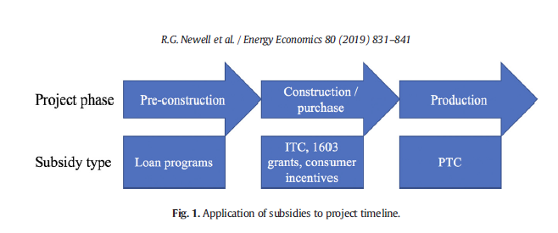

Slide 27
Setting – Eligible Technologies (as of 1/1/2020)
ITC and PTC
ITC
PTC
PTC-eligible projects that started construction from 2009-2011
Geothermal
Solar (PIS 2004-2006)
Certain advanced/refined coal projects
Solar
Small wind
Fuel cell
Heat and power systems
Microturbine
Wind
Hydroelectric, marine, and hydrokinetic
Open and closed-loop biomass
Landfill gas and trash
Small Irrigation
Notes:
Eligible tech

Slide 28
Accounting for Investment Tax Credits
Alpha Electric invests in a new solar project on 12/31 of Year 1 with an eligible project basis of $333. Alpha Electric claims a 30% investment tax credit for the project, amounting to approximately $100 ($333 times 30%). The expected book life of the solar project is 20 years. Alpha’s income tax rate is 21%, and the utility follows the deferral method of accounting for ITCs. They determine the future recovery in rates of temporary basis differences is probable for the ITC.
In Year 1, Alpha Electric records the reduction in current year tax expense for the ITC:
Income Tax Payable 100
Income Tax Expense/Benefit 100
In Year 1, Alpha Electric also defers the impact of the ITC for financial reporting purposes, as the utility will amortize this credit for GAAP purposes over the useful life of the solar project:
Income Tax Expense/Benefit 100
Unamortized ITC 100

Slide 29
Accounting for ITCs (Part 2)
In Year 1, Alpha Electric also records the effects of regulatory accounting—this journal entry is required because the utility determines it will pass along the temporary basis differences through decreased electric rates to end consumers. This will affect future income taxes payable, resulting in a temporary book-tax difference. Alpha Electric records a third journal entry to account for this, but then grosses up this difference because the regulatory liability itself generates an additional book-tax difference since it decreases revenue which decreases future taxes payable. Alpha Electric records the two following journal entries:
Deferred Tax Asset 21 (21% tax rate * $100 ITC)
Regulatory Liability 21
Deferred Tax Asset 6*
Regulatory Liability 6
*($21 of deferred tax asset / (1 – 0.21) – 21 = 5.5823 or approximately $6

Slide 30
Accounting for ITCs (Part 3)
In Year 2 and beyond, as Alpha Electric operates the solar project and amortizes this ITC balance, the utility records two journal entries each year over the remaining life of the solar project. One is to record amortization of the unamortized ITC balance to recognize the income tax benefit for GAAP purposes and the second is to record the gradual resolution of the temporary book-tax difference recorded in step 3 above.
Unamortized ITC 5 ($100 ITC / 20-year project life)
Income Tax Expense/Benefit 5
Regulatory Liability 1.35^
Deferred Tax Asset 1.35 ^ ((21+6) total regulatory liability / 20-year useful life = 1.35)

Slide 31

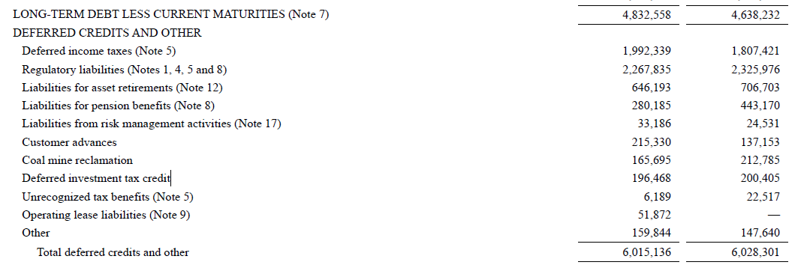
Unamortized ITC
(ITCB)

Slide 32
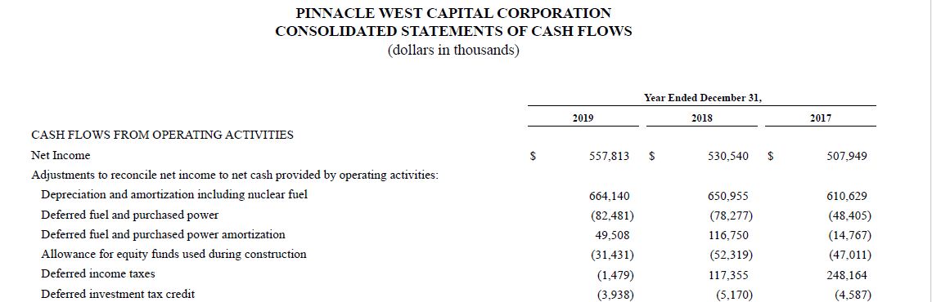

Slide 33

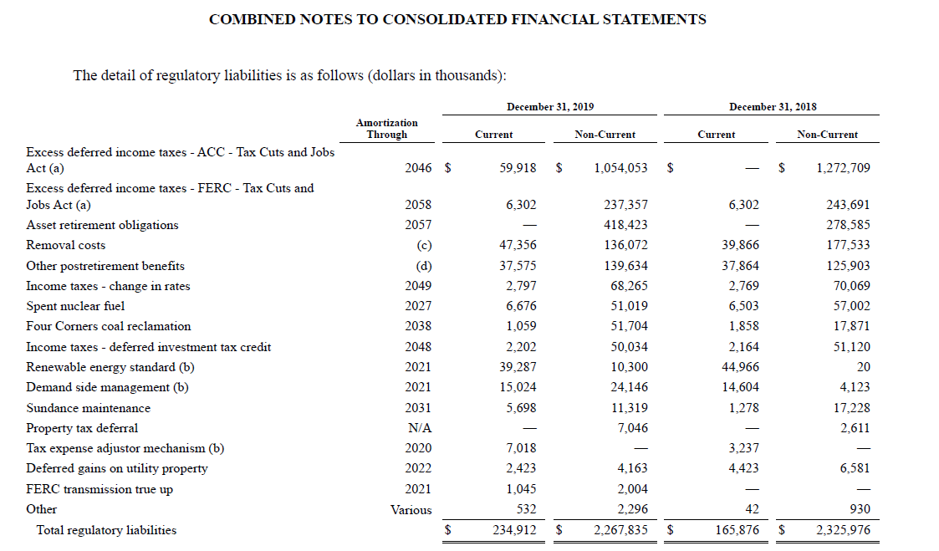

Slide 34
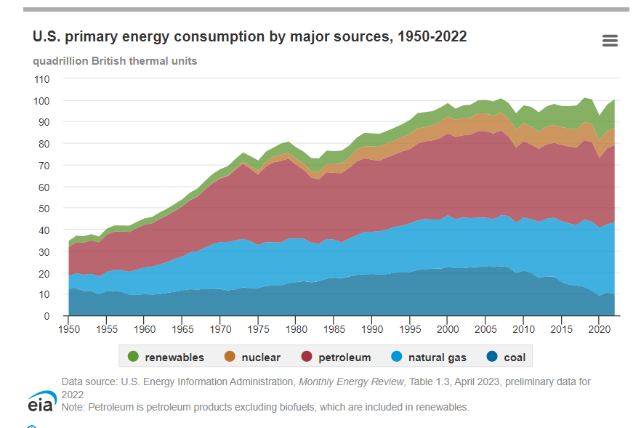
Notes:
https://www.eia.gov/energyexplained/us-energy-facts/

Slide 35
