Slide 1
Summer Term High School Programs​
Instructor Training, Summer 2025​
May 7, 2025
Summer Term Pre-College Team

Slide 2
Training Schedule​
3:00-3:15 pm
Overview of Programs, Pre-College Team, & Instructor Introductions ​
3:15-3:50 pm
Program Procedures, Policies, and Deadlines​
3:50-4:00 pm
Break
4:00-4:45 pm
Center for Teaching & Learning Resources ​
Presentation by Deborah Breen, Director of the Center for Teaching & Learning
Please note: We will provide a copy of this presentation via email

Slide 3
5 Pre-College Programs
High School Honors​
Summer Term coursework​
Research in Science and Engineering (RISE)​
Internship + Practicum in Computational Neuroscience​ or Data Science
Academic Immersion (AIM) ​
4 tracks: Creative Writing, Experimental Psychology, Medicine, & Business​
Summer Challenge​
19 seminars representing BU’s schools and colleges​
Summer Preview​
3 seminars: Biology, Business, & Creative Writing​

Slide 4
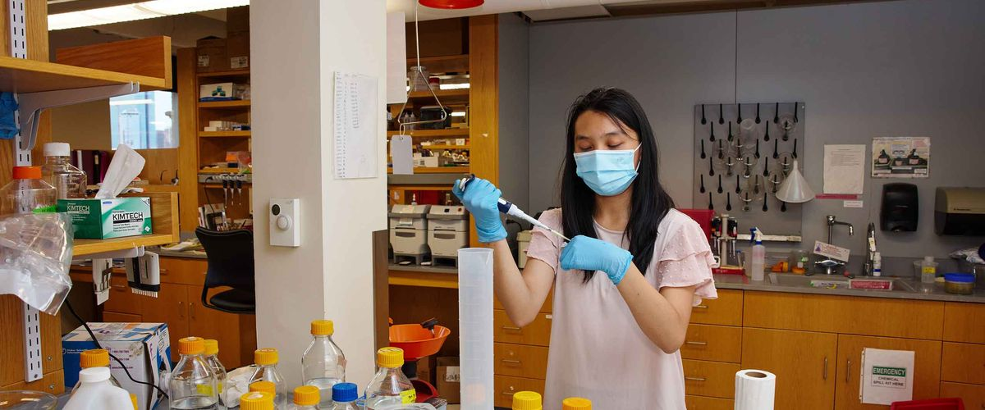
RISE
6 weeks ​
Rising seniors​
Residential or commuter
Monday Workshops/Fieldtrips: 9:30 - 11:30am, and 1 - 5 pm
Lecture: 9:30 - 11:30 am, T-F​
Labs: 1 - 5 pm, T-F
June 30 – August 8​
Tracks:
Internship
Practicum 1: Computational Neurobiology
Practicum 2: Data Science (NEW)

Slide 5
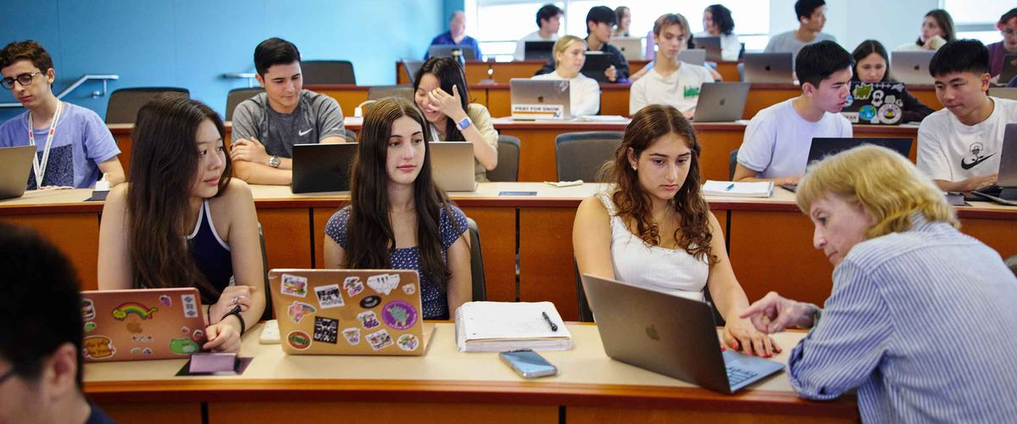
AIM
3 weeks ​
Rising juniors, and seniors​
Residential or commuters
Morning Lecture: 9:30 - 11:30 am, M-F​
Afternoon seminar: 1 - 4:30 pm, M-F​
Session 1​
Introduction to Experimental Psychology and Business
June 30 – July 18
Session 2​
Creative Writing and Medicine
July 21 – August 8

Slide 6
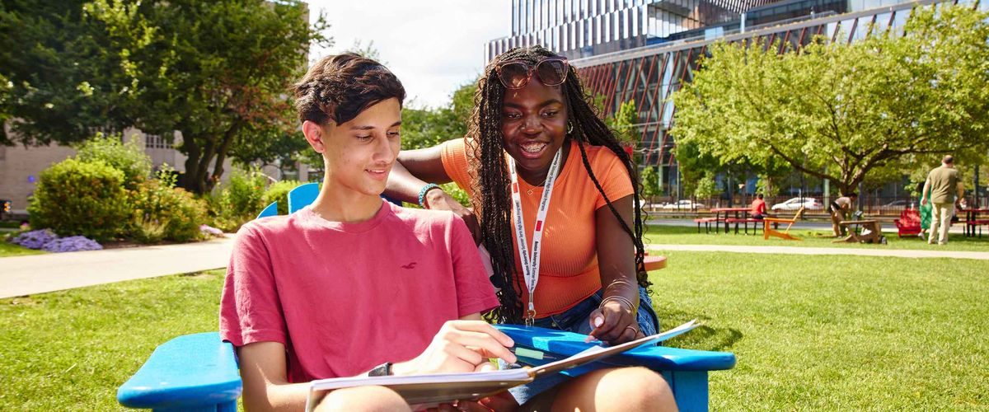
Summer Challenge​
2 weeks ​
Rising sophomores, juniors, and seniors​
Residential
Morning seminar: 9:30 - 11:30 am, M-F​
Afternoon seminar: 1 - 3 pm, M-F​
Session 1​
June 16 – June 27
Session 2​
July 7 – July 18​
Session 3​
July 21 – August 1

Slide 7
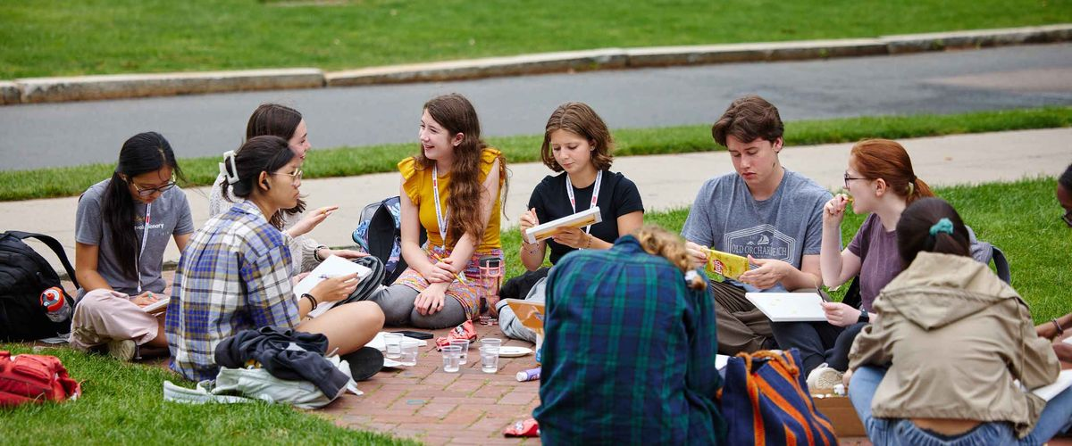
Summer Preview​
1 Week​
Rising 8th, 9th, and 10th graders​
Residential or commuter​
Morning class: 9:30 - 11:30 am, M-F​
Afternoon class: 1 - 3 pm, M-F​
June 16 – June 20
Seminar topics
Biology, Business,​ & Creative Writing​

Slide 8
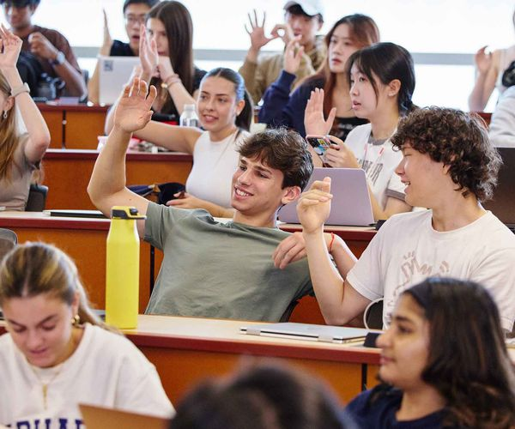
Our Students
Domestic (~70%) and International (~30%)​
Summer 2024: from 40 states and 56 countries​
Seek a preview of college life: academics and social offerings​
Summer Challenge: residential only
RISE, AIM, Summer Preview: residential or commuter
May be supported by a Community-Based Organization (CBO) or through financial aid

Slide 9
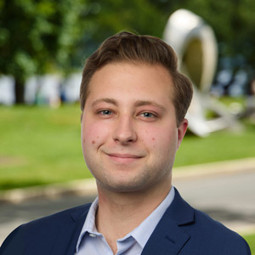
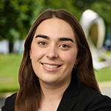
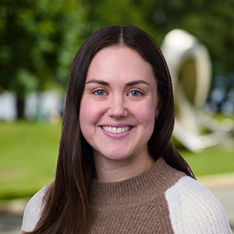
Meet Our Team: Program Managers
Bentley Warren
Summer Challenge &
Summer Preview
Ursula Imbernon, PhD
RISE & AIM
Elinor Klein
High School Honors

Slide 10
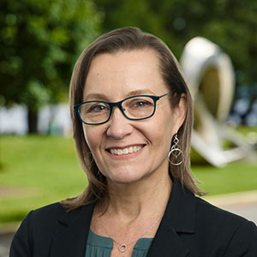
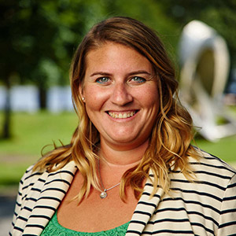
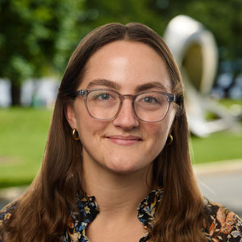
Meet Our Team: Leadership
Christine Parker, PhD
Director
Pre-College Programs
Amanda Wein, PhD
Associate Director,
Summer Term
London Judge
Assistant Director Pre-College Programs

Slide 11
Introductions
Please share…​
Name​
Academic Year position/department​
New or returning to Summer Term​
Program and subject/seminar​

Slide 12
Resources & Information for Instructors​​
https://www.bu.edu/summer/faculty-staff-high-school/​

Slide 13
Pre-Program Requirements:​
Due immediately
Personnel Record Form (emailed)​
Due soon
Signed Contract (emailed)​
CORI/SORI Documents and ID Verification
Protection of Minors Online Training Courses (via United Educators)
Boundary Training for Educators
Protecting Children: Identifying and Reporting Sexual Misconduct

Slide 14
Pre-Program Requirements:​
Due Wednesday, May 14th
Textbook/Supplies Order Request
For textbooks, please use the Google Form link you were emailed​
Due Tuesday, May 27th
Syllabus (required) & Course Packet​/Reader (optional)
Include a cover page with seminar/course title and instructor name
All seminars are required to have a printed syllabus for students.
To Submit: Email as a PDF attachment to Bentley or Ursula
Field Trip Schedule (off-campus only)
Provide date, location, and transportation information to Bentley or Ursula

Slide 15
Your Class Roster & Welcome Email​
Classroom locations and a “final” roster will be emailed to you at least one week before the program begins​
Roster includes: legal name, nickname, preferred gender/pronouns, grade level, email address, and home state/country​
Any changes to the roster will be sent by the Program Manager ​
Please keep your roster updated as you'll be responsible for taking attendance at the beginning of every class ​
Sending a “welcome email” to your students a few days before the program begins is mandatory ​
Remind them to bring a notebook/pen or laptop on the first day​
Feel free to give them an assignment for the first class; but keep in mind that they will only receive their seminar materials on the Sunday before the program​ begins​
Please cc summerhs@bu.edu (SC and SP) / buaim@bu.edu (AIM) / rise@bu.edu (RISE)

Slide 16
First Day of Class/Program​
PAs will walk students to class​​
On that first day, you need to report absences and confirm that the students in the room match your roster​​
Students should arrive with a pen, paper, syllabus, and textbook/course packet/reader (if assigned)
Please note that no changes to seminar registrations are permitted after students arrive for their first class​​
After the first day of class, students are responsible for getting themselves where they need to be​​
Exception: Summer Preview students are escorted daily by PAs​

Slide 17
Staff Who Can Help: Program Assistants (PAs)​
BU students provide 24-hour support to the high school students in our programs. These Program Assistants (PAs) are a wonderful resource for instructors as well. ​​
PAs can be counted on to do the following:​​
Walk students to your first class​​
Search for missing students and bring them to class when found​​
Escort students to/from Student Health Services or other appointments off-campus​​
No student should be released from class without a PA present​​
Accompany your class on off-campus field trips, ensuring mandated adult : student ratios​​
Check on students who are struggling​​
Please do not reach out to PAs directly; Summer Term will contact PAs to request check-ins​

Slide 18
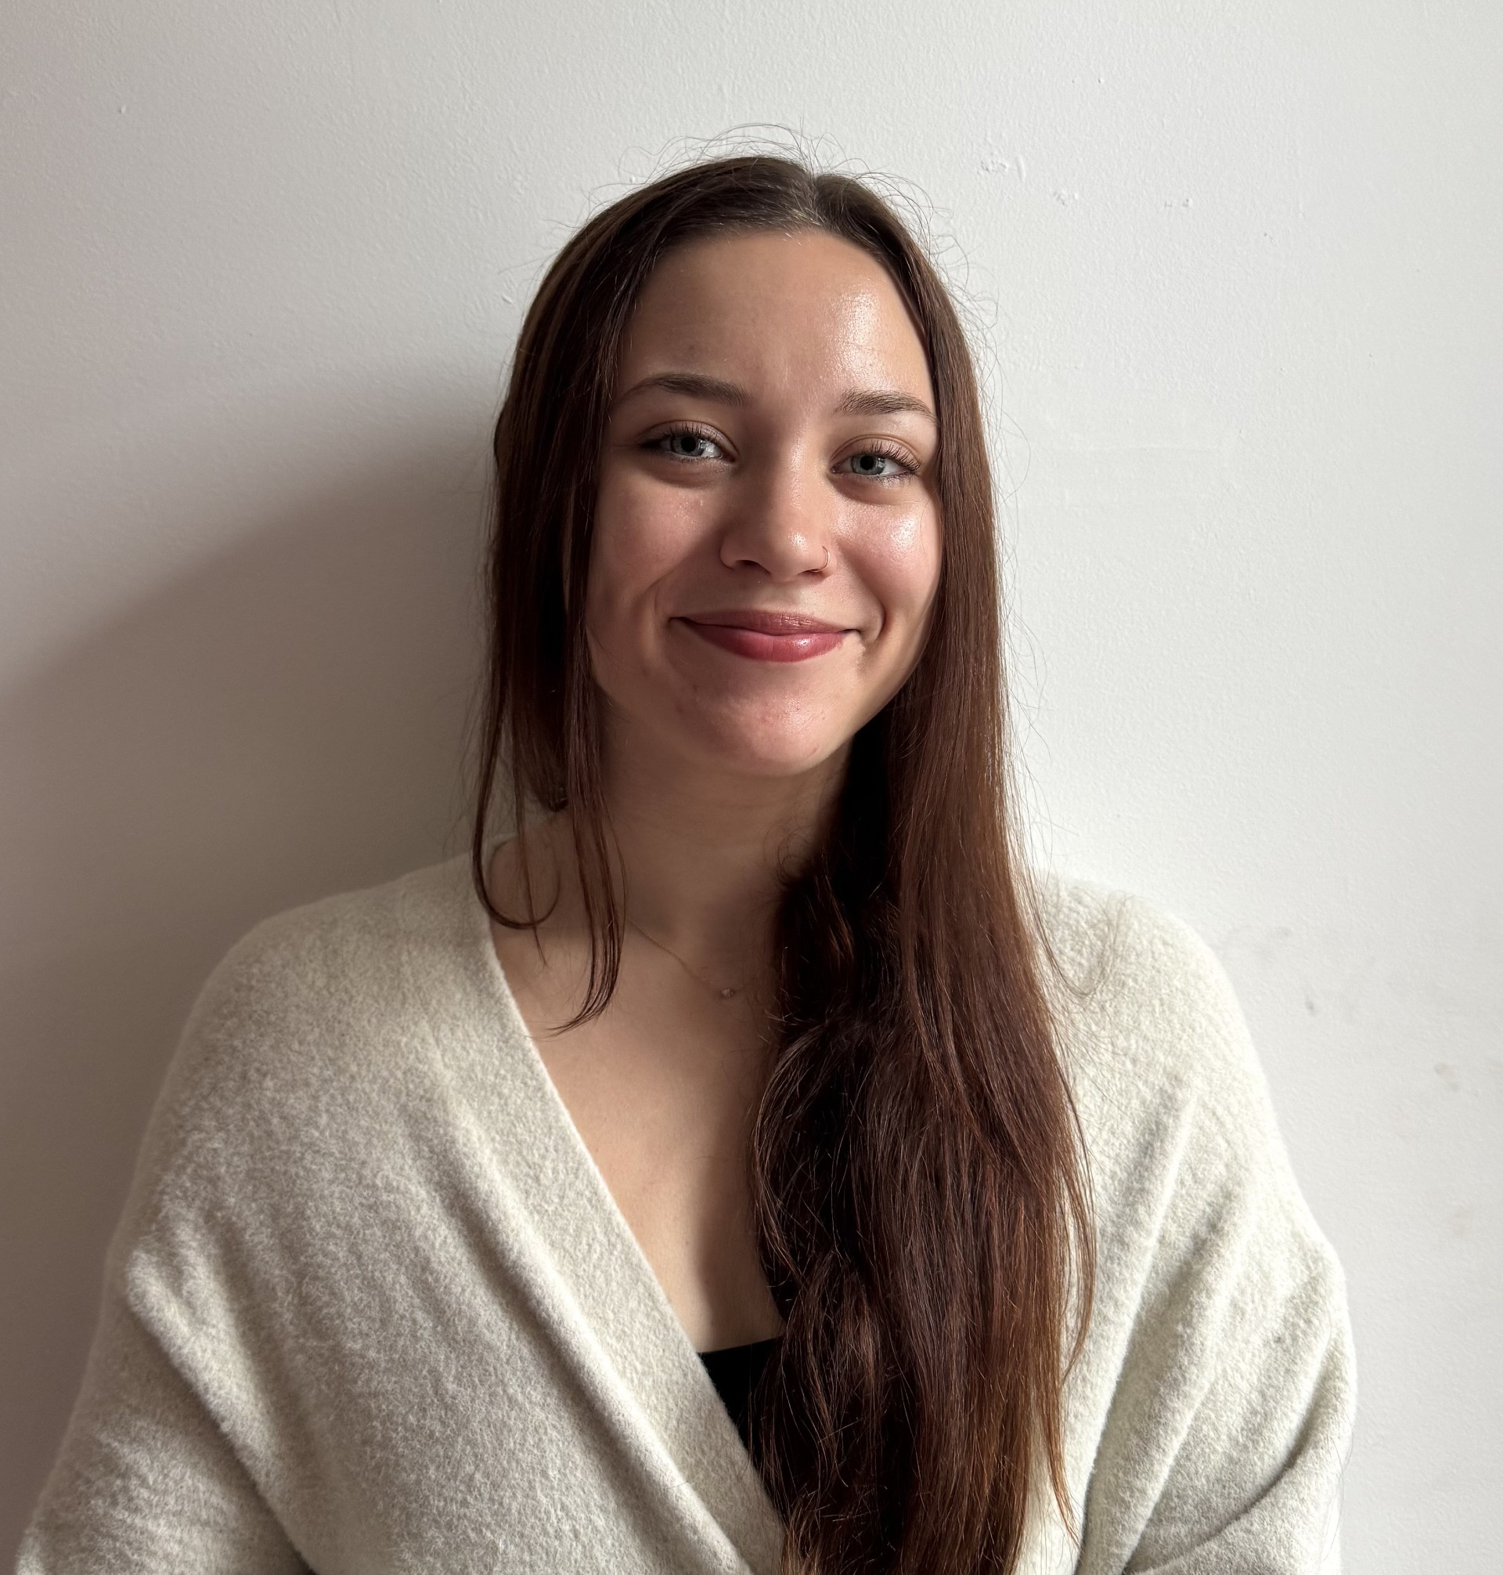
Staff Who Can Help:
Cora Lauffer, Student Life Director​
Full-time, summer position in the Summer Term office
Main responsibility is to respond to, communicate about, and document student life issues as they arise
Manages incidents and disciplinary concerns, and communicates with parents/guardians and Summer Term staff as needed

Slide 19
Classroom Guests​
You are welcome to invite guests into the classroom to enhance the lesson of the day​
Unfortunately, there is no budget for paying these speakers​
Please ensure that these guests are *never* alone (i.e., in a breakout group or leading a session without you present) with the students; you must be there at all times​
If guests are going to be alone with the students (to run a small group workshop, for example) for any amount of time, they must be background checked by BU prior, and they must complete the online protection of minors training ​courses
Do not share student contact information and/or materials with the guests​

Slide 20
Off-Campus Field Trips​
You are encouraged to plan a relevant field trip for your students during the program​
Look for free events/site visits​
Some examples: MFA, ISGM, ICA, BU events/conferences​, etc.
Field trips must begin and end during the regular class meeting hours​
Please let us know the date, location, and transportation information by Tuesday, May 27 so we can staff Program Assistants
1-2 Program Assistants (PA) will meet you at your classroom
We can usually provide T-passes for you and your students​

Slide 21
Seminar/Course Evaluations​
Will be distributed electronically​
Evaluations should be conducted on the following date:​
Summer Challenge – last Thursday of the program
Summer Preview – last day (Friday) of the program​
These evaluations will be made available to you in the fall

Slide 22
Final Presentations & Receptions​
Summer Challenge
SC1: June 27th | SC2: July 18th | SC3: August 1st
9:30 – 10:30 am for AM seminars​
11 am – 12 pm for PM seminars​
AIM
July 18th, AIM Psych and Bus: 9:30 – 11:30 am / 12 – 1 pm
August 8th, AIM Med and CW: 9:30 – 11:30 am / 12 – 1 pm
RISE
August 8th, 1 – 3 pm
Summer Preview
None

Slide 23
Student Evaluations​
If your role requires you to write them, it will be noted on your teaching contract along with the due date!
One-page letters addressed to the student
Summary of the material covered in the seminar
Feedback on student performance/interests
We can provide sample letters from previous years and will provide guidelines on our faculty-staff webpage.

Slide 24
Student Safety: Working in Labs
You will be provided a handout that you must go over on the first day of class​
Required for the following seminars/courses:​​
Summer Preview Discovering Biology
Summer Challenge Infectious Diseases
Summer Challenge Chemistry of Medicine
Summer Challenge Anatomy & Physiology
RISE Practicum in Computational Neurobiology

Slide 25
Student Safety: Reporting Absences​
Classes must be held every day for the full-appointed time​
Students should never be released early from class​
Our office needs to know where students are at all times, so also keep us apprised of any location changes (even on campus)​
Take attendance at the start of each class period​
A student is excused from class only if our office informs you; don’t take their word for it!​
Report absences to our office 10 minutes after class starts
To report student absences, you can either:
Use the Summer Term Student Absence Form (link will be shared before program begins)
Call 617-353-1378​
Program Assistants (PAs) will find missing student and walk them to your class​​
If a student arrives late to class, please ask the student to text the PA on Call number to confirm their arrival. Also let us know later or when you can!

Slide 26
Student Safety: Reporting Concerns​
The Summer Term High School Programs office is your resource for any and all concerns involving the students. Instructors should be able to focus on teaching – not discipline. We are here to help!​
Please inform us about students who are:​
Repeatedly late to class (even if they arrive before the 10-minute mark)​
Disrespectful to you or their classmates​
Not completing assignments or not participating​
Showing signs of mental health or other health-related problems​
Except in emergency situations, concerns can be reported to the Program Manager by email. (Emergency protocol will be discussed subsequently.)​

Slide 27
Reporting Health/Safety Emergencies​
Notify the BUPD at 617-353-2121 if on-campus​​
Call 911 if off-campus​​
Remain with student until help arrives​​
Notify Summer Term office when it is safe and appropriate to do so​​
We will send on-call PA or staff member to the scene to provide assistance​​
If medical transport is necessary, request EMTs to take student to Children’s Hospital in Boston​​
You might have to explain that student is a minor​​
PA should accompany student in ambulance (if possible) or to Student Health Services​

Slide 28
BU Protection of Minors​ Requirements
CORI/SORI Documents will be submitted through CSI portal
Massachusetts iCORI ID verification must be completed in person with a professional staff member in our office.​
Protection of Minors Online Training Certificate(s) will be submitted to Bentley​ or Ursula for the following 2 courses:
Boundary Training for Educators
Protecting Children: Identifying and Reporting Sexual Misconduct
Directions for accessing all materials have been already sent by email

Slide 29
We are all Mandatory Reporters​
Who is required to report suspected cases of abuse or neglect of minors?​
Any member of the BU community who knows or suspects that a student in a University or third-party program or activity under the age of 18 has been abused or neglected must report the suspected abuse or neglect​
Boston University’s Confidential Reporting Policy protects individuals from retaliation when they make good faith reports about concerns​
See https://secure.ethicspoint.com/domain/media/en/gui/8779/index.html for more information​

Slide 30
Guidelines for Interacting with Minors​
Avoid any physical or digital contact with minors that could be misinterpreted, an occasional pat on the back, or a touch on the arm to get one’s attention is acceptable; back rubs, massages, tickling, rough-house play, and caressing or intimate touching is inappropriate and unacceptable.
Personal emails (unrelated to course material) or text messages/phone calls of any kind are also to be avoided.​

Slide 31
Guidelines for Interacting with Minors​
Do not take photographs of students for personal use; do not post photographs of students on social media or publish them in any form.​
If it is necessary to take a minor aside for a private conversation relating to behavior or some other issue they want to discuss, do so in full view of other people, or in the presence of a second adult. ​

Slide 32
Guidelines for Interacting with Minors​
During conversation, avoid disclosing intimate information about yourself or seek to learn intimate information about the minor, particularly about sexual behavior. ​
Issue praise appropriately and avoid excessive praise or criticism of any minor.​
Do not tell sexually-oriented or off-color jokes to or in the presence of minors.​

Slide 33
Massachusetts iCORI Identity Verification
If you received an email from us about completing your in-person iCORI Identity Verification AND brought your government-issued photo ID, we can complete your verification after questions!

Slide 34
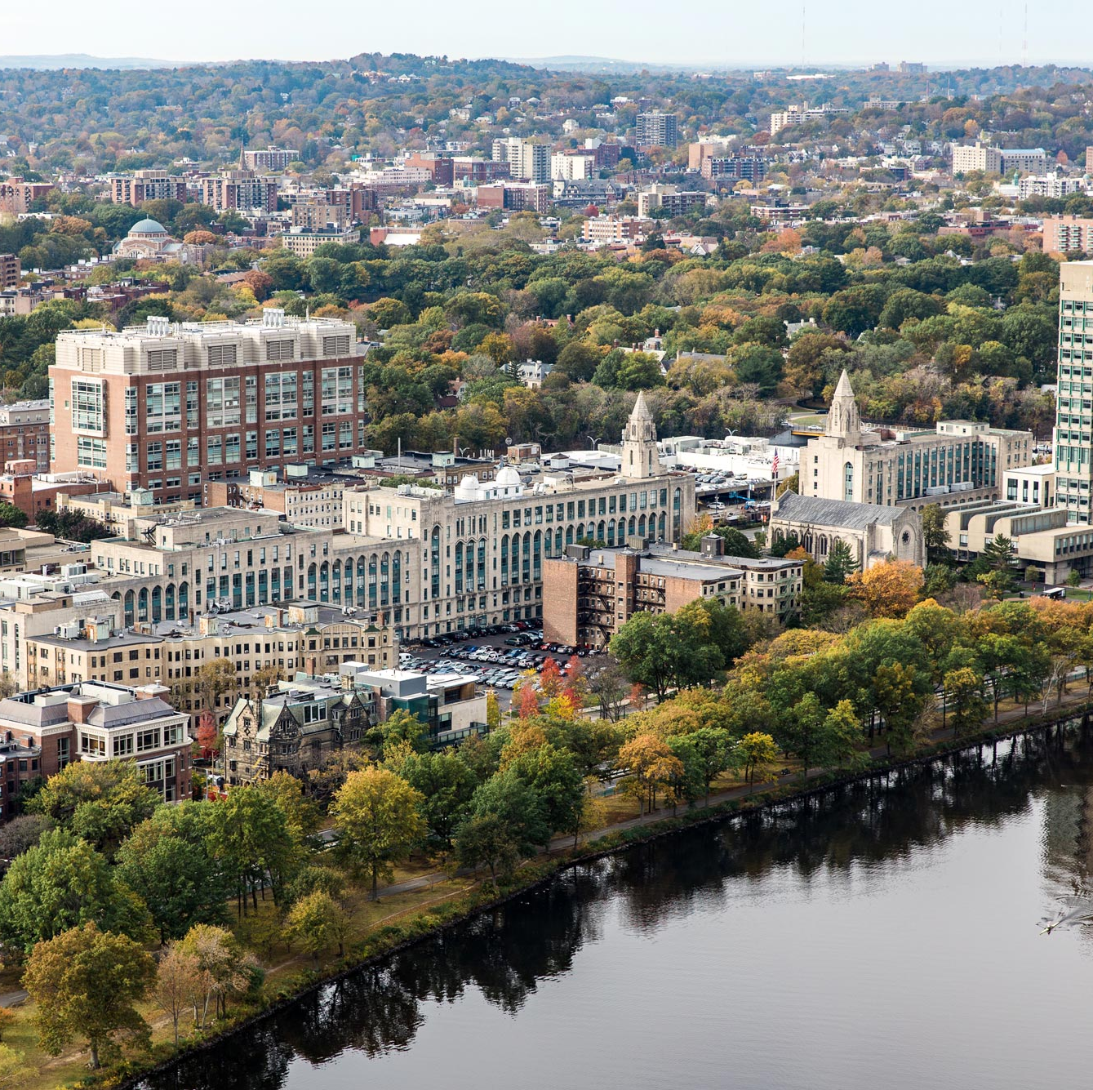
We are looking forward to a great summer with you all!
Thank you!

Slide 35
Questions?

